Slide 1





2024-2025

Slide 2
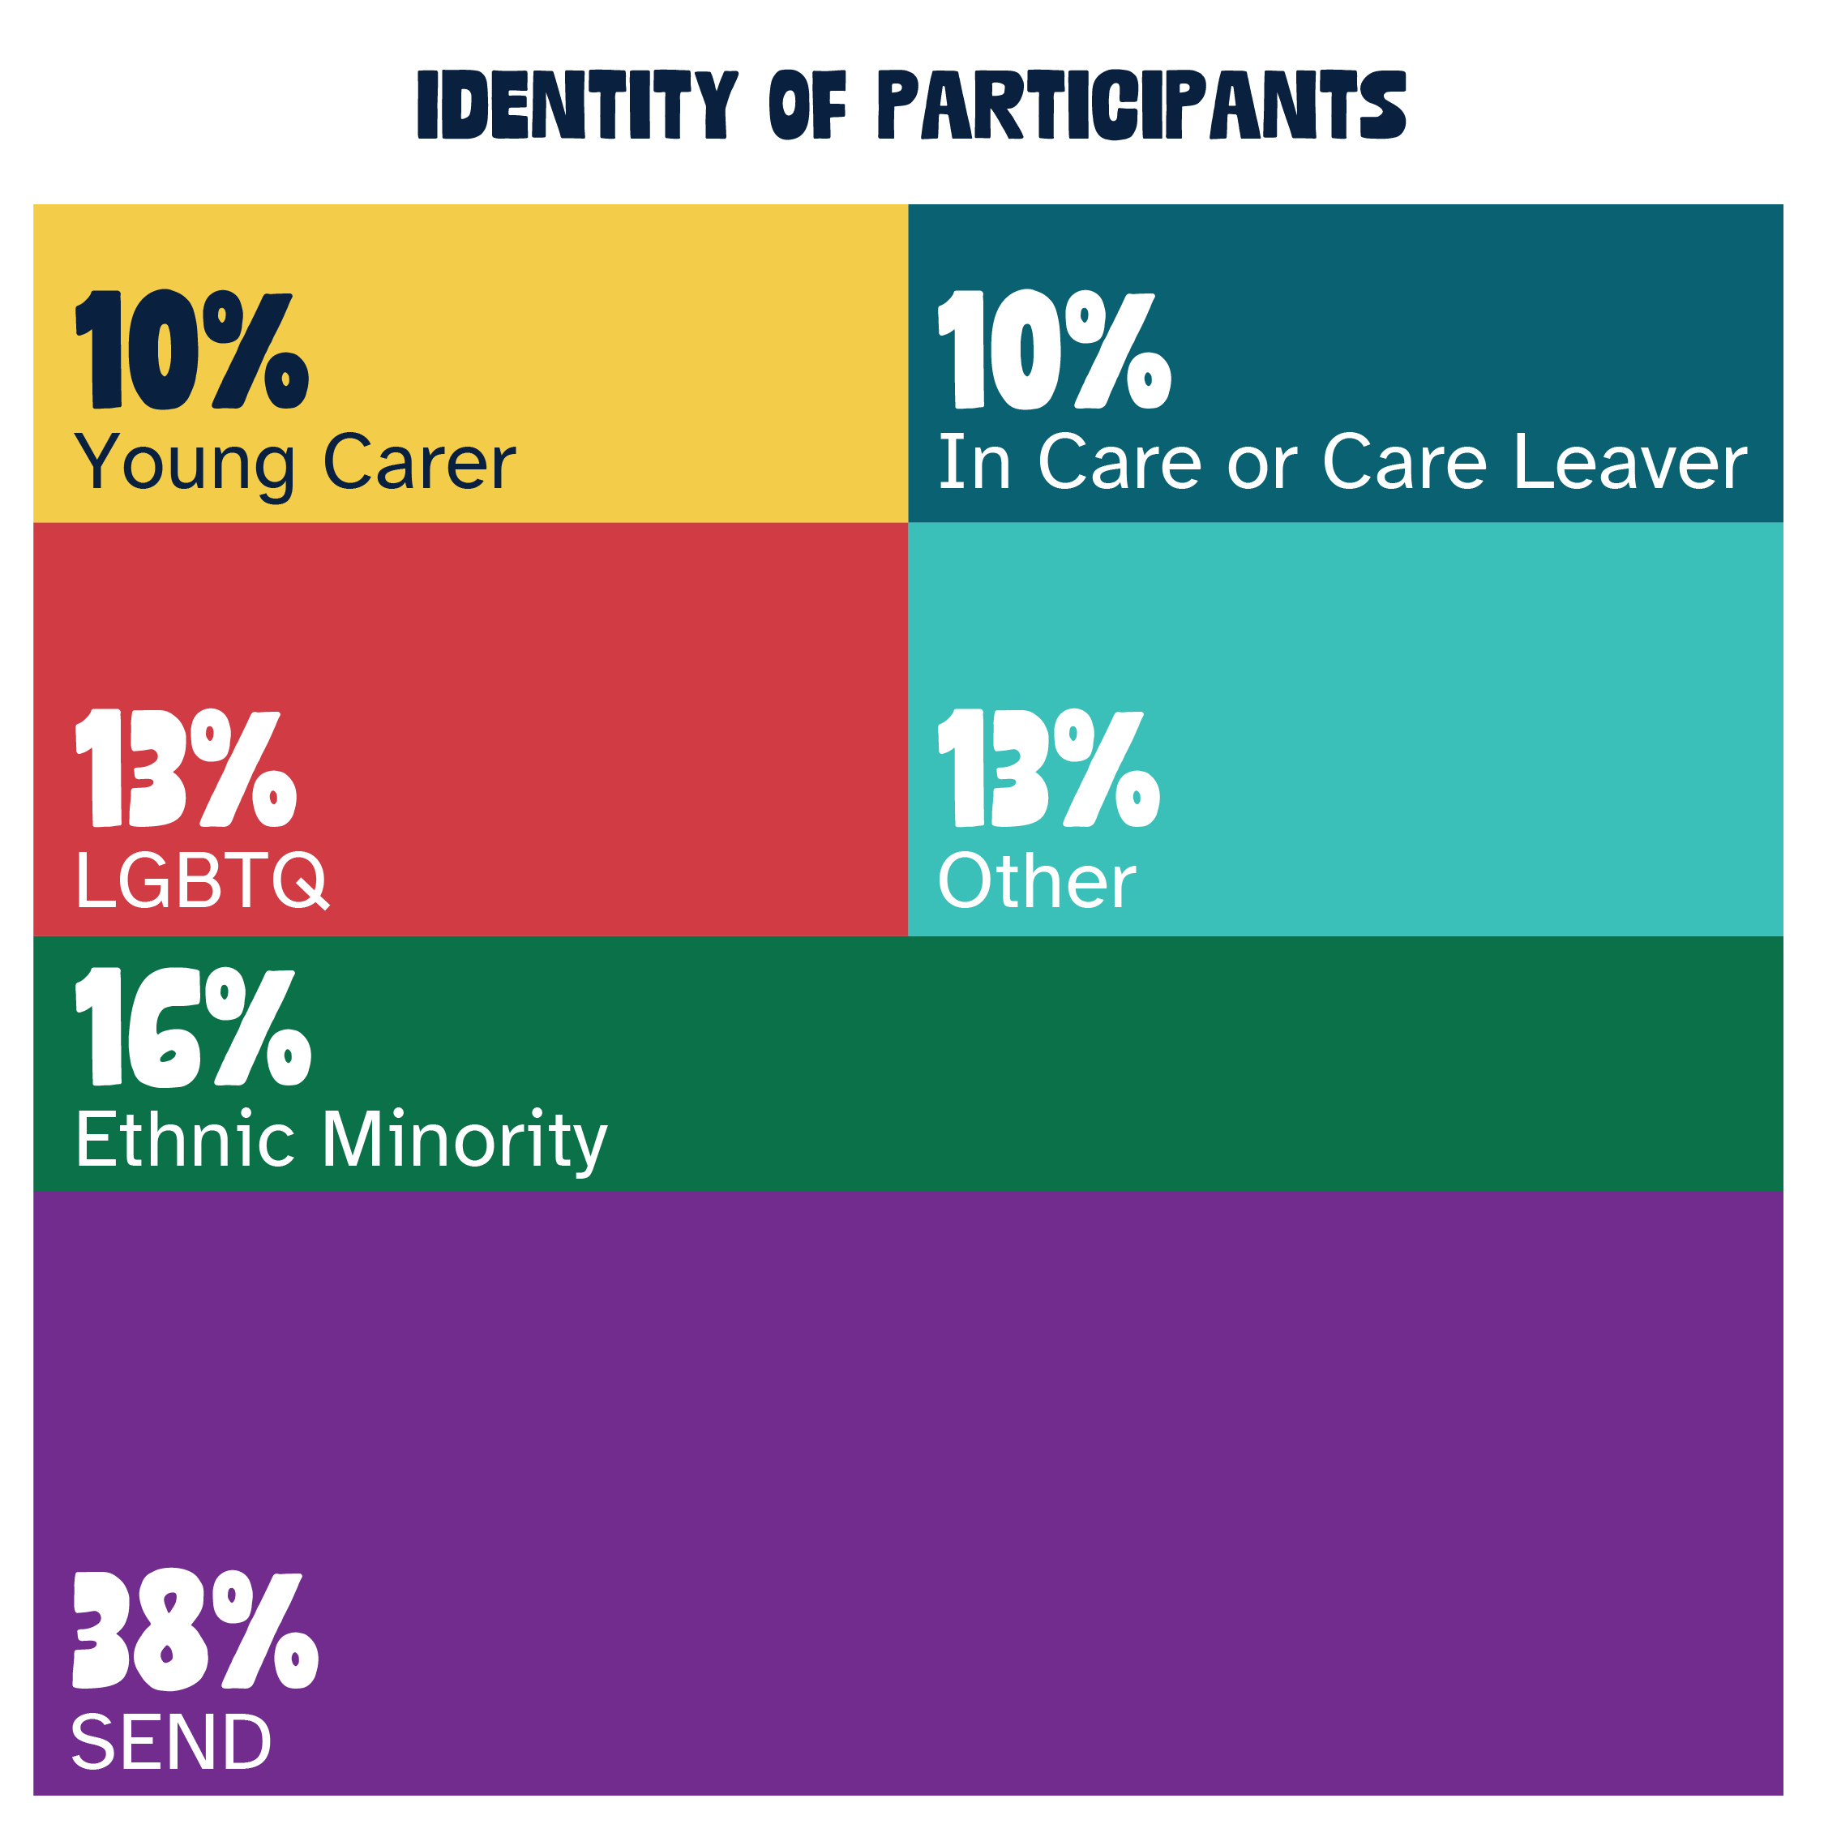

Evidence
Information about the participating young people
Other included:
Military family and home schooled

Slide 3
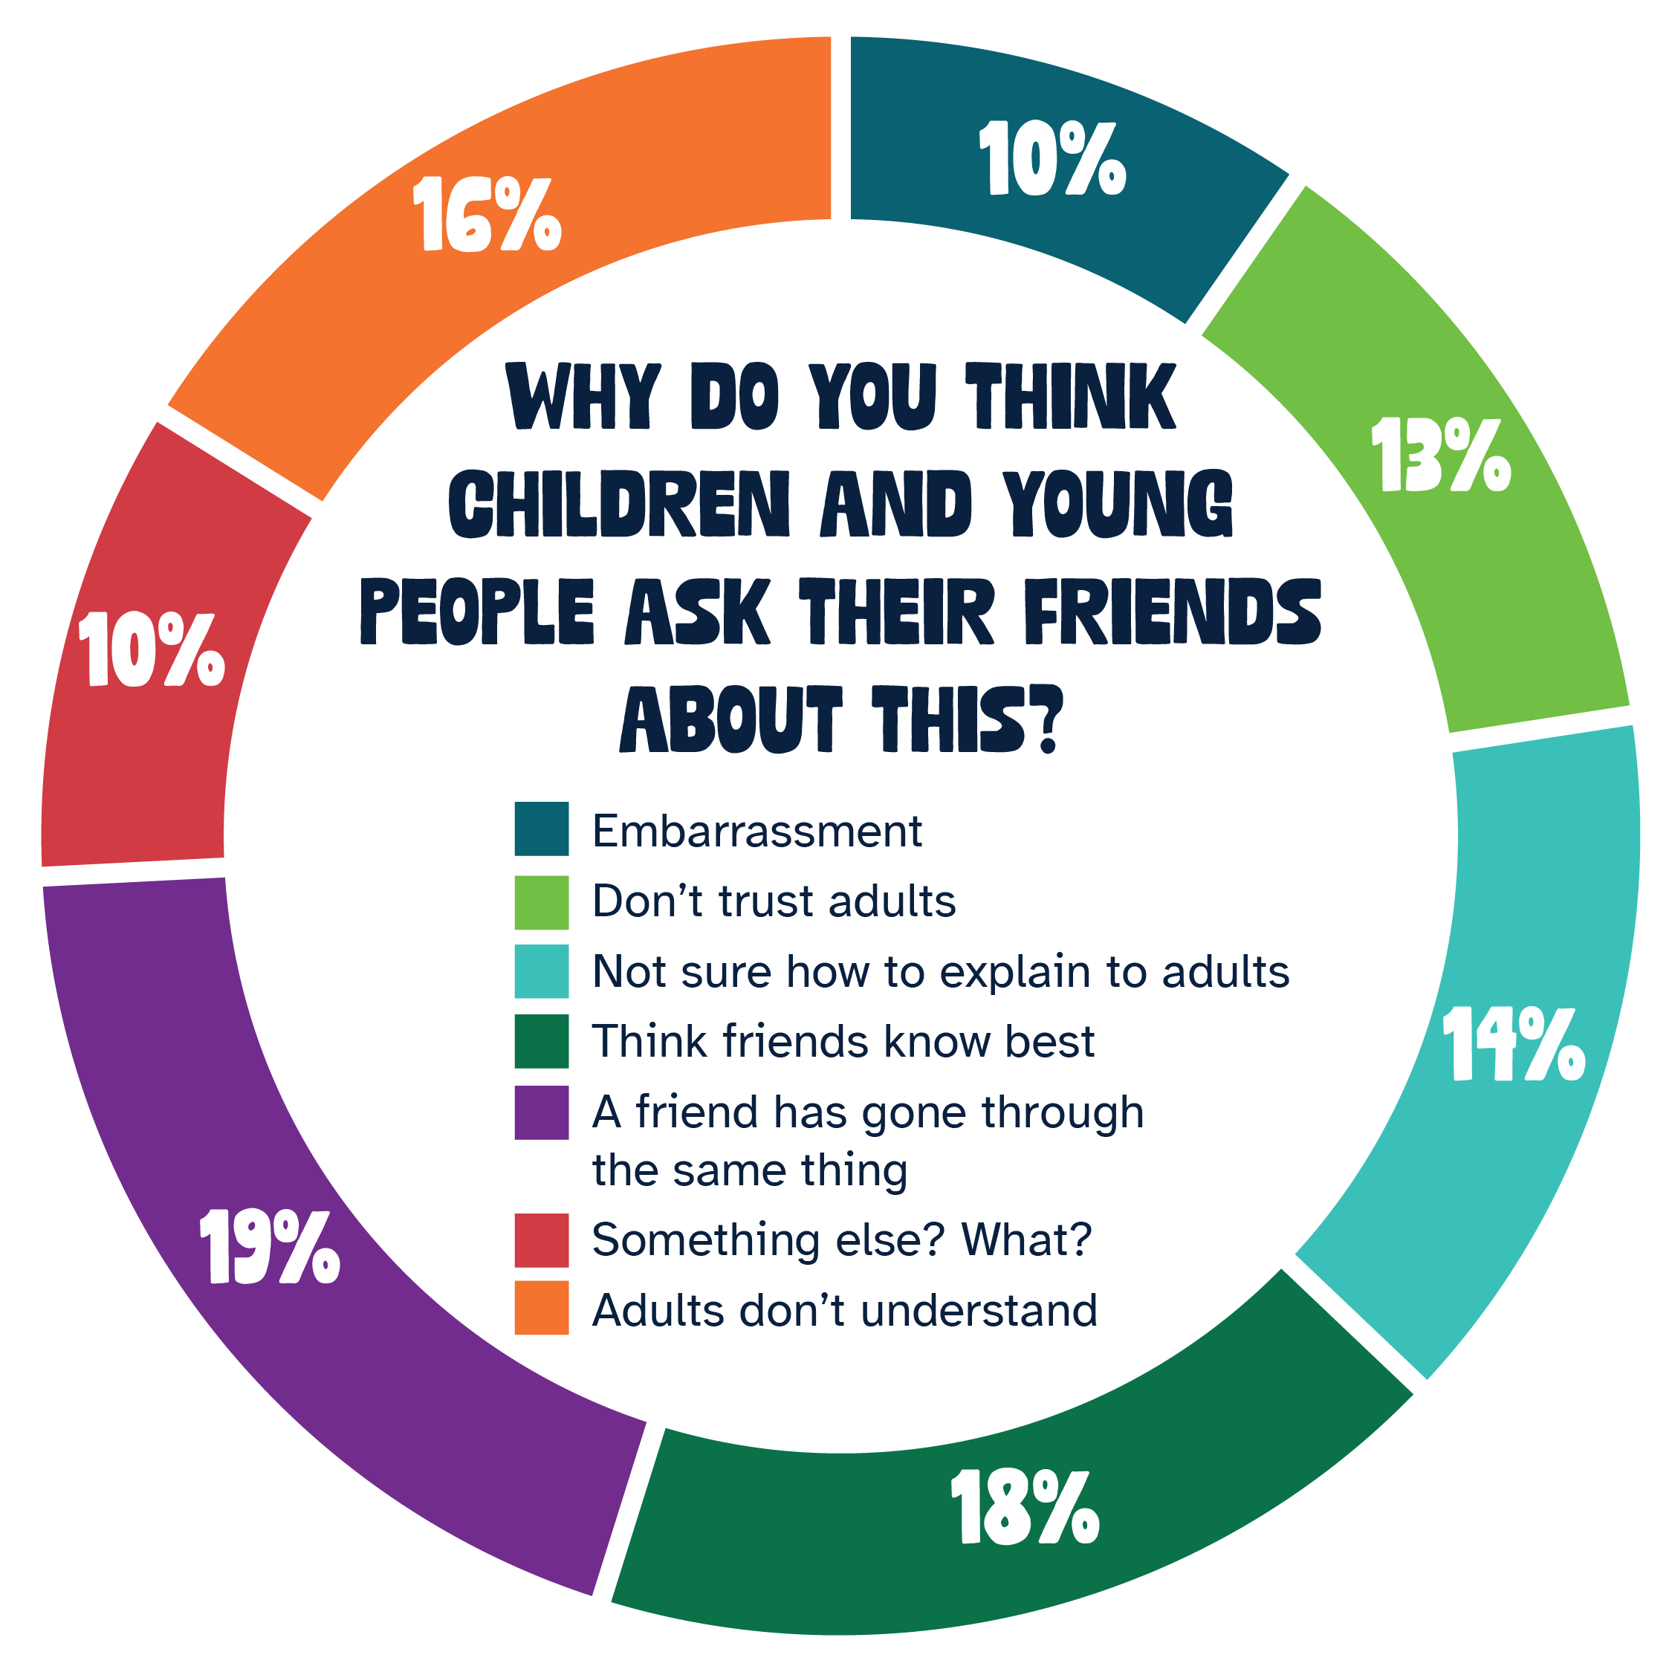
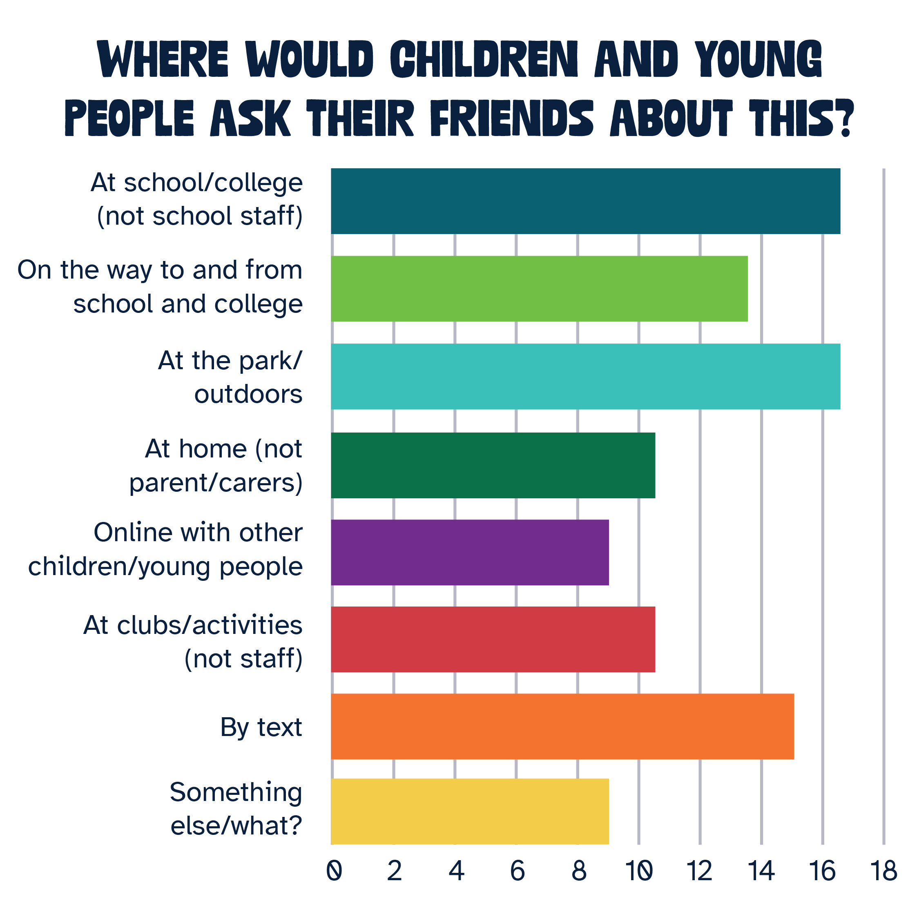
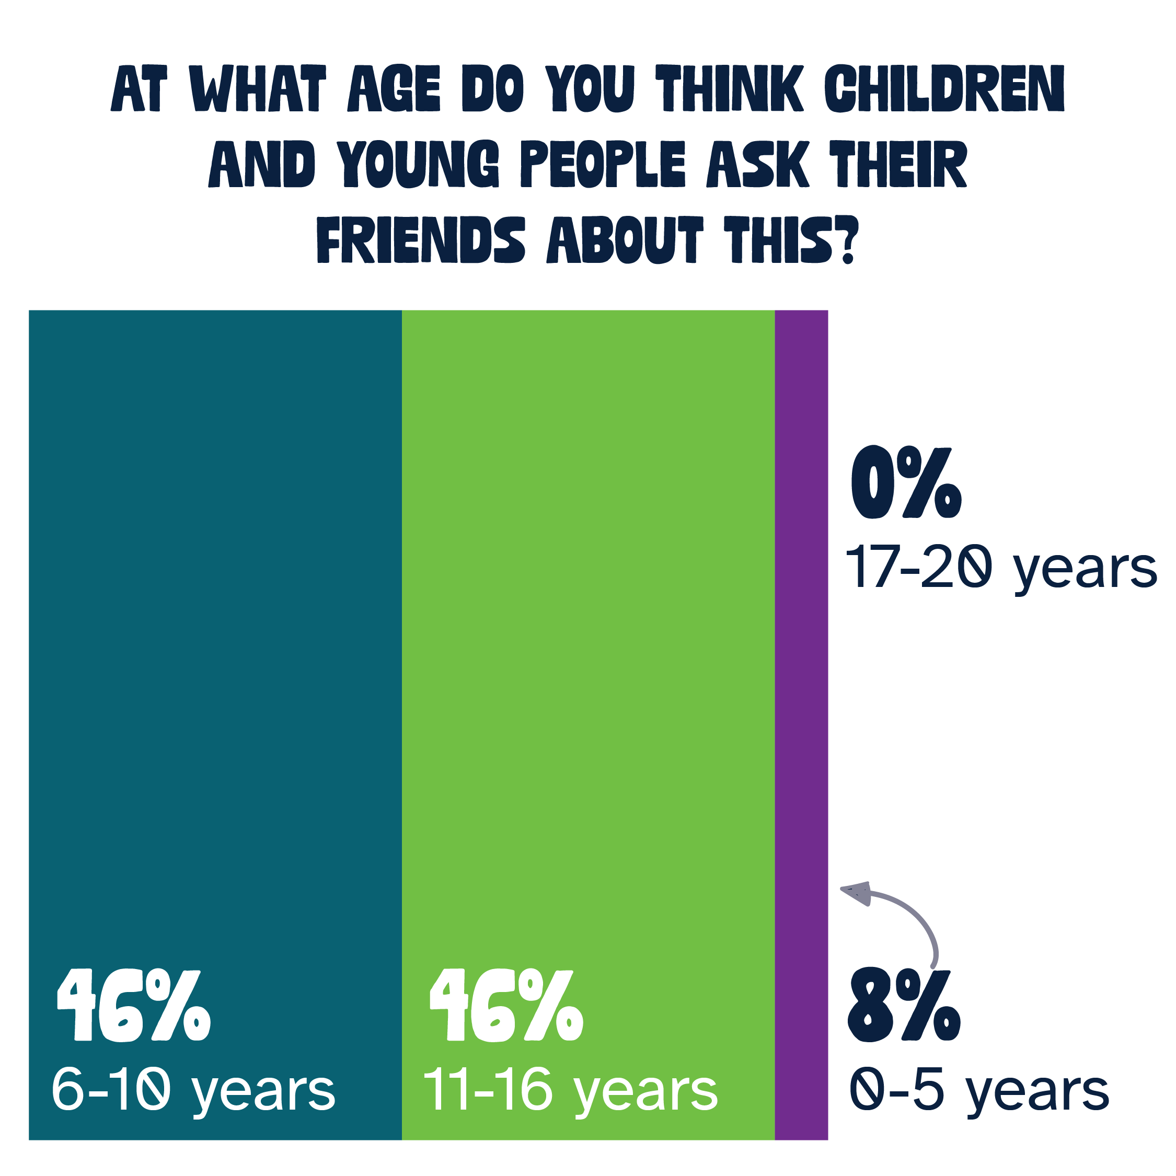
Help your friend/s with their poor emotional or mental health

Slide 4
Help your friend/s with their poor emotional or mental health
Findings
They feel that other young people talk about their emotional and mental health more when they are younger up into their mid-teens, but not at all in their late teens.
The top three reasons young people talk to their friends about emotional and mental health are:
  A friend has gone through the same thing
  They think their friends know best
  Adults don’t understand
Other reasons include: their friends respecting their privacy, concerns about adults making assumptions or judgements, adults are the ones causing the problems and concerns about the consequences if they tell adults
They’ll talk about it at school, outdoors/parks or by text/messaging

Slide 5
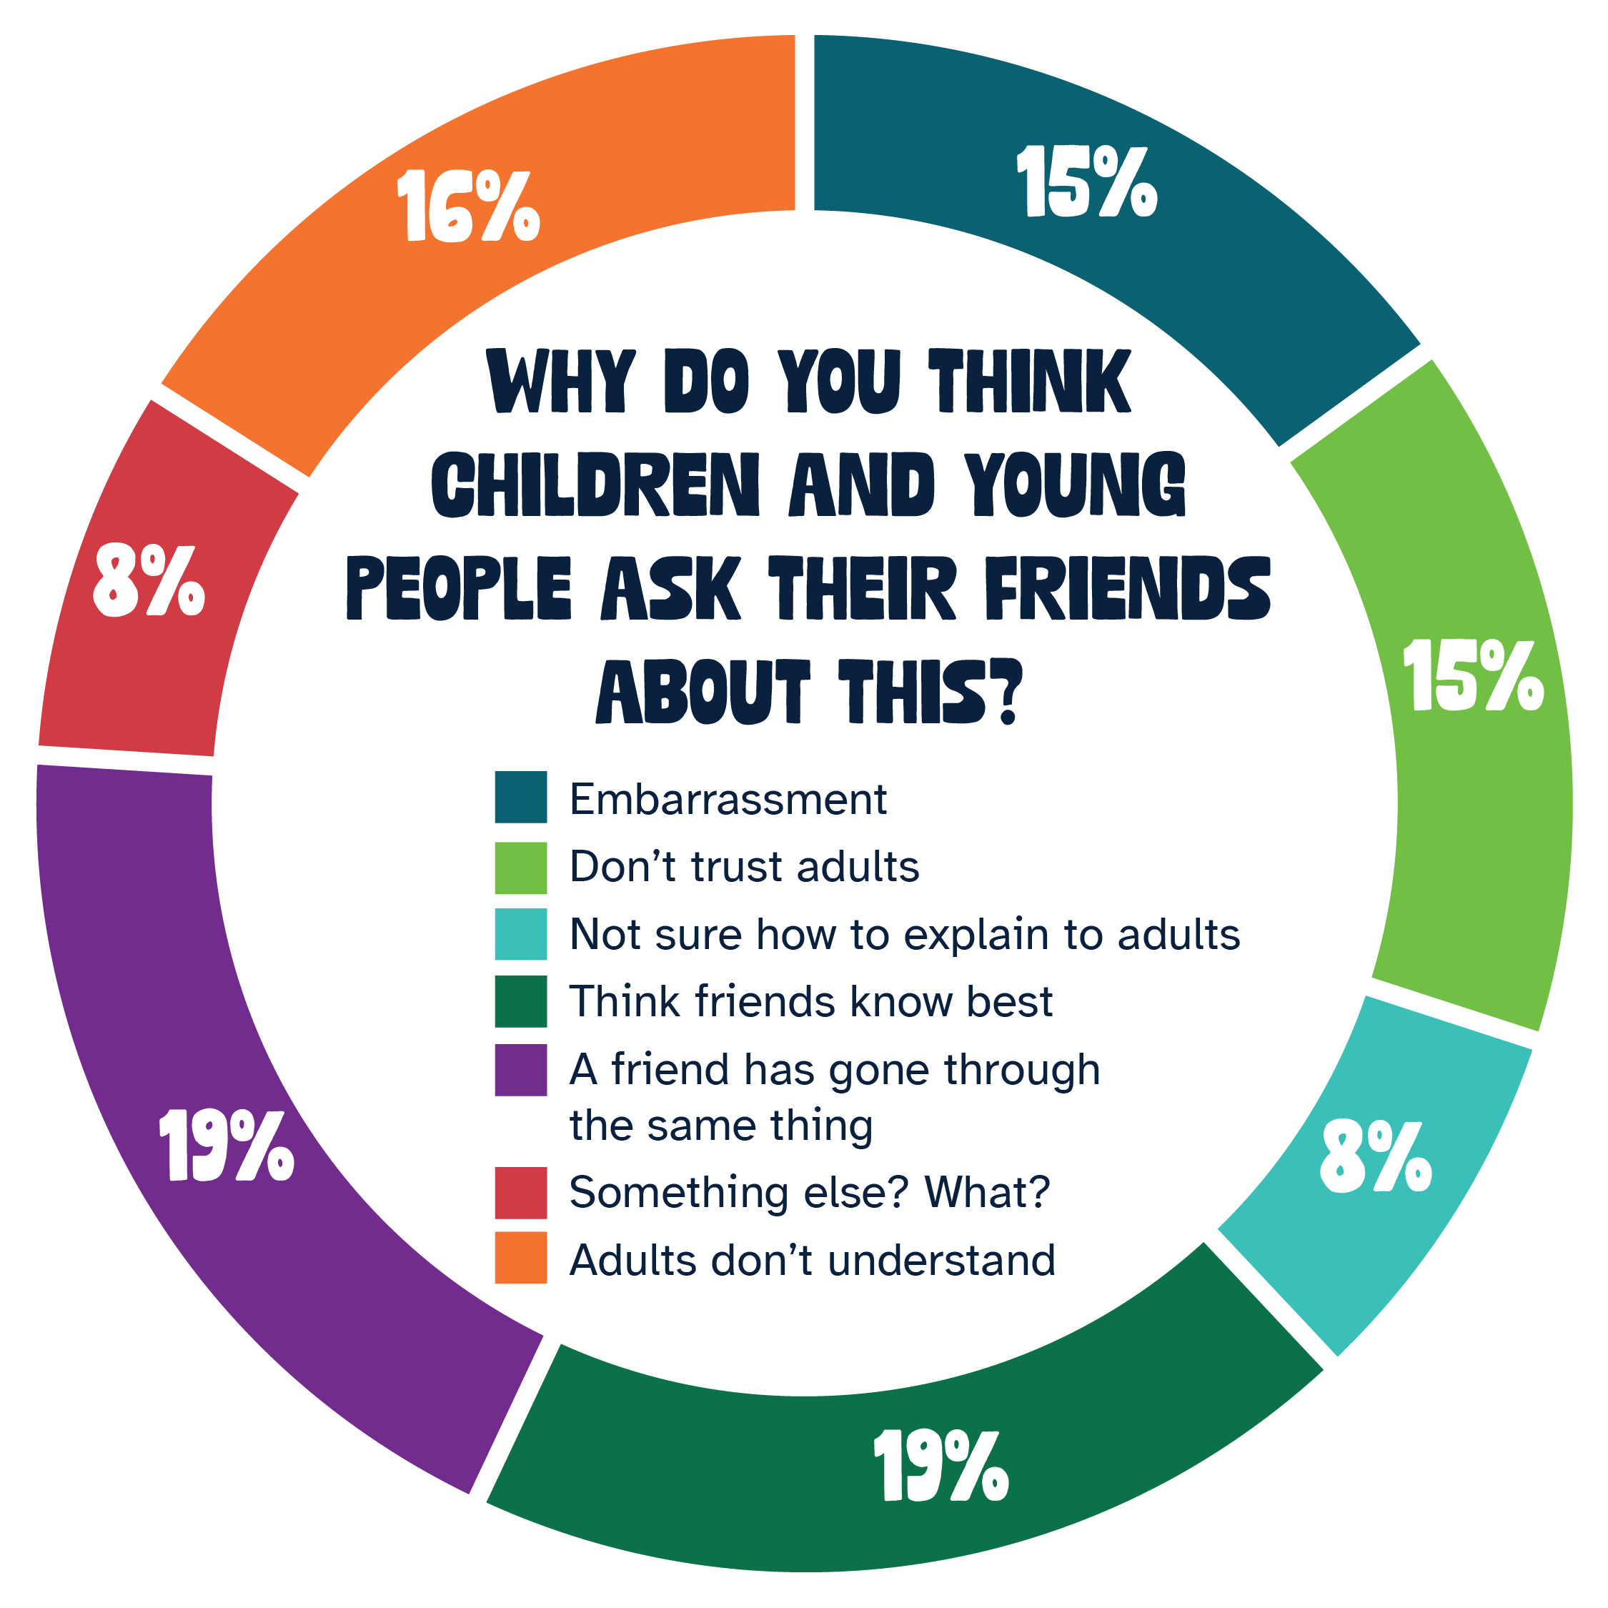
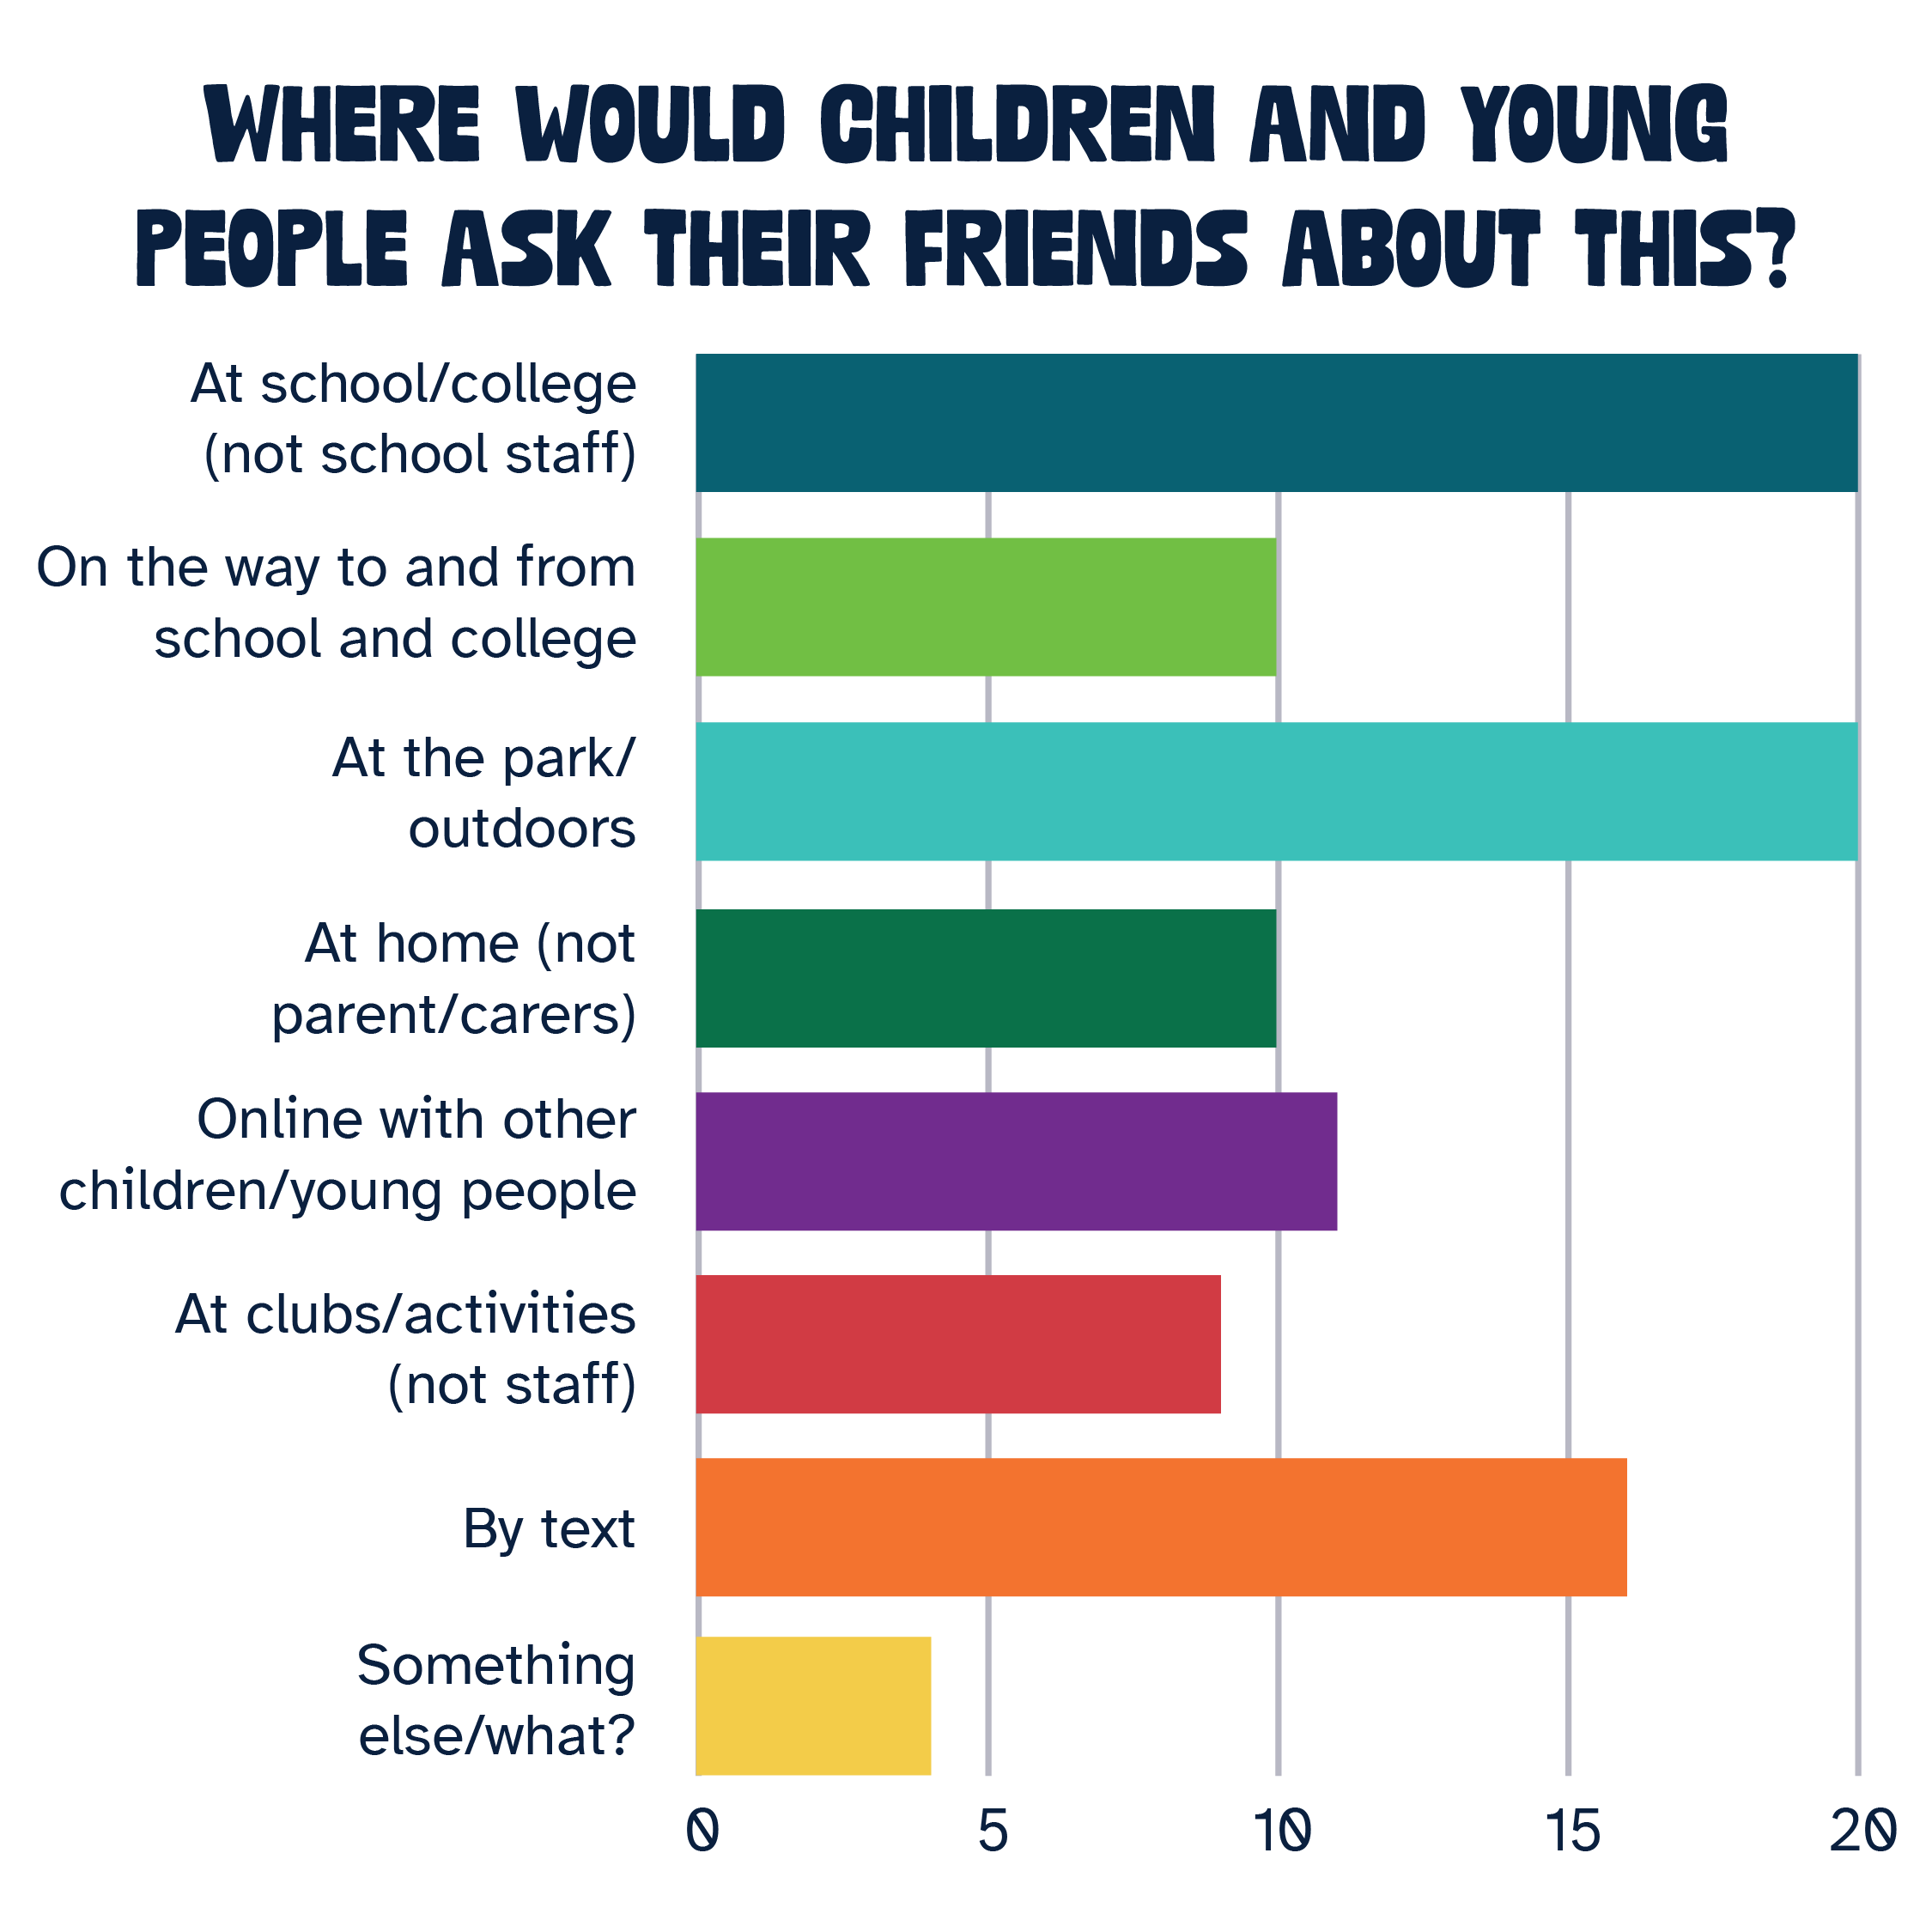
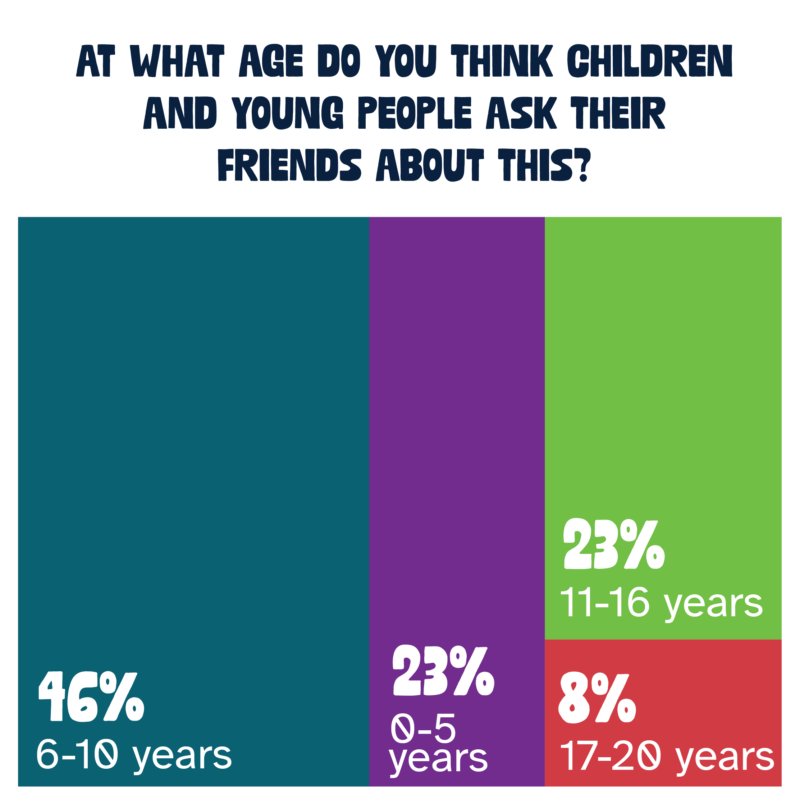
Help your friend/s with issues with families/problems at home

Slide 6
Help your friend/s with issues with families/problems at home
Findings
They feel that other young people talk about issues with family and problems at home across all ages, but more so before they become teens.
The top three reasons young people talk to their friends about issues with family and problems at home are:
  A friend has gone through the same thing
  They think their friends know best
  Adults don’t understand
Other reasons include: parents being busy and not having the time to talk to them, being shy, they are concerned it might make their parents upset or angry, adults may tell them everything is fine but argue behind their back and some things they just want to keep private
They’ll talk about it mostly at school, outdoors/parks or by text/messaging and a lot less any other way

Slide 7
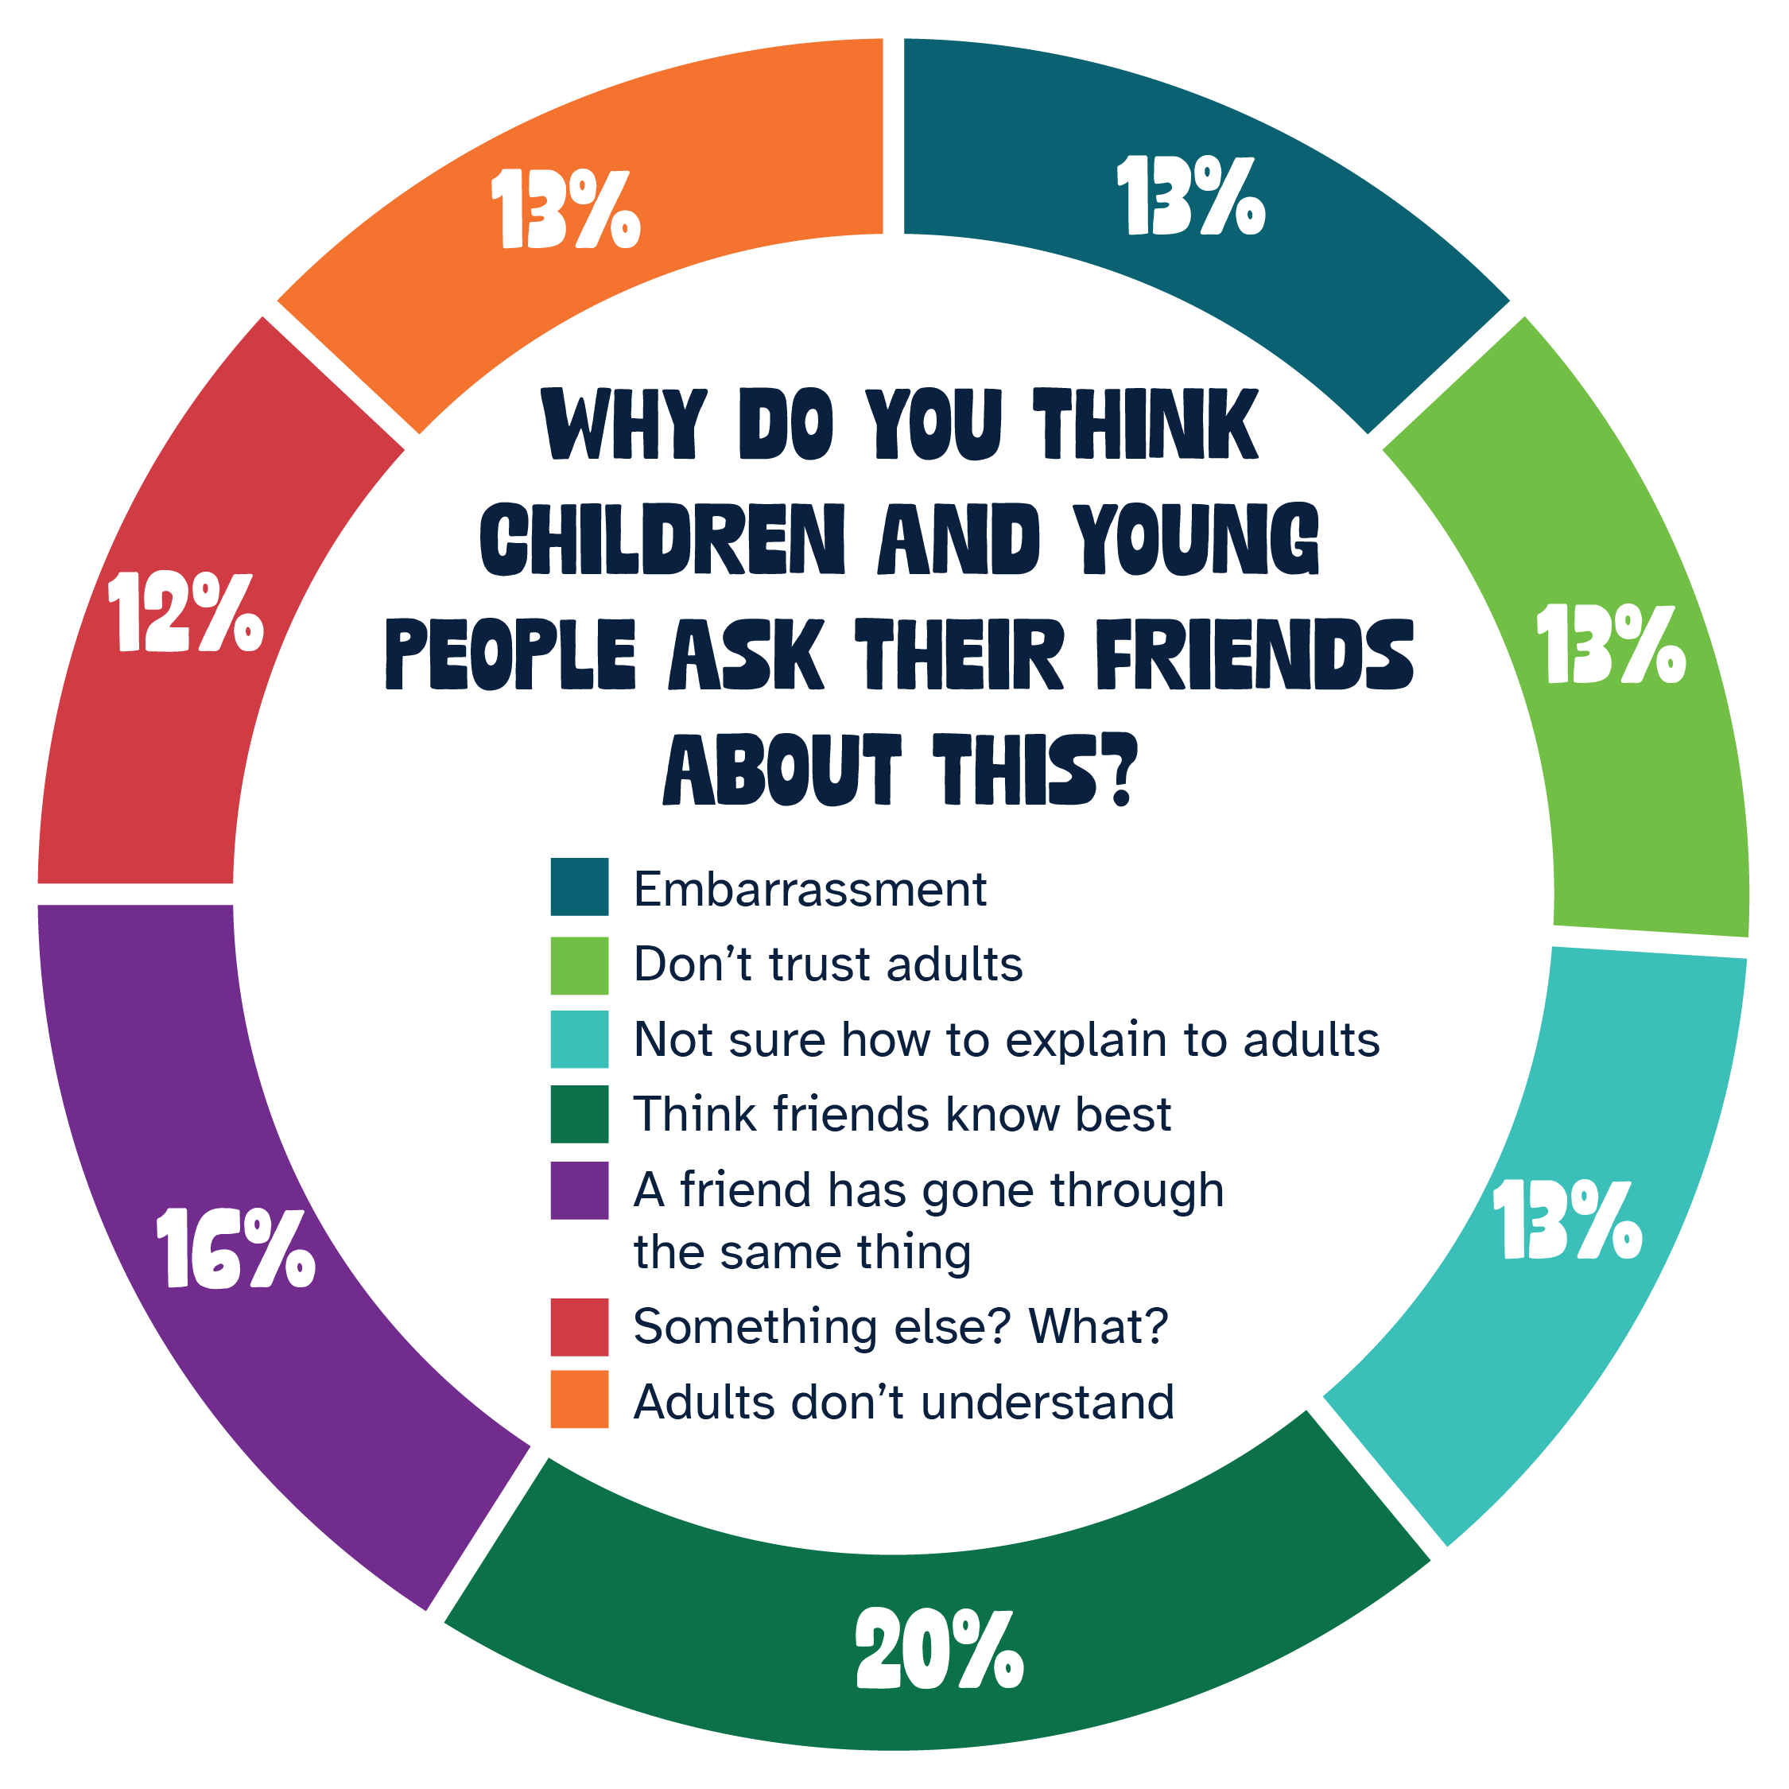
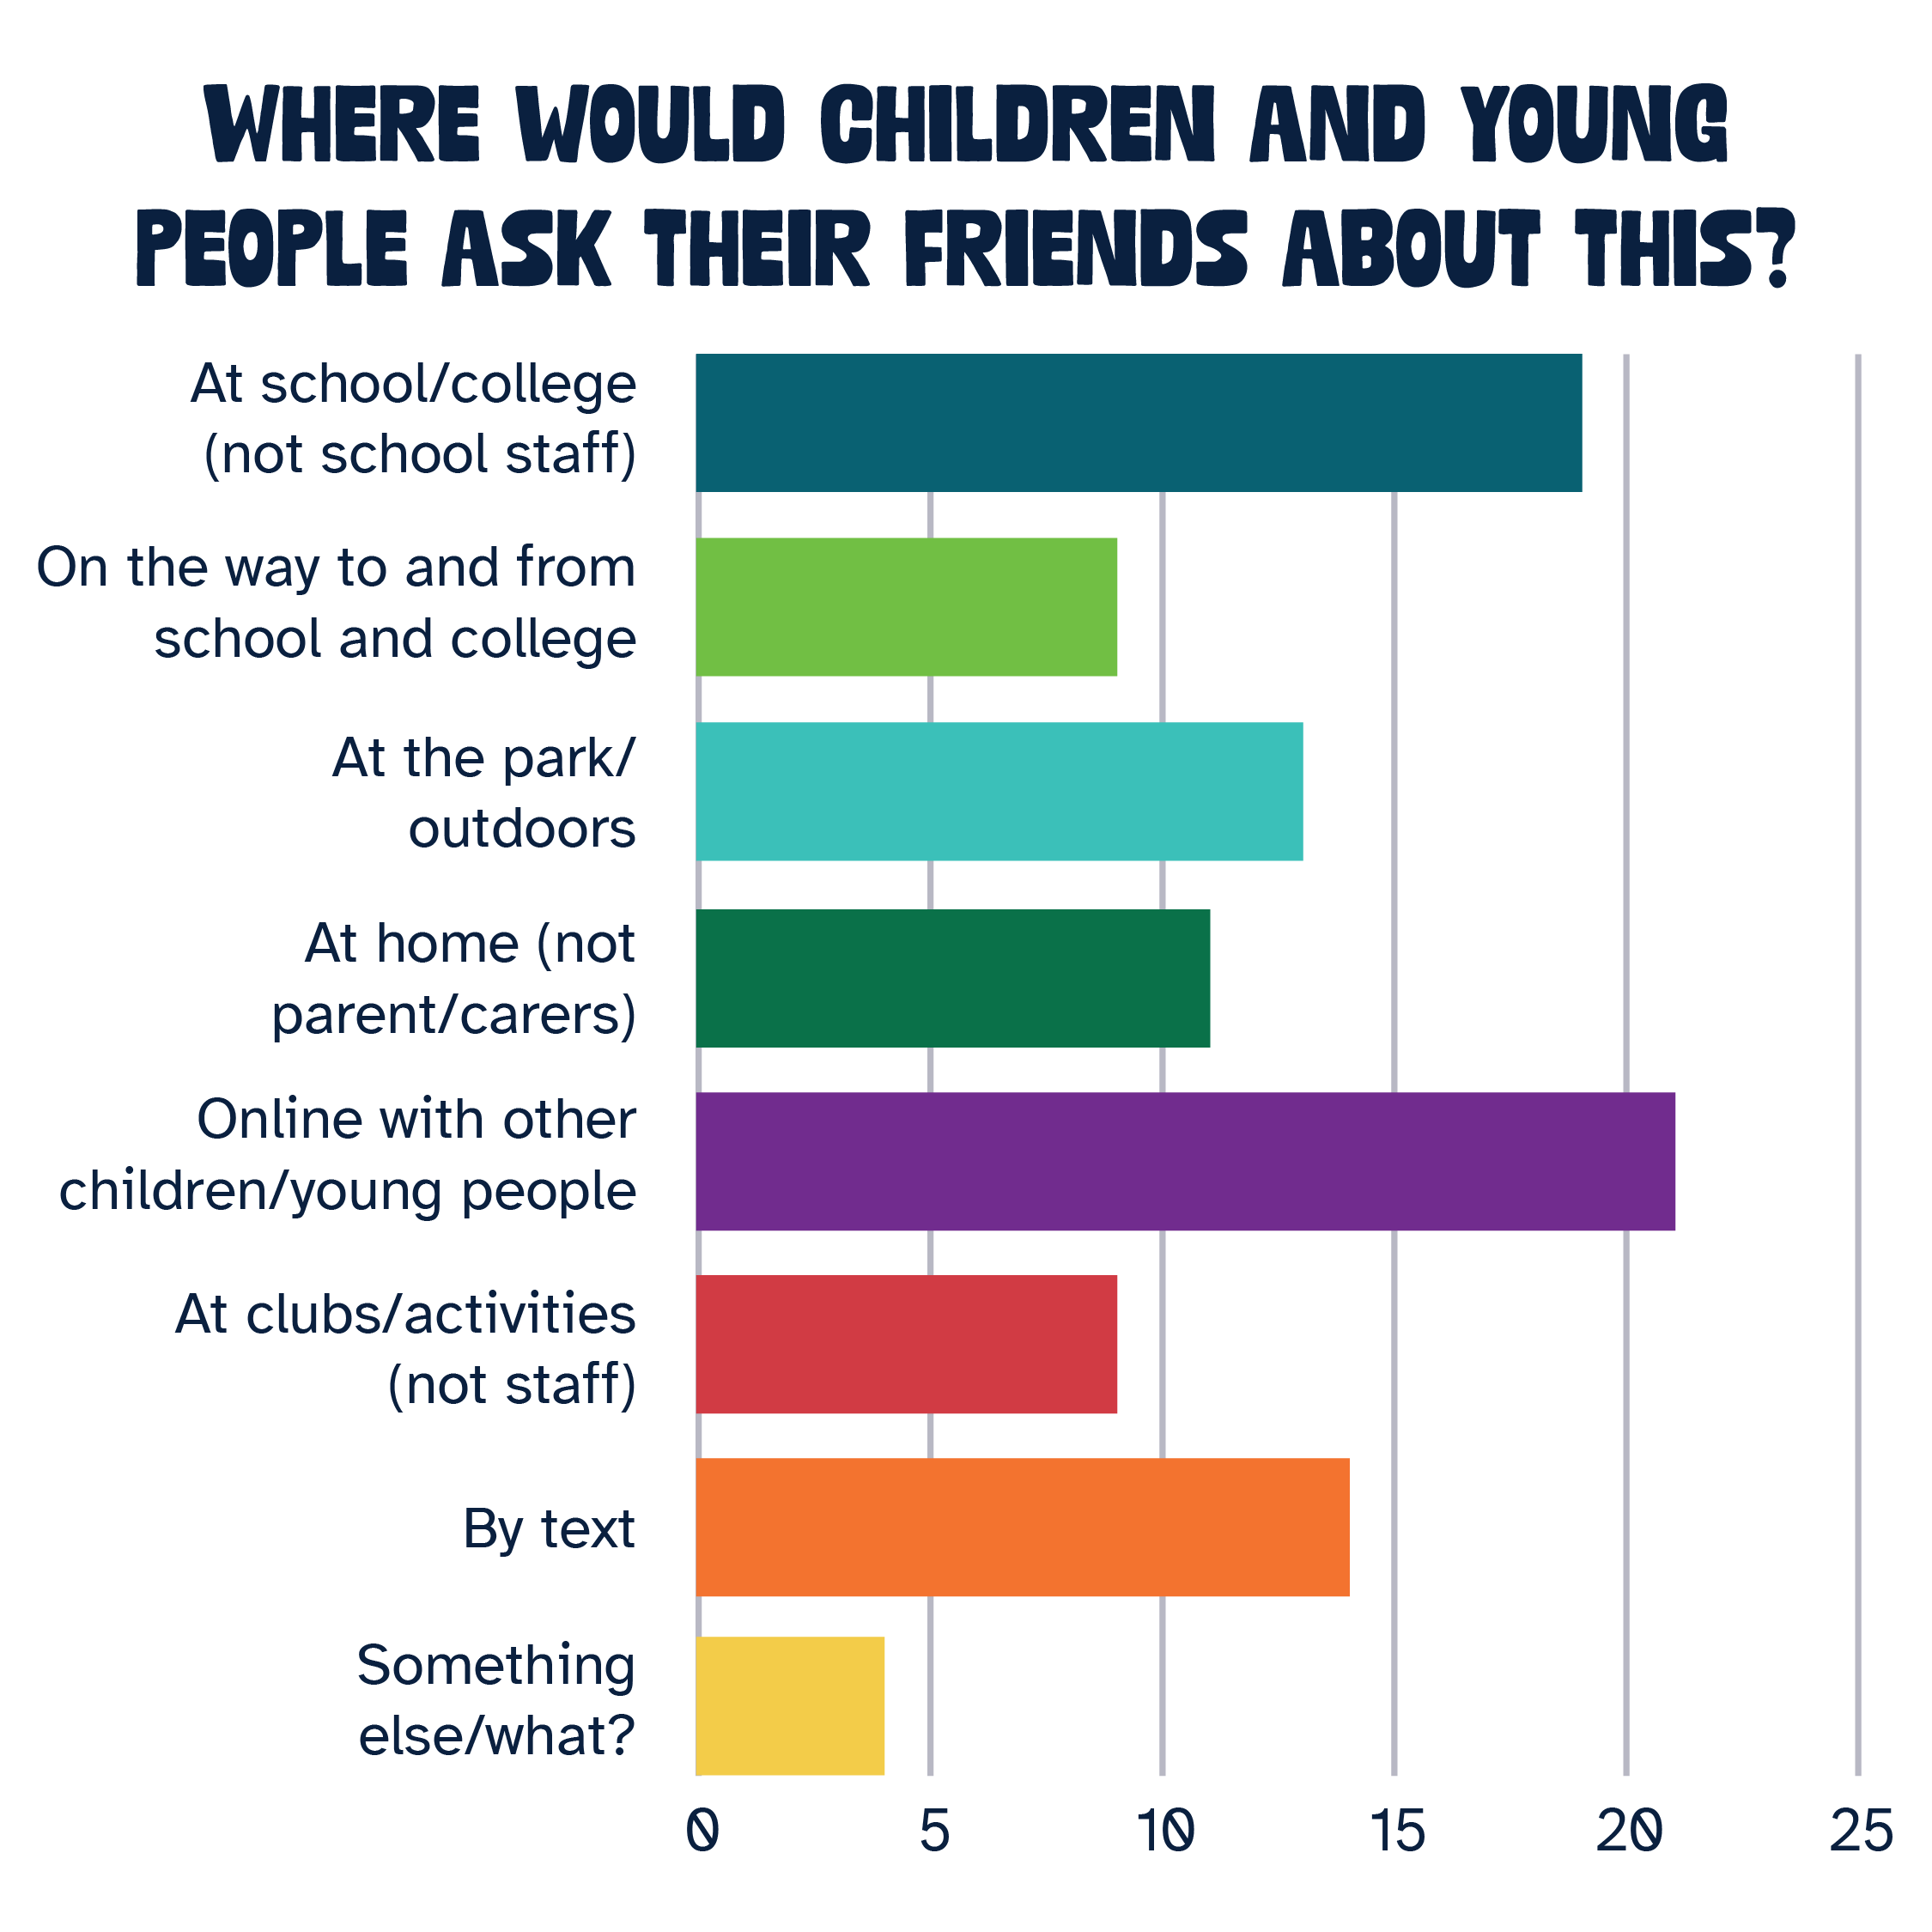
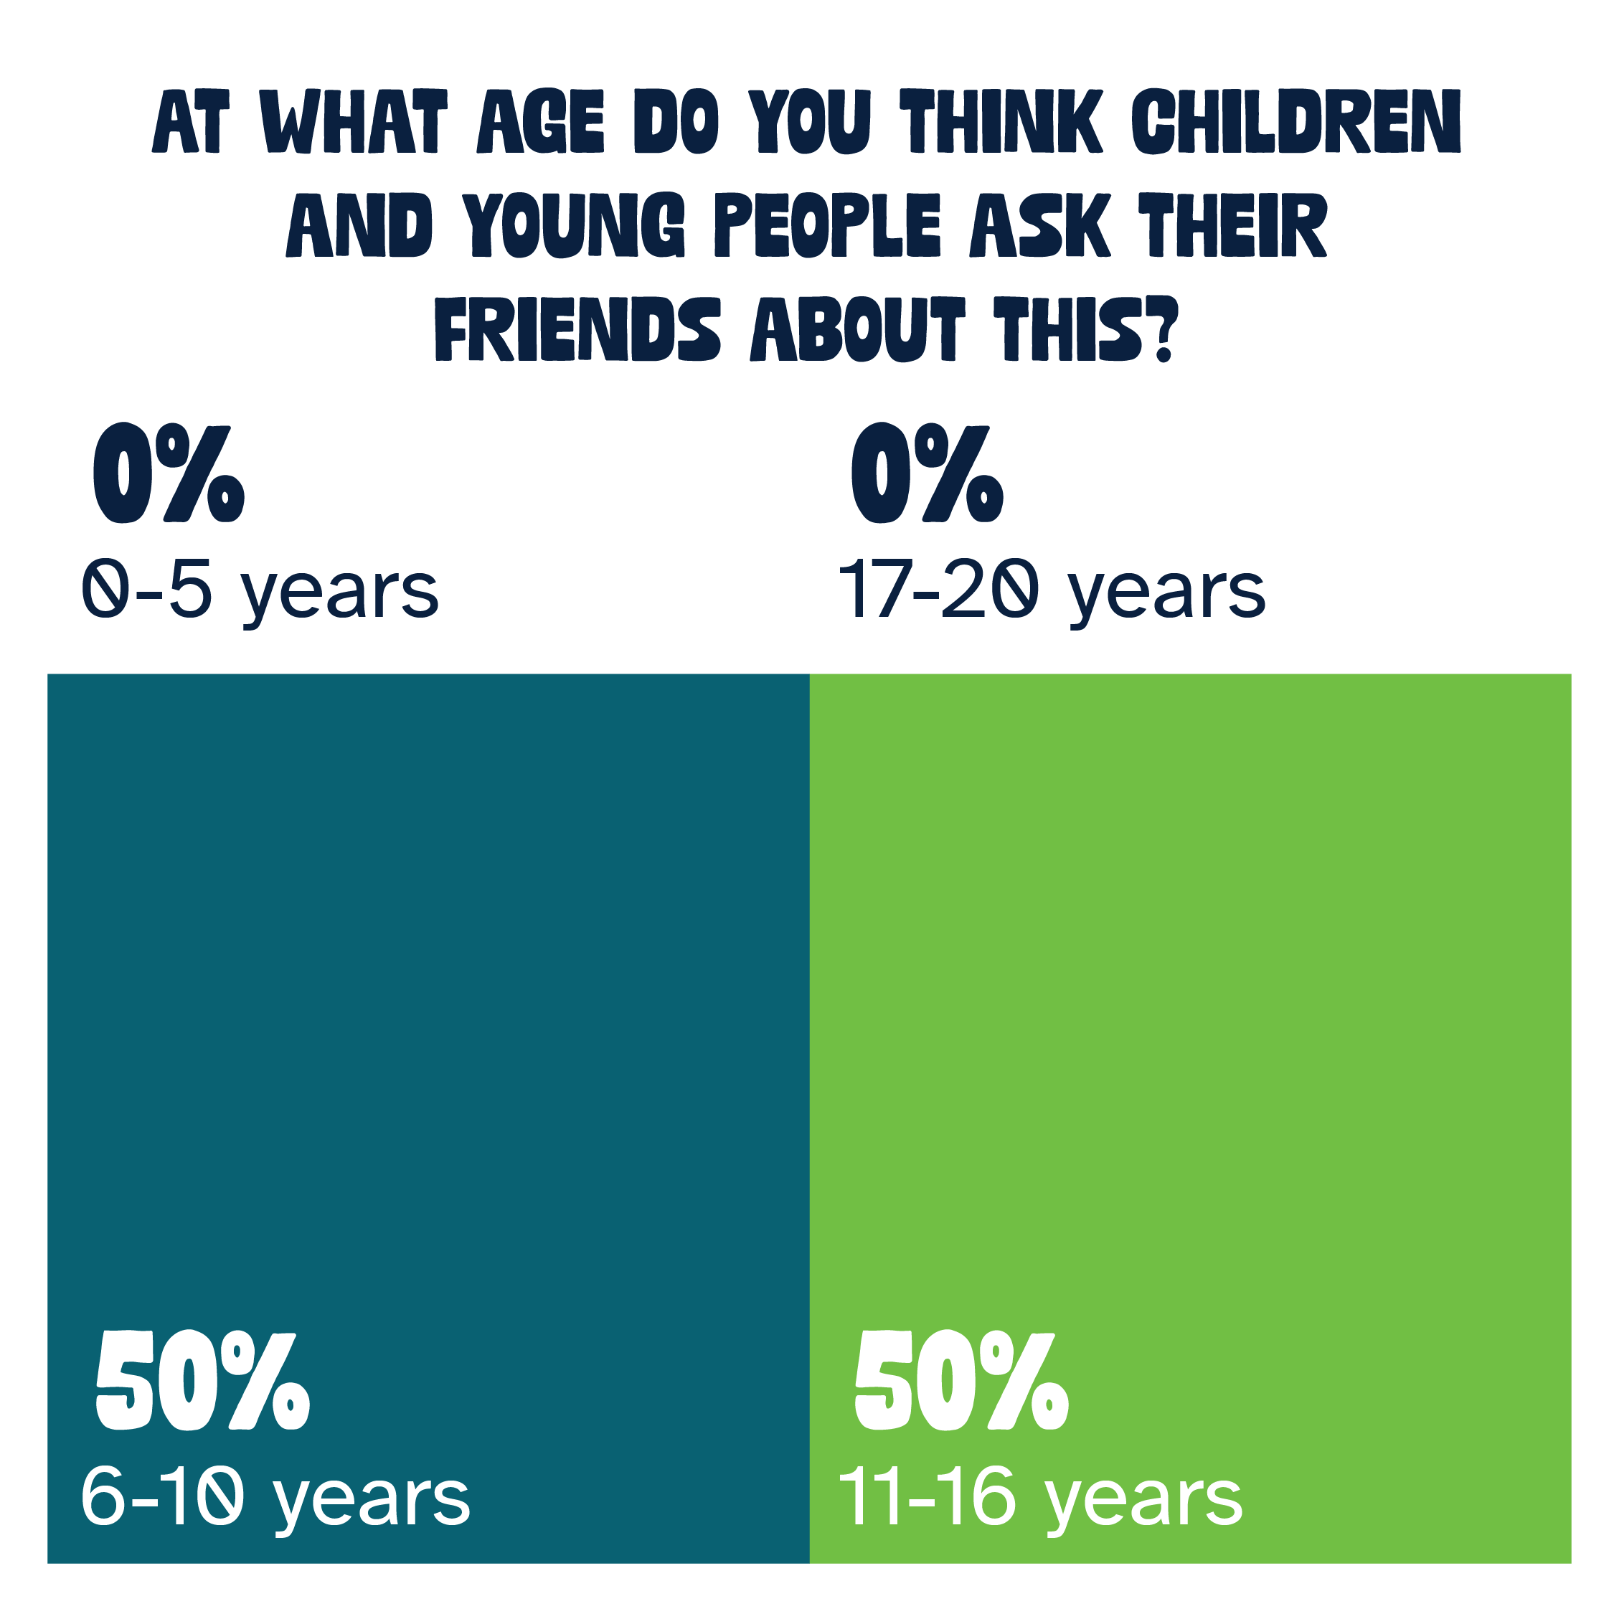
Helps your friend/s with their confidence

Slide 8
Helps your friend/s with their confidence
Findings
They feel that other young people talk about their friend’s confidence more during their school age years.
Their top reasons young people talk to their friends about confidence are:
  A friend has gone through the same thing
  They think their friends know best
  All of the other options were fairly even
Other reasons include: toxic masculinity, because it helps to build their confidence
They’ll talk about it mostly at online or at school

Slide 9
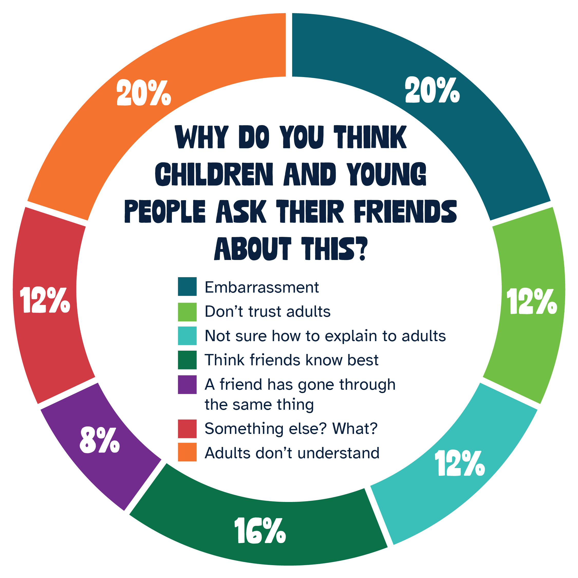
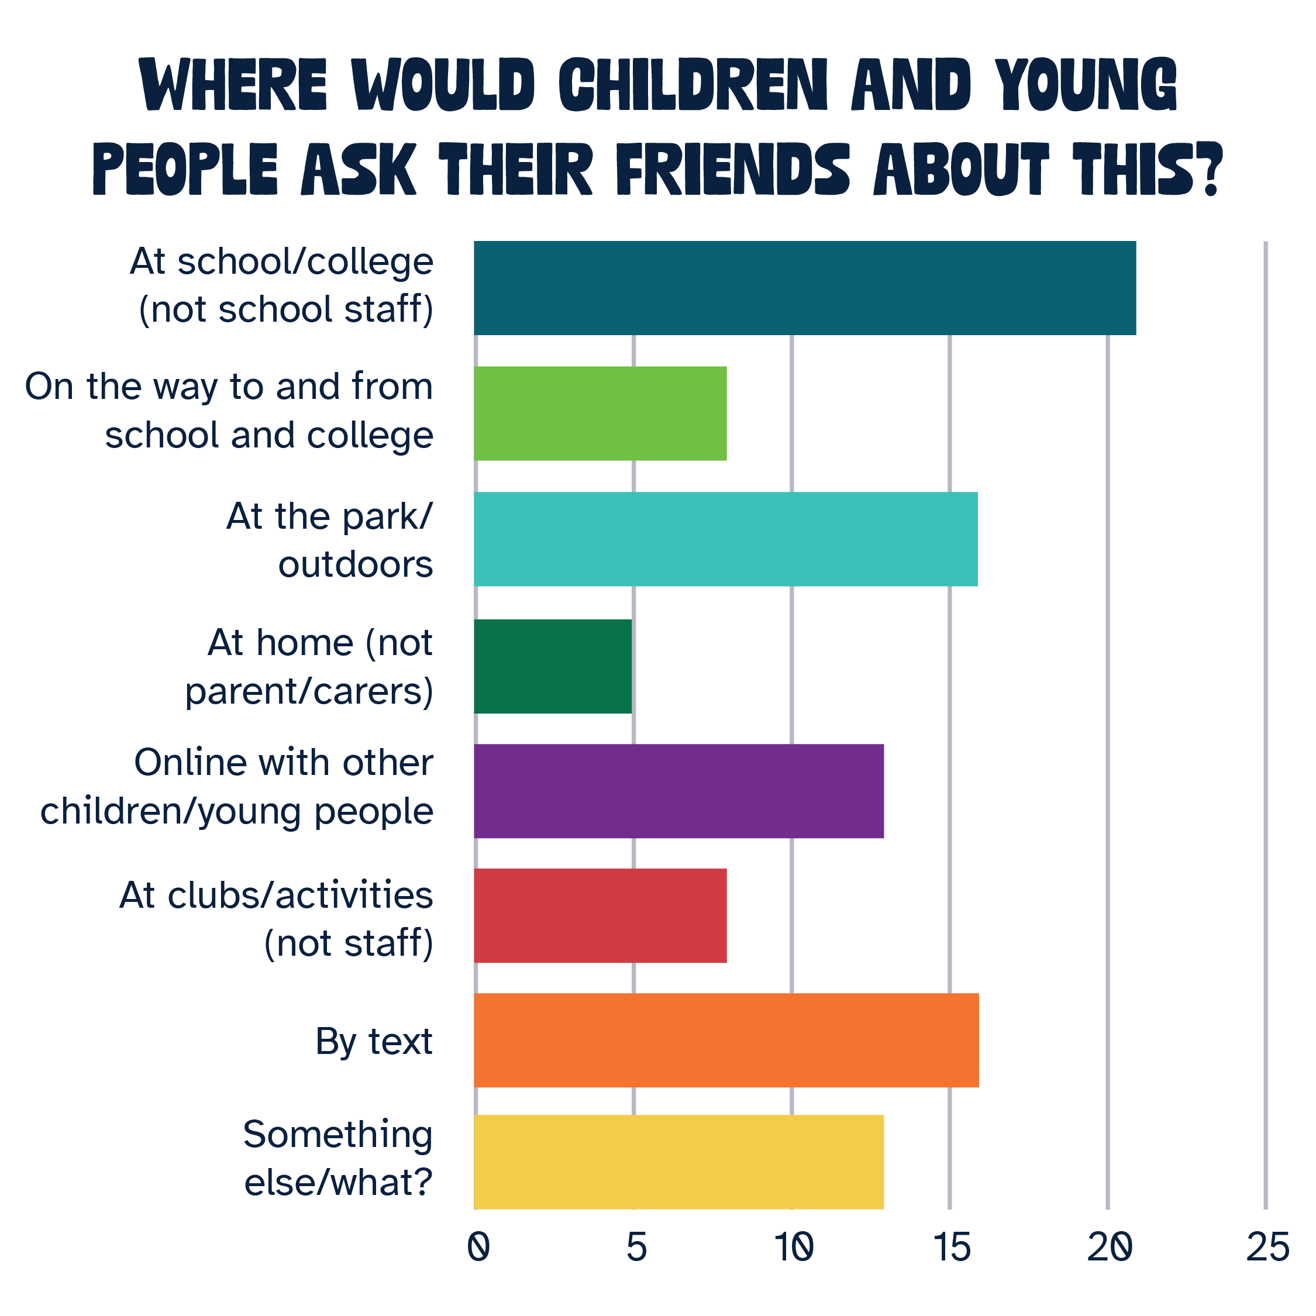
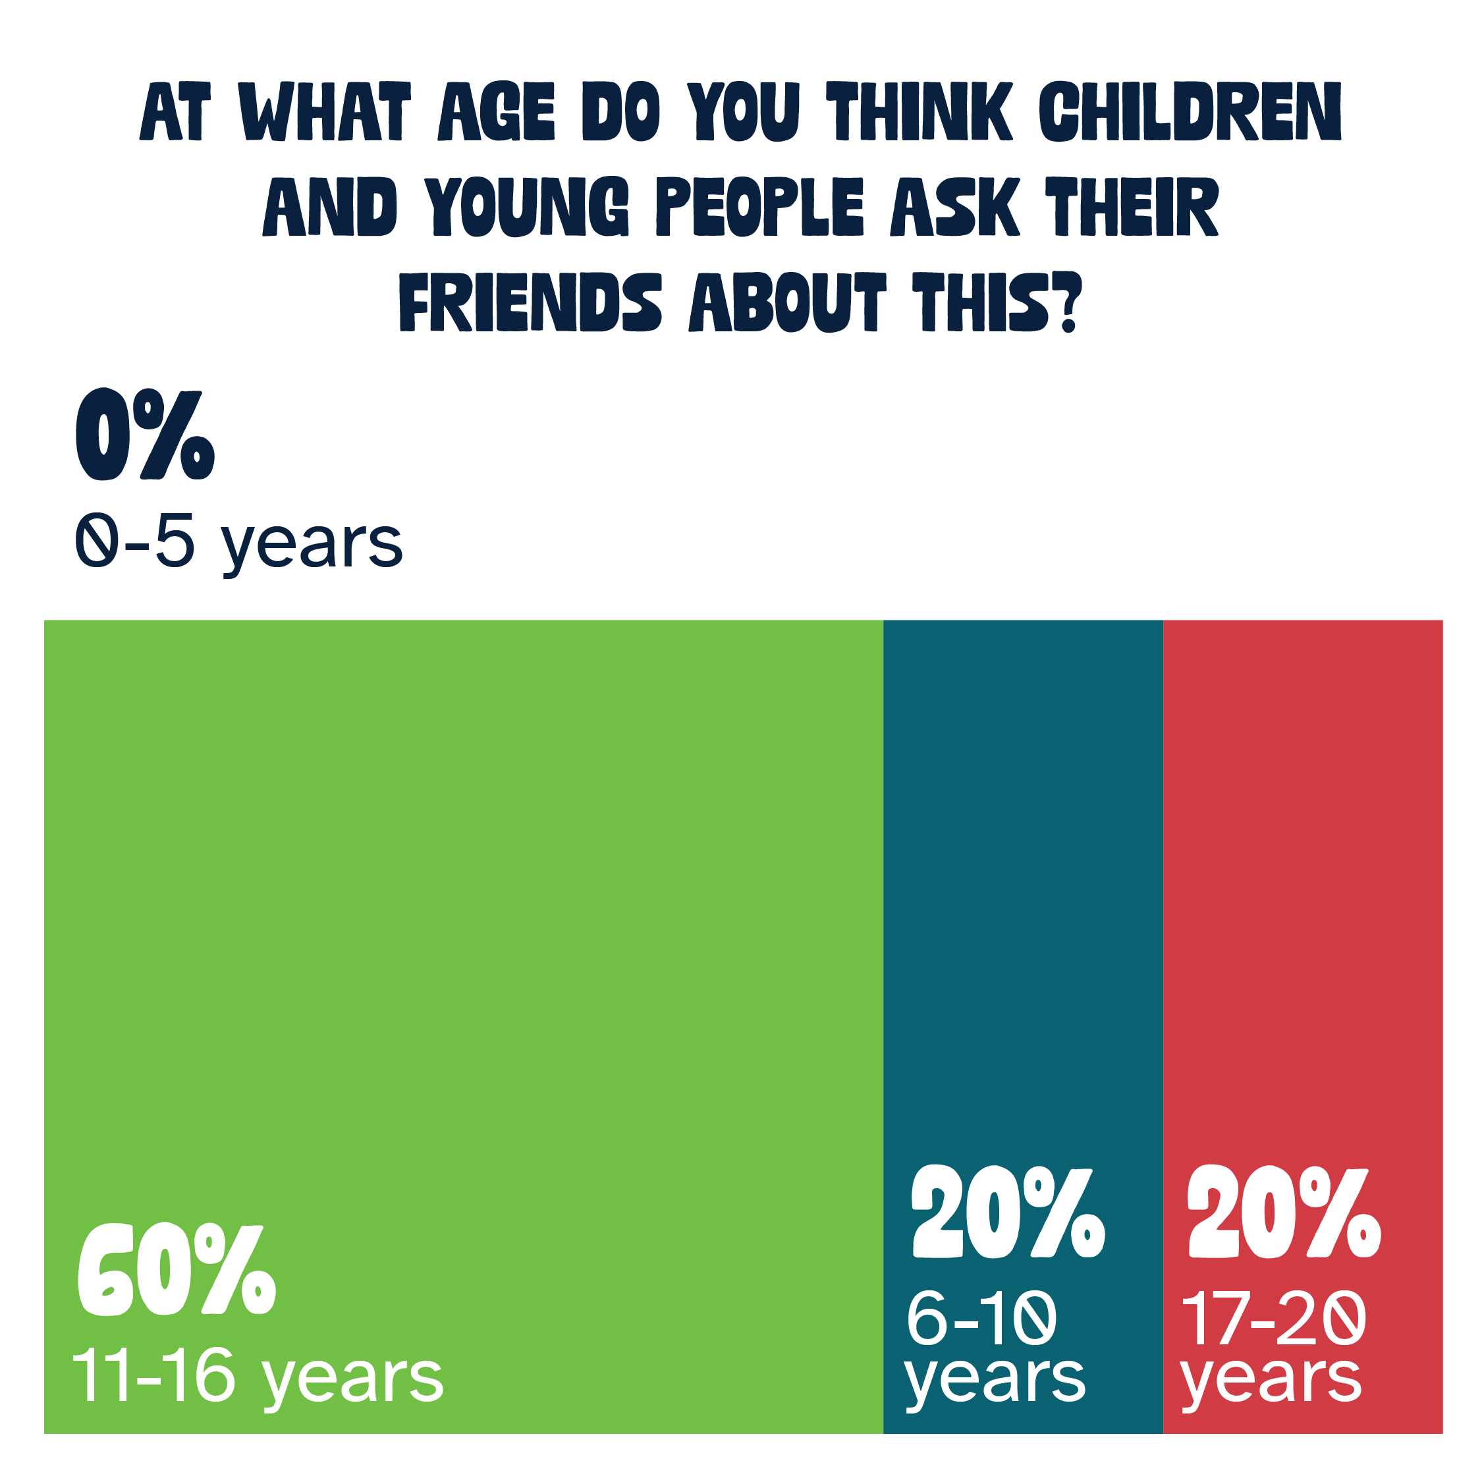
Help your friend/s with their self-harm problems

Slide 10
Help your friend/s with their self-harm problems
Findings
They feel that other young people talk about self-harm mostly once they are in secondary school, but will still talk about it when they get older.
The top three reasons young people talk to their friends about self-harm problems are:
  Adults don’t understand
  Embarrassment
  Think their friends know best
Other reasons include: shame, fear, concerns about judgement, punishment, blame and concerns about adults invalidating them
They’ll talk about it mostly at school, outdoors/parks or by text/messaging
This was the topic that fewer sessions covered, likely this is due to age and/or appropriateness for the group of young people as it is quite a sensitive subject

Slide 11
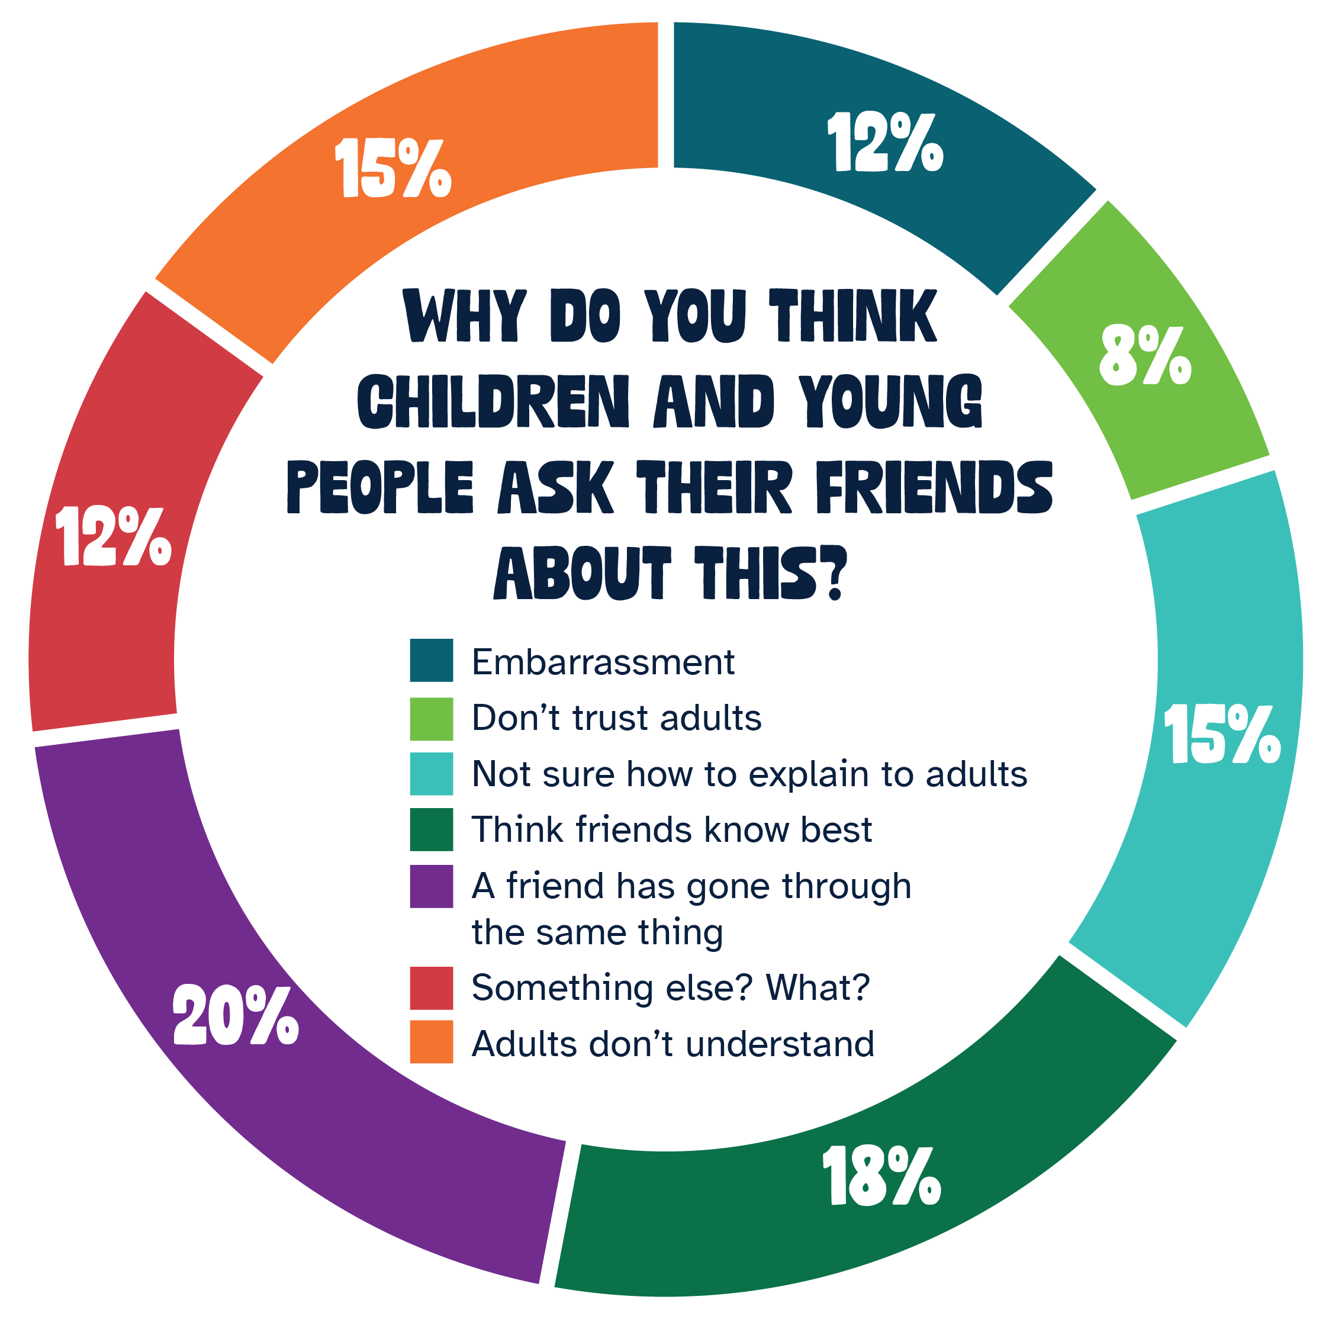
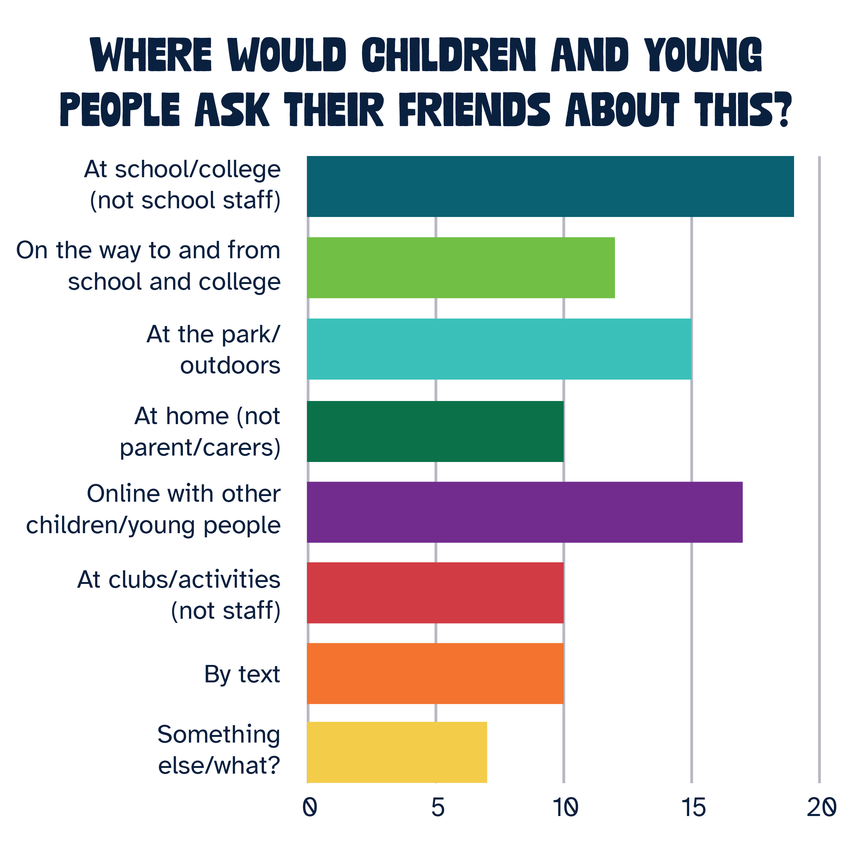
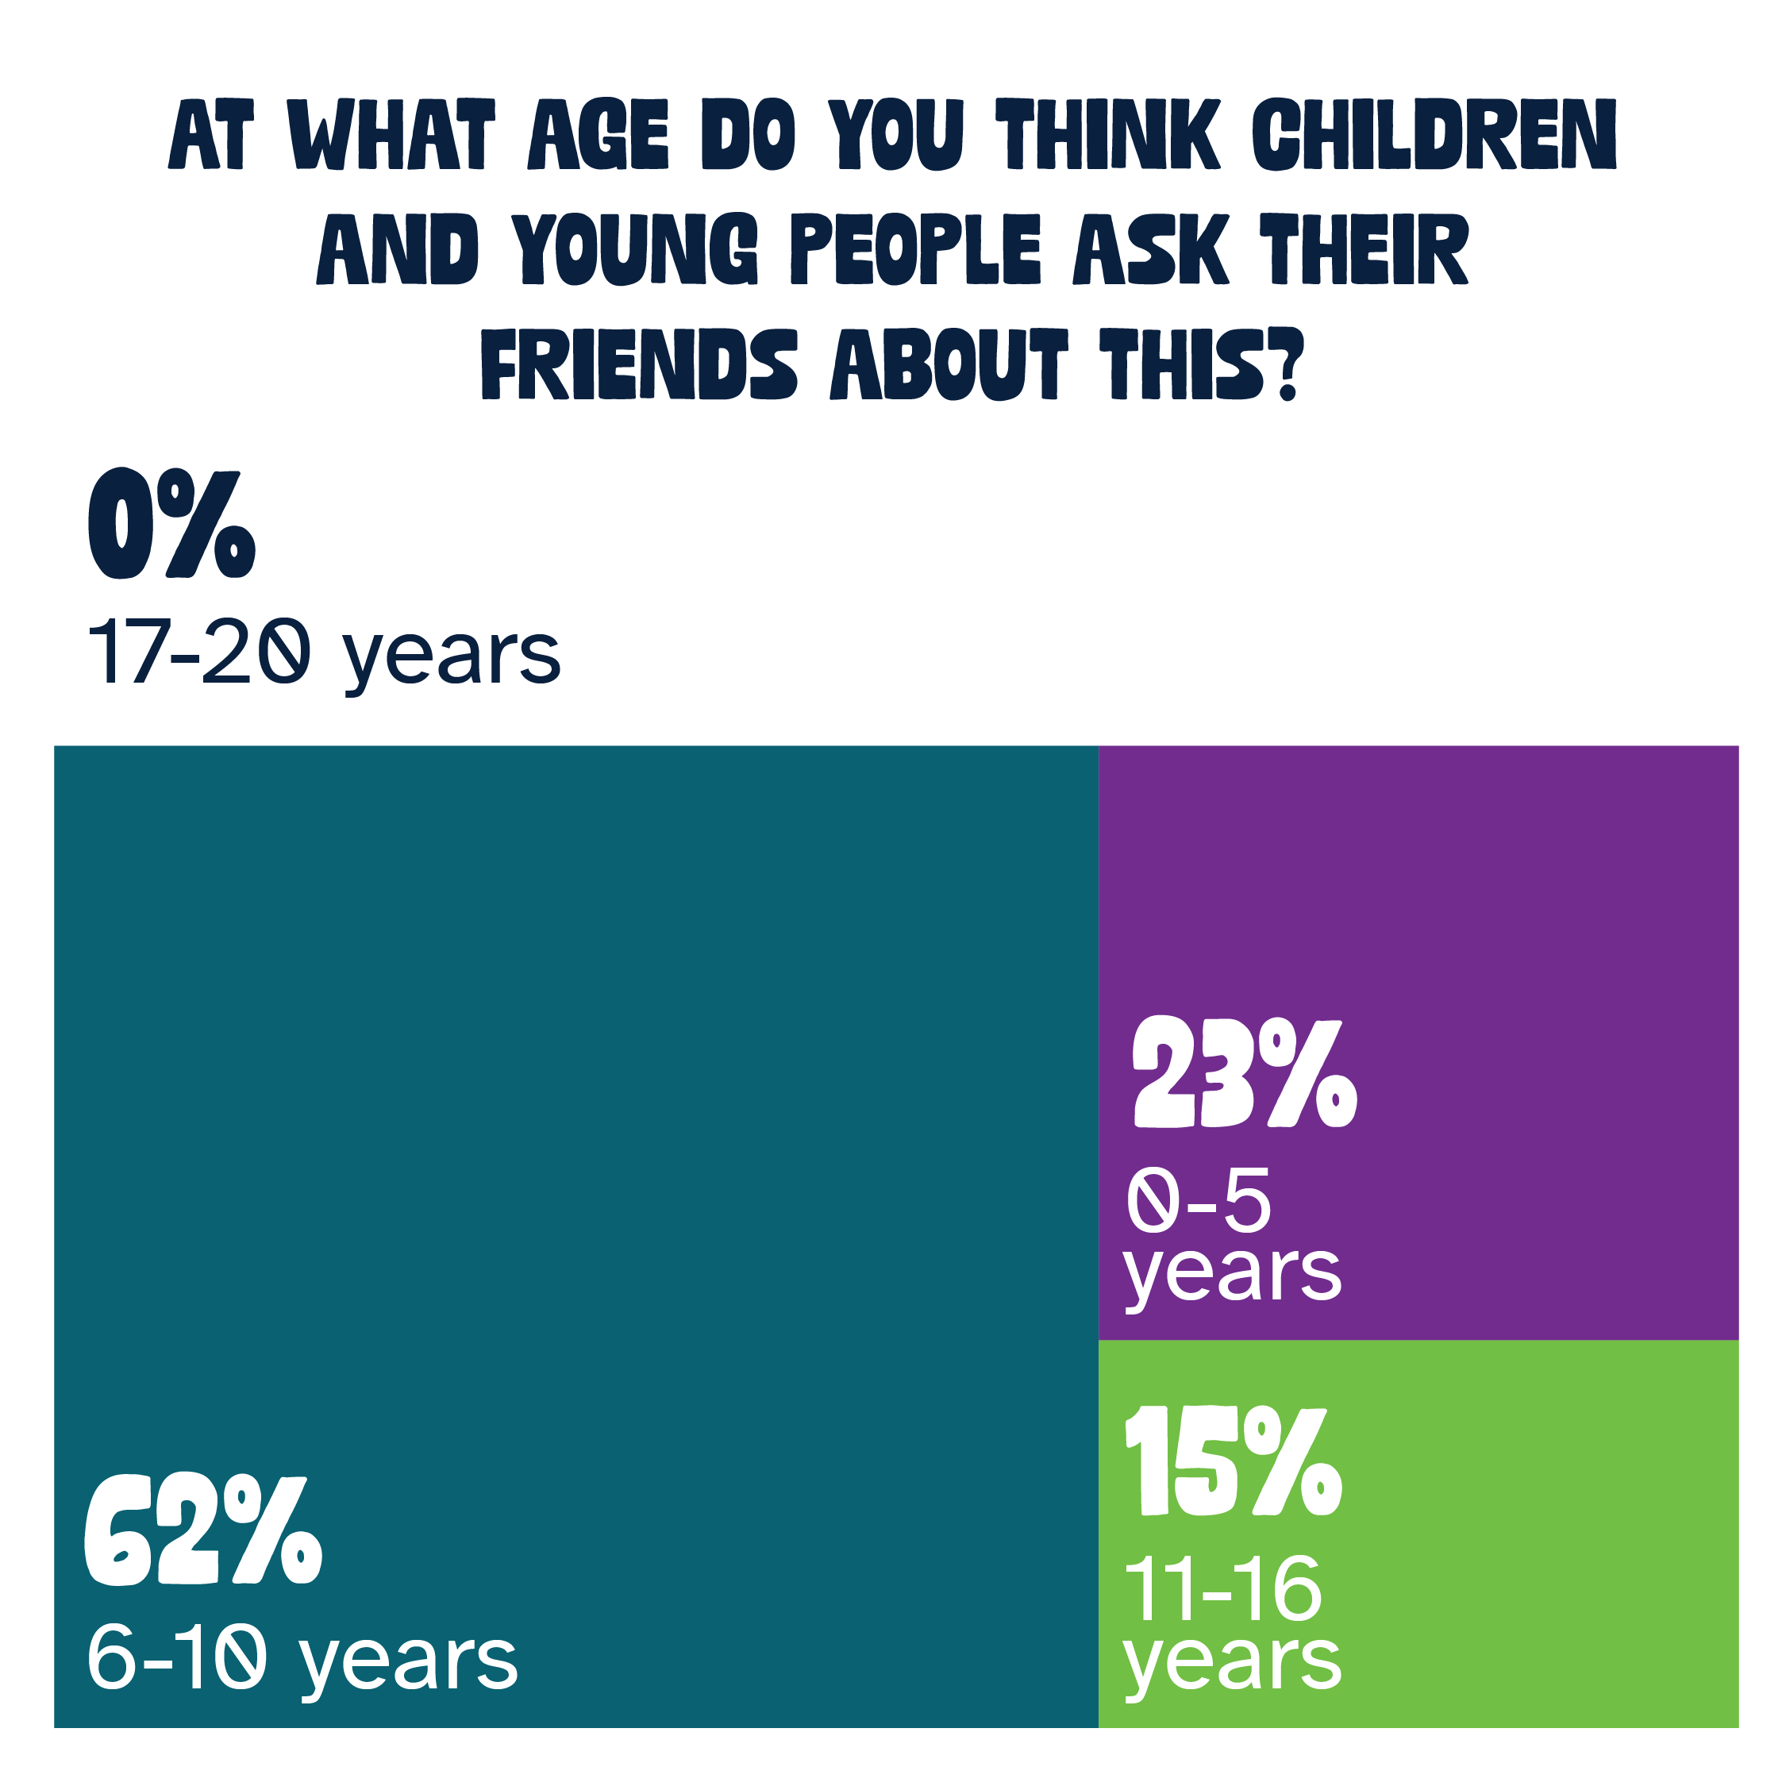
Help your friend/s with making and keeping friends

Slide 12
Help your friend/s with making and keeping friends
Findings
They feel that other young people talk about making and keeping friends mostly in their early school years and don’t talk about it once they leave school.
The top reasons young people talk to their friends about making and keeping friends are:
  A friend has gone through the same thing
  They think their friends know best
  Adults don’t understand
  Not sure how to explain to adults
Other reasons include: feeling lonely or left out, shared interests/community
They’ll talk about it mostly at school or online

Slide 13
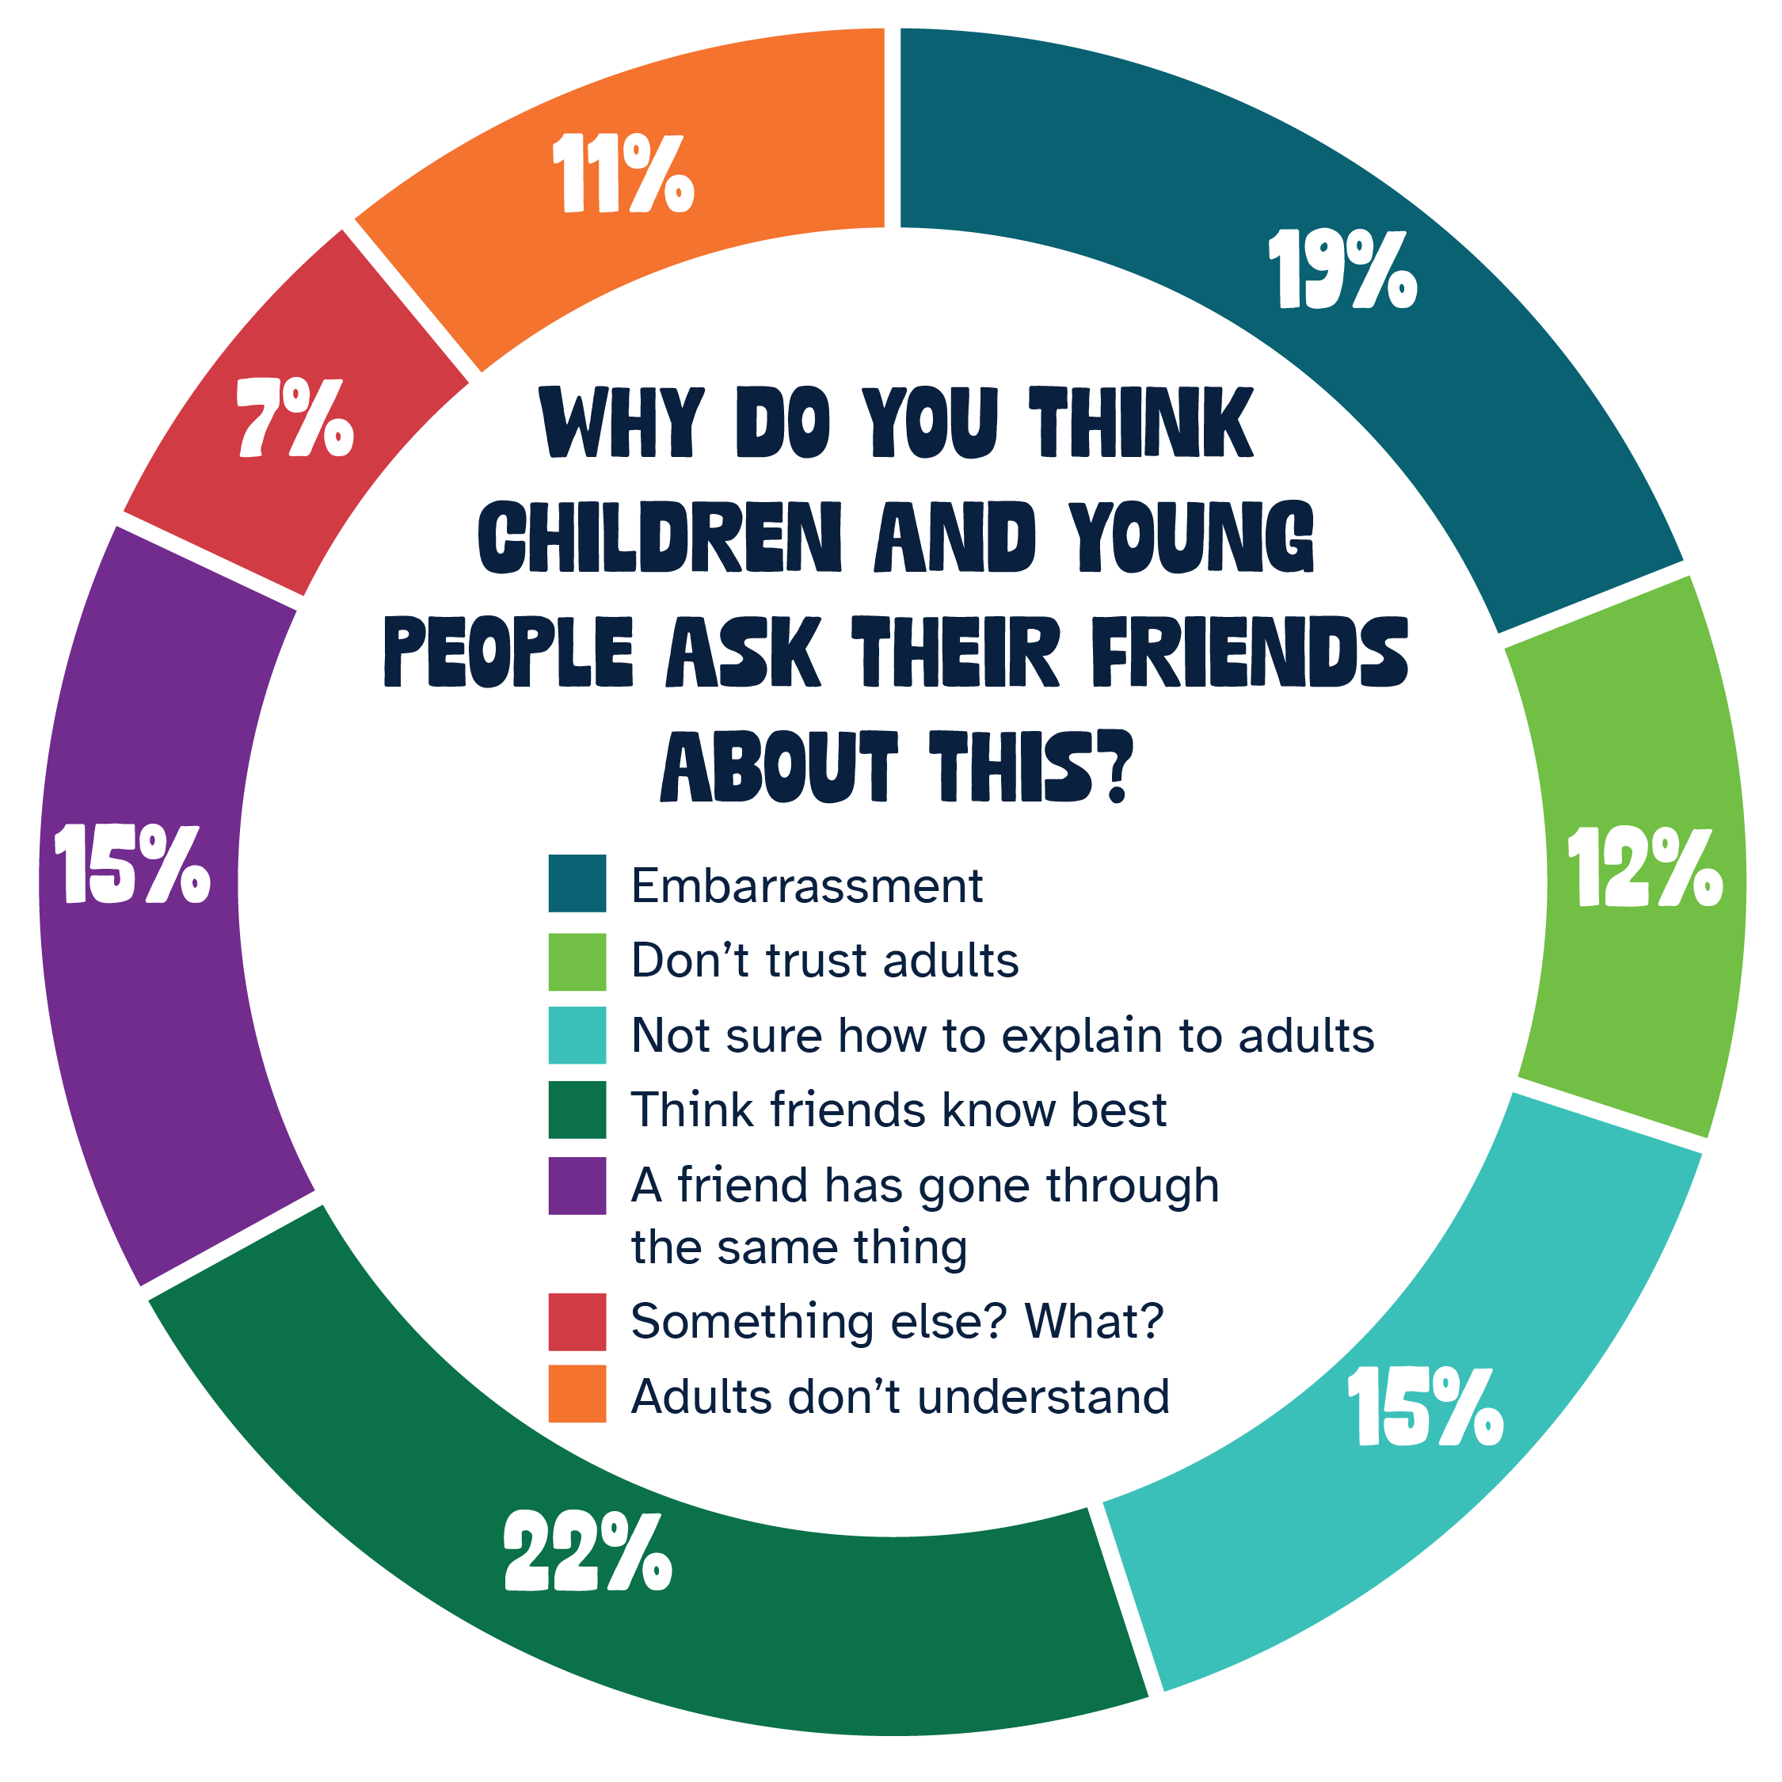
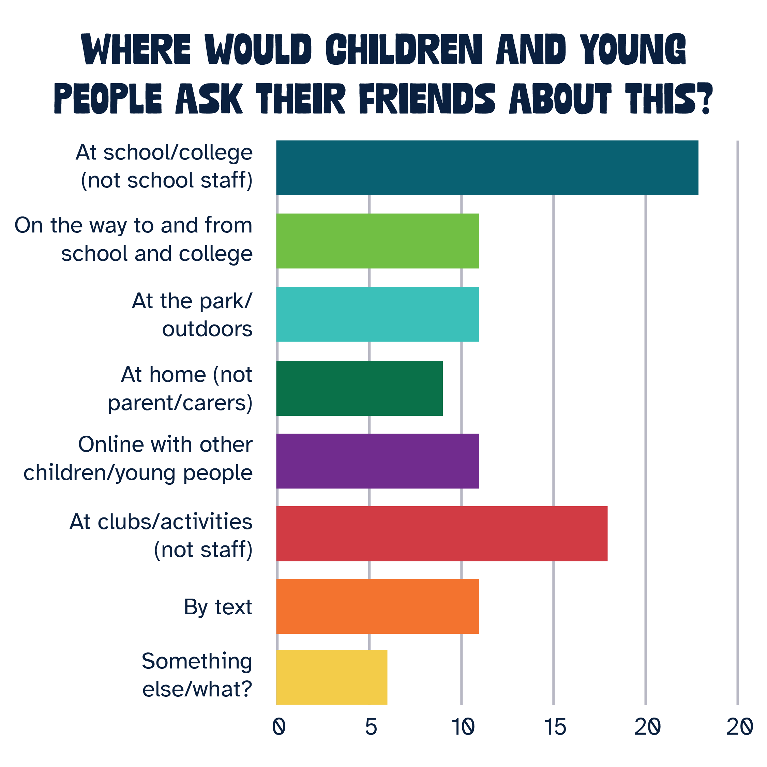
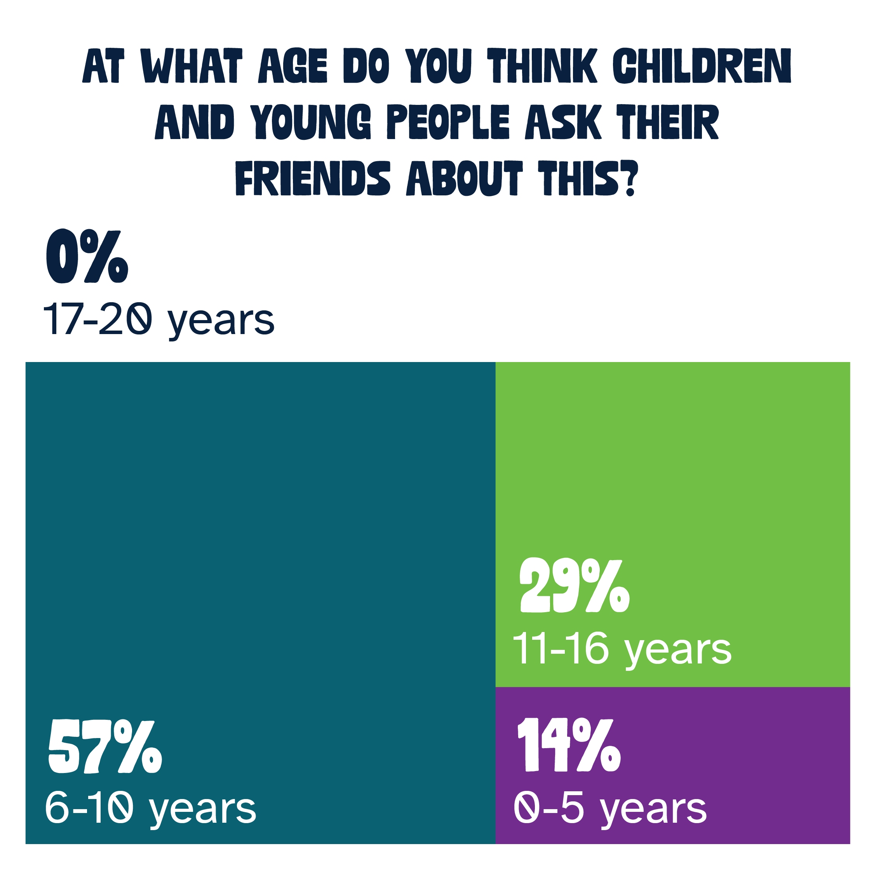
Help your friend/s with their physical health and wellbeing

Slide 14
Help your friend/s with their physical health and wellbeing
Findings
They feel that other young people talk about helping friends with their physical health and wellbeing mostly in their school years and don’t talk about it once they leave school.
The top reasons young people talk to their friends physical health and wellbeing are:
  They think their friends know best
  A friend has gone through the same thing
  Not sure how to explain to adults
Other reasons include: concerns that parents might send them to the doctor, concerned adults might be mean about it and not listen
They’ll talk about it mostly at school or at clubs
One of the sessions found it interesting that younger girls (8-11) talked about body image, hair and weight

Slide 15
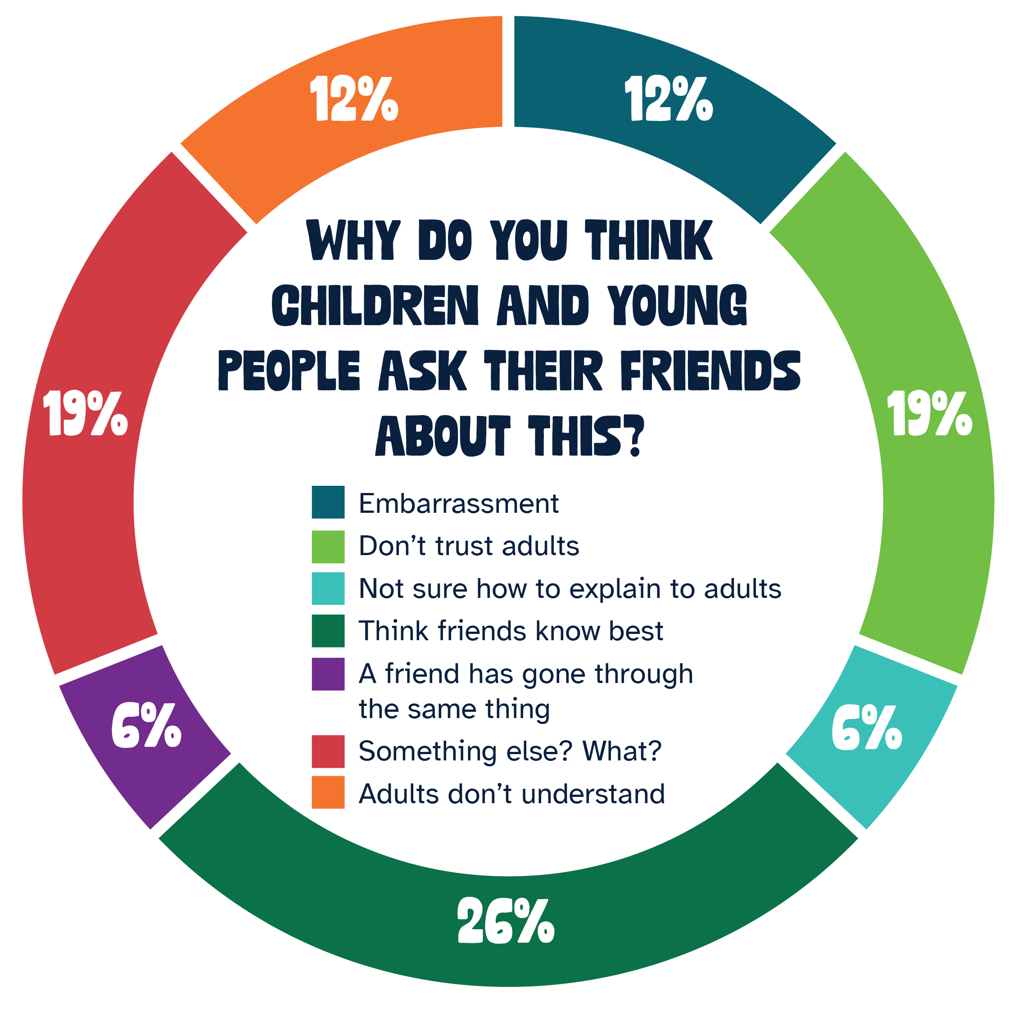
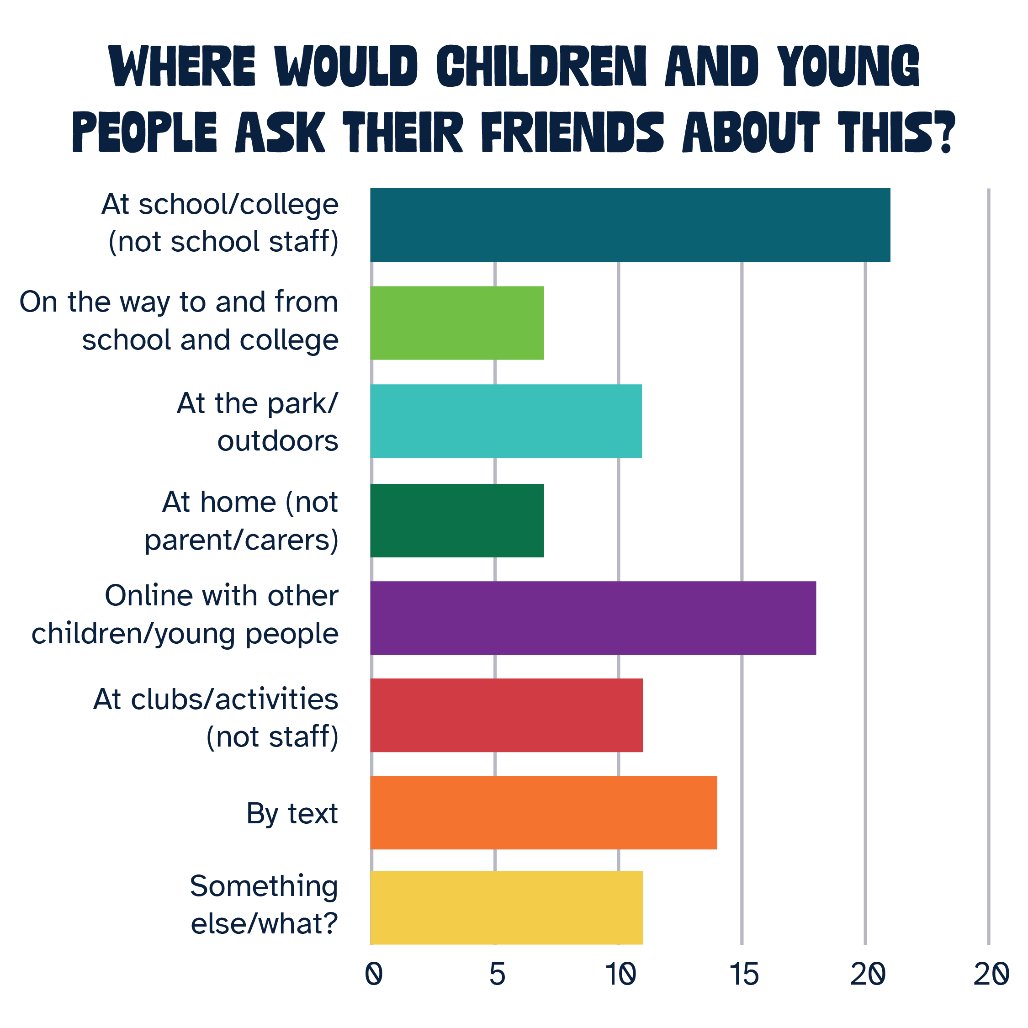
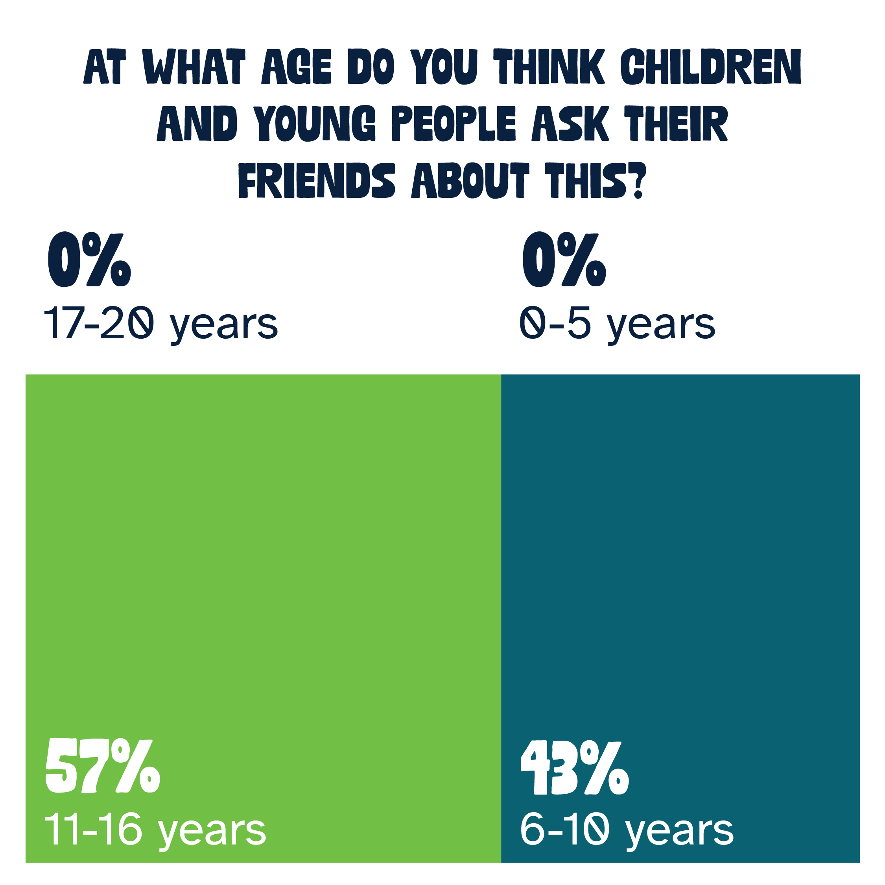
Help your friend/s with where they live

Slide 16
Help your friend/s with where they live
Findings
They feel that other young people talk about helping friends with where they live during their school age years, but not before or after.
The top reasons young people talk to their friends about where they live are:
  They think their friends know best
  Don’t trust adults
  Other
Other reasons include: inviting friends around for a play date, helping to keep their home tidy, to feel comfortable going to their friend’s house/sleepovers,
They’ll talk about it mostly at school or online
A lot of the young people felt they wouldn’t talk about it as where they lived was not something they could control

Slide 17
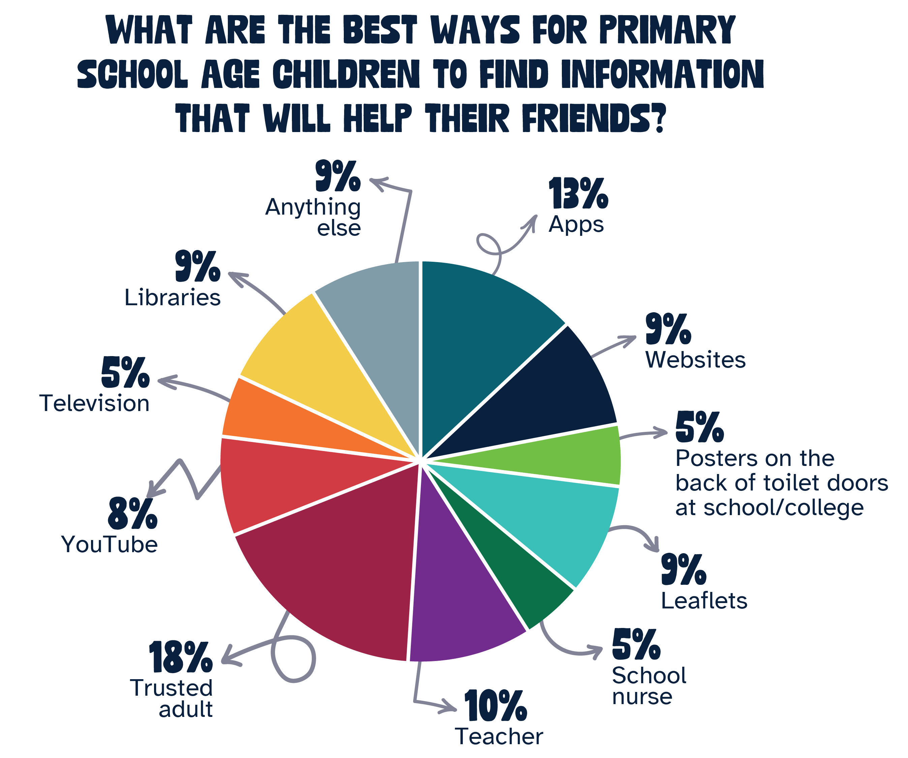
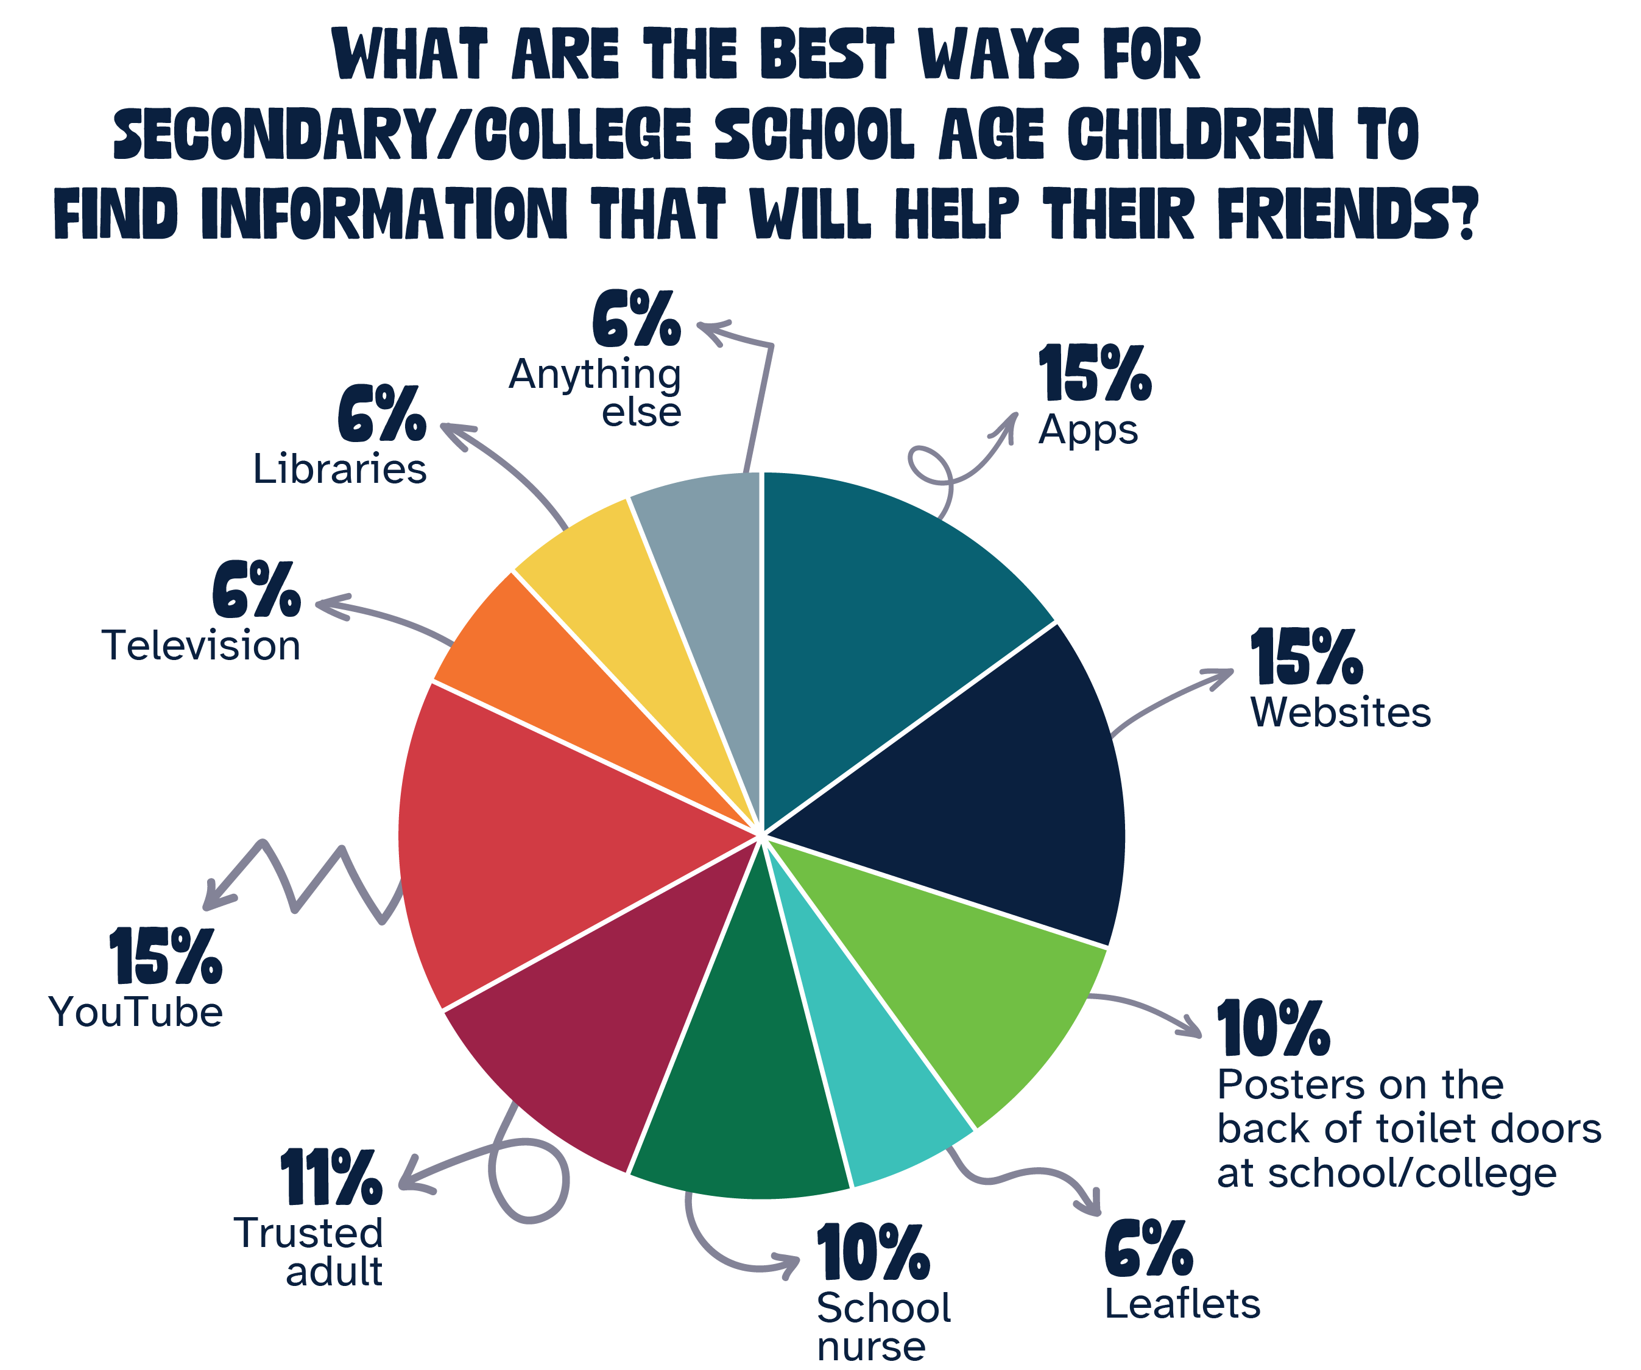
Best ways to help

Slide 18
Best ways to help
Findings
Participants felt that the best ways to help Primary aged young people would be through:
  Trusted adults
  Teachers
  Apps
They felt that the best ways to help Secondary and College aged young people would be through:
  Apps
  Website
  YouTube
They also pointed out that a lot of schools don’t have nurses, even though they’d go online – apps, websites, YouTube and social media for answers they couldn’t always trust what they saw and that younger people couldn’t get access to the internet.

Slide 19

What are we missing?

Slide 20
Conclusion
Generally young people believe that their friends know best due to their own lived experience and that adults don’t understand; as well as embarrassment about talking to adults about certain subjects.
Friends are usually consulted at school/college or outdoors and in parks or by text. Fewer young people also consult with friends online or at clubs and activities.
Problems at home and with families are consulted on at all ages; self-harming is consulted on at secondary age, but making friendships and physical health is consulted on at primary school. They cannot really perceive how they would deal with problems beyond school age.
Overall participants believed that primary school children recommend that their friends talk to trusted adults and secondary school friends are directed to online support.

Slide 21
Recommendations
Making adults who work with primary school aged children aware of where to find information to convey to the children.
Giving adults who work with primary school aged children awareness of child friendly websites and support.
Empowering trusted adults to be able to have ‘difficult’ conversations with children and young people.
Giving secondary school aged children and young people access to child and young person friendly digital information.
Audit what is generally available to Somerset children and young people and identify duplication, misinformation and missing information, as well as ease of access and suitability of content.
Work with Connect Somerset and other agencies on the idea of a one-stop-shop specifically for children and young people and involve young people in this work.
Market the one-stop-shop through awareness to adults via social media and newsletters, as well as merchandise handed out to children and young people at schools, colleges, clubs, etc.

Slide 22
Young People’s Steering Group
Conclusions
The number of responses to this project shows that it is an important topic for young people
Young people appreciated that engagement sessions were facilitated, as it made them more inclusive
They felt that the question ‘Help your friend/s with where they live’ was a bit inappropriate as most young people don’t have much control about where they live
Young people have to drive all advice and support is needed
There needs to be realism about funding

Slide 23
Young People’s Steering Group
Top Tips
For young people to talk about their issues, it’s important that young people feel free and safe in their environments
Adults need mainly to listen, while young people mainly need to lead conversation
Adults need to be more trauma informed
Conversations should not be forced, and adults should not give unsolicited advice
Young people might want a conversation, but might not be ready, so adults should wait for young people to be ready
It’s important that adults be knowledgeable, as it can be frustrating or triggering for young people to share and adults not know enough to be able to help or support

Slide 24
Thank You
participationmailbox@somerset.gov.uk

