Slide 1

Front Page
Notes:
image
No alt text provided
ReportNameSHAPE
No alt text provided
shape
No alt text provided
image
No alt text provided

Slide 2
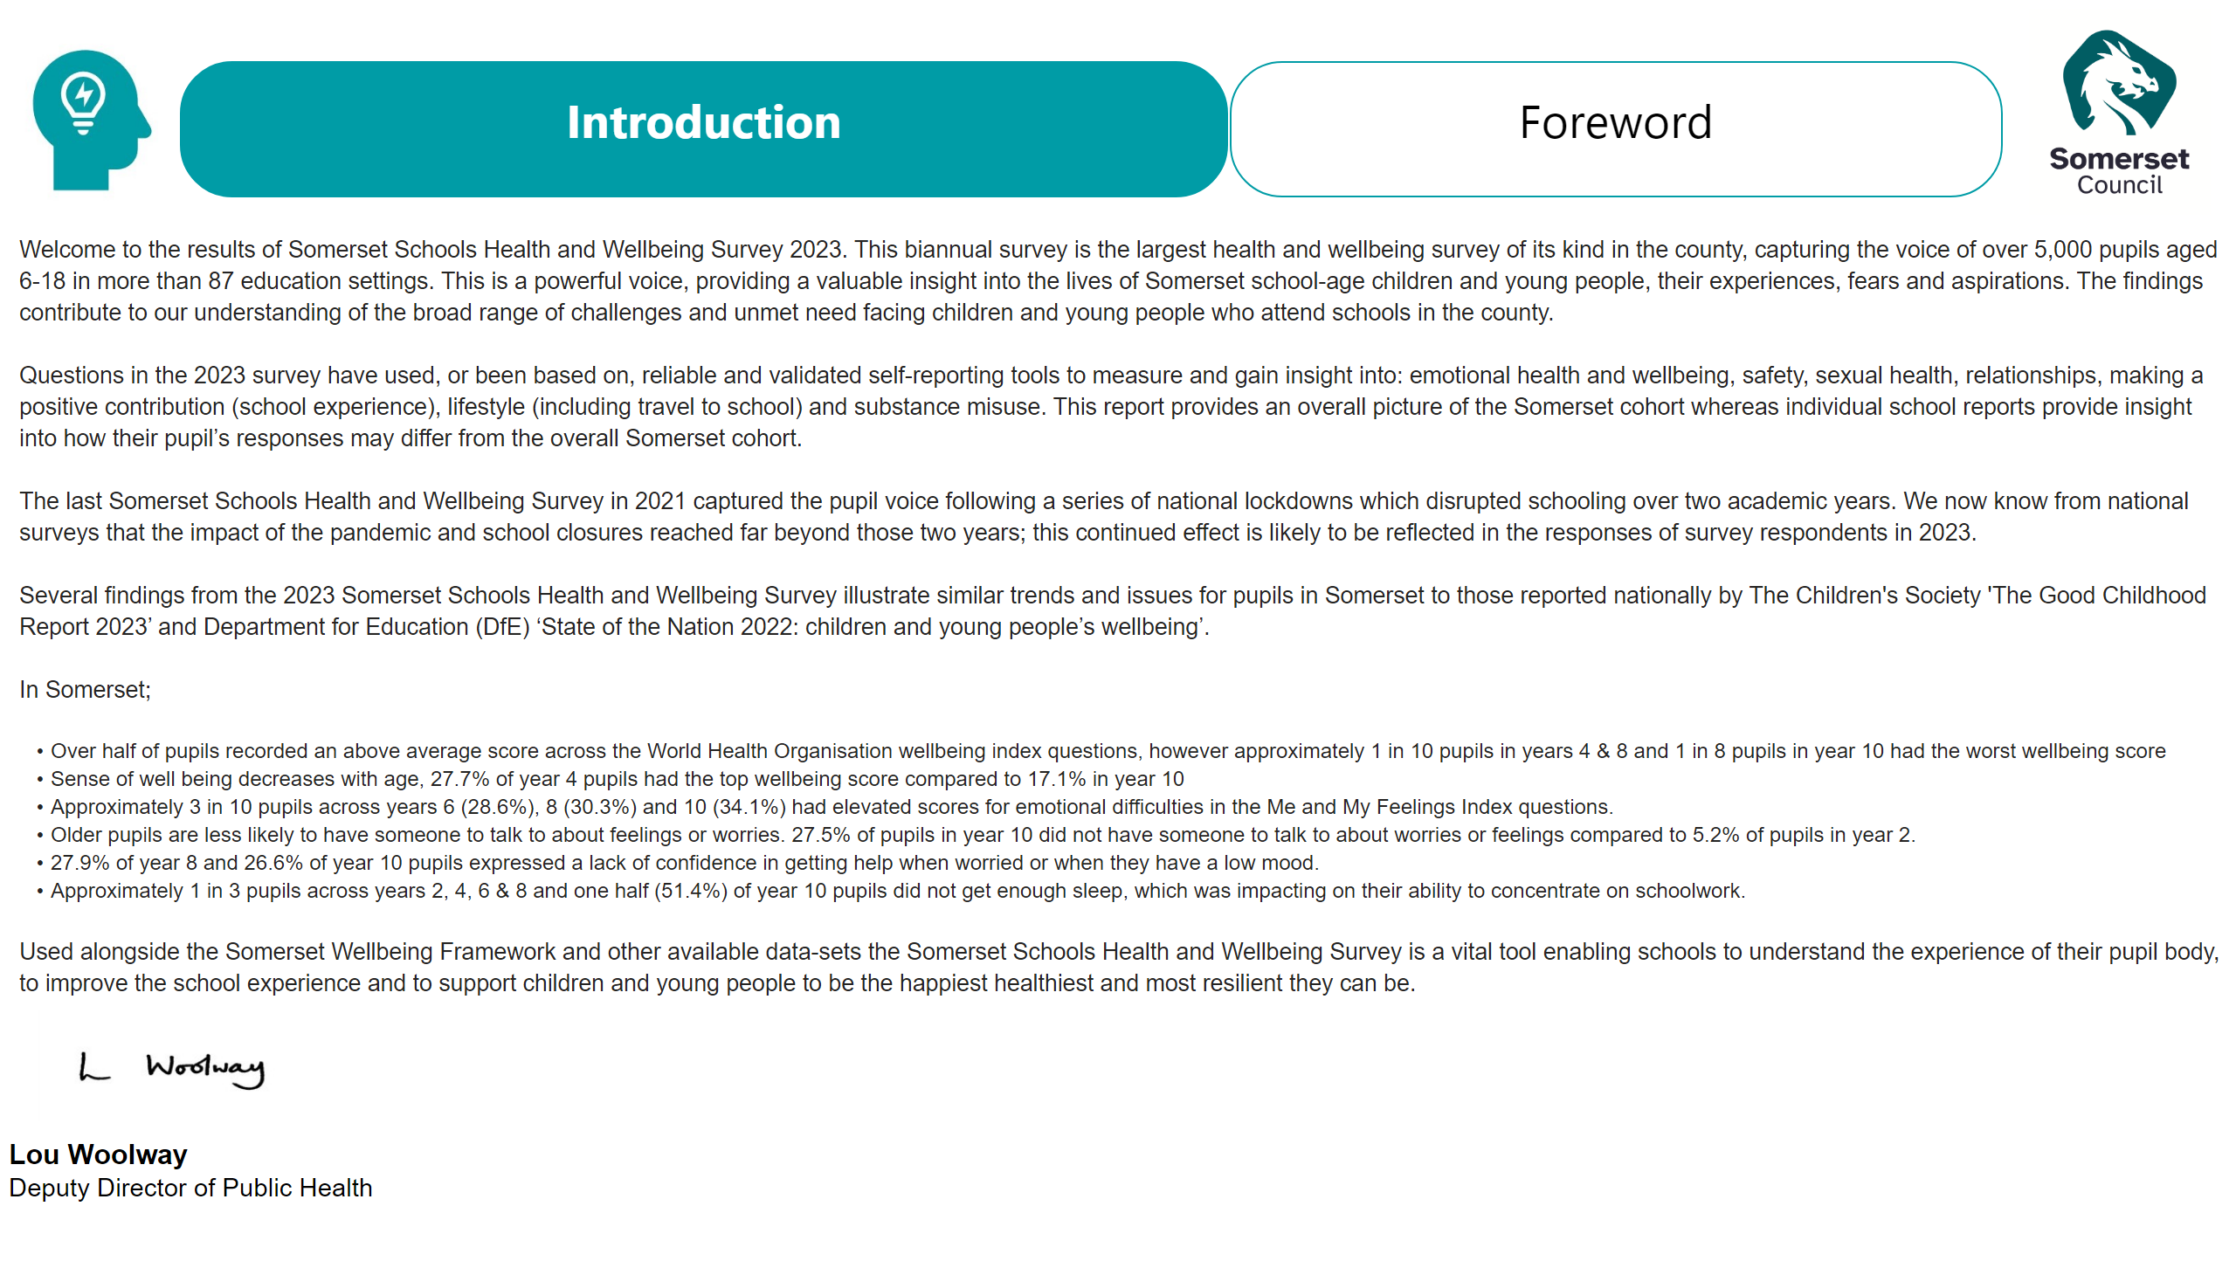
Foreword
Notes:
textbox
No alt text provided
textbox
No alt text provided
textbox
No alt text provided
image
No alt text provided
textbox
No alt text provided
image
No alt text provided
image
No alt text provided

Slide 3
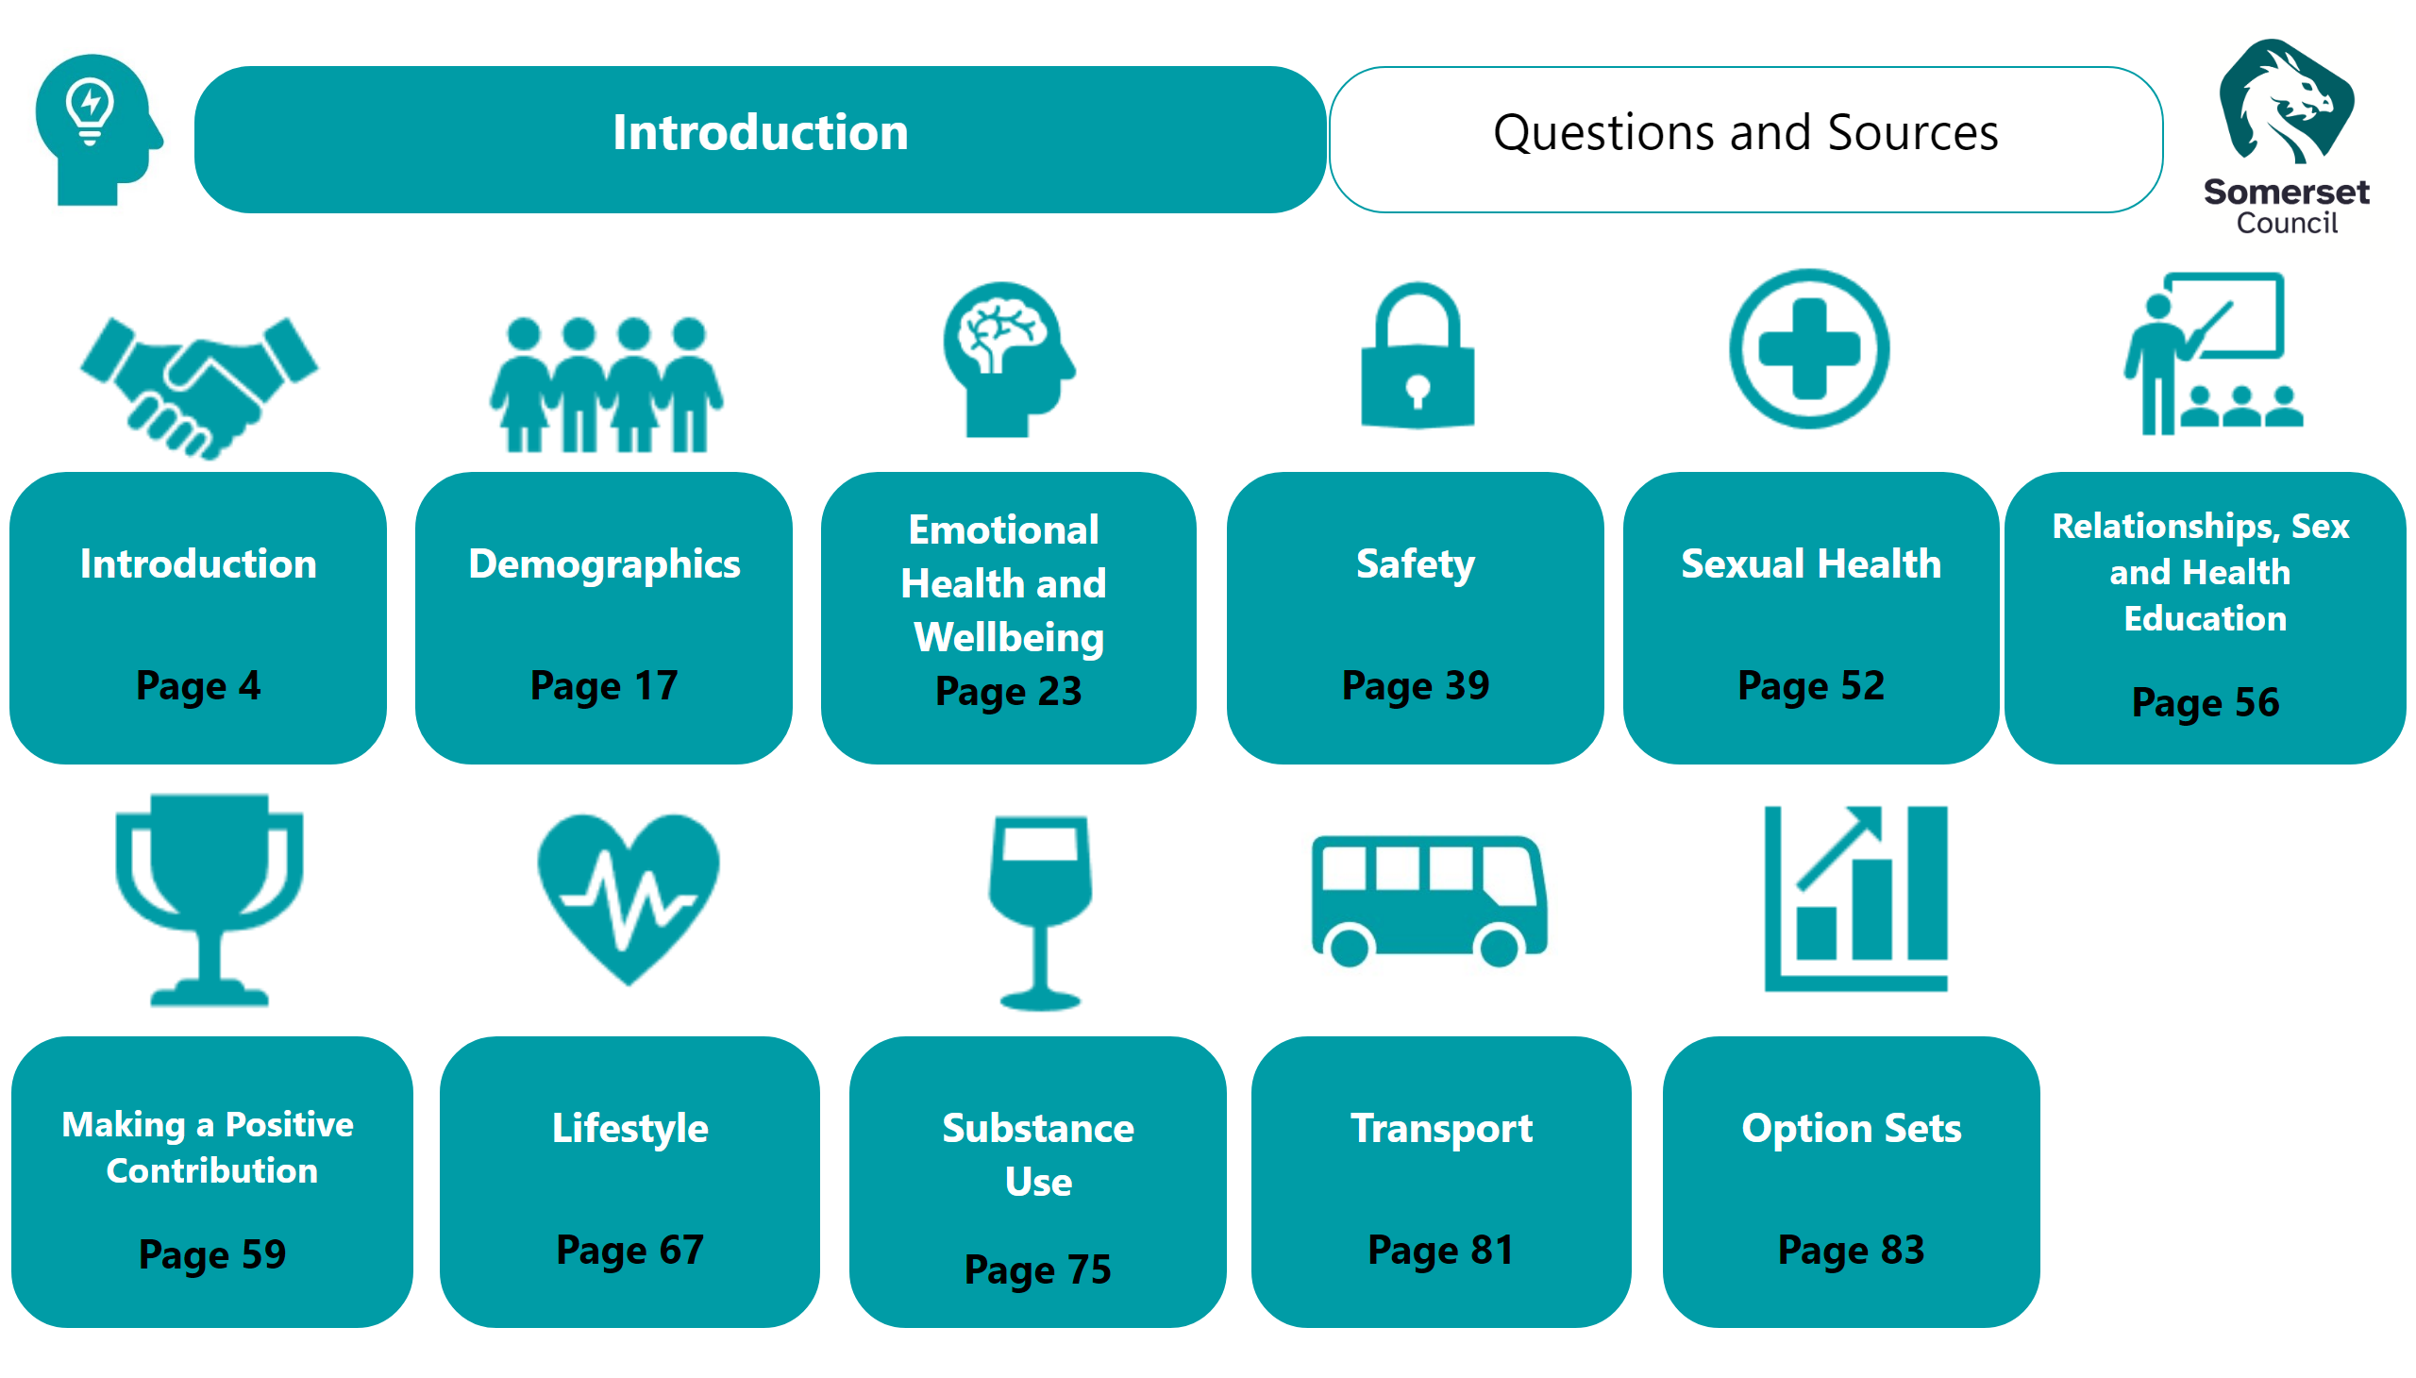
Contents
Notes:
textbox
No alt text provided
image
No alt text provided
textbox
No alt text provided
image
No alt text provided
textbox
No alt text provided
image
No alt text provided
image
No alt text provided
textbox
No alt text provided
image
No alt text provided
image
No alt text provided
textbox
No alt text provided
textbox
No alt text provided
textbox
No alt text provided
image
No alt text provided
textbox
No alt text provided
textbox
No alt text provided
textbox
No alt text provided
textbox
No alt text provided
image
No alt text provided
image
No alt text provided
image
No alt text provided
textbox
No alt text provided
textbox
No alt text provided
image
No alt text provided
image
No alt text provided
image
No alt text provided

Slide 4

Title - Introduction
Notes:
image
No alt text provided
ReportNameSHAPE
No alt text provided
shape
No alt text provided
image
No alt text provided

Slide 5
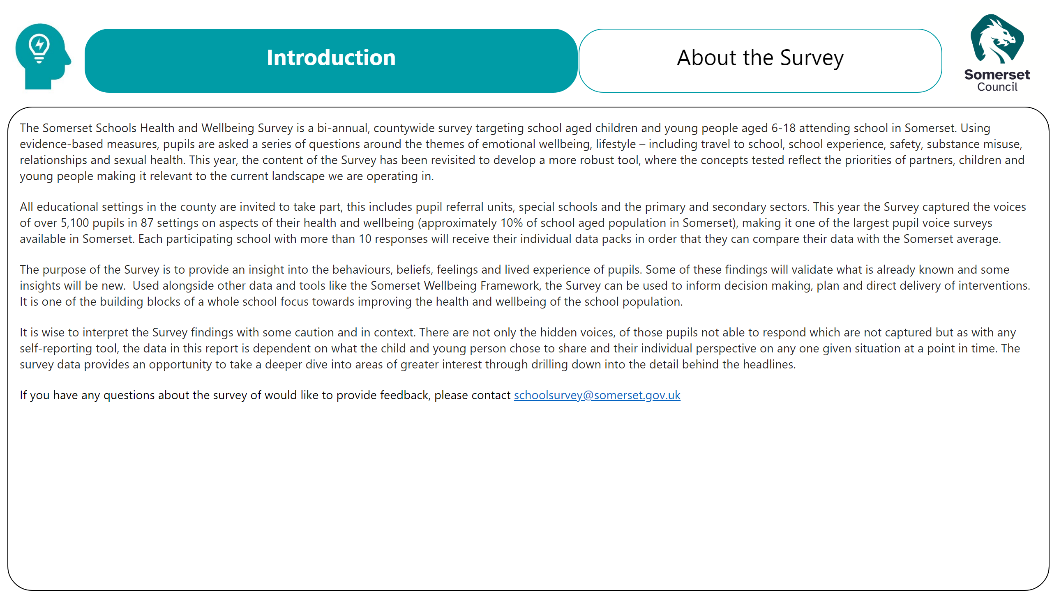
Introduction
Notes:
textbox
No alt text provided
textbox
No alt text provided
textbox
No alt text provided
image
No alt text provided
image
No alt text provided

Slide 6
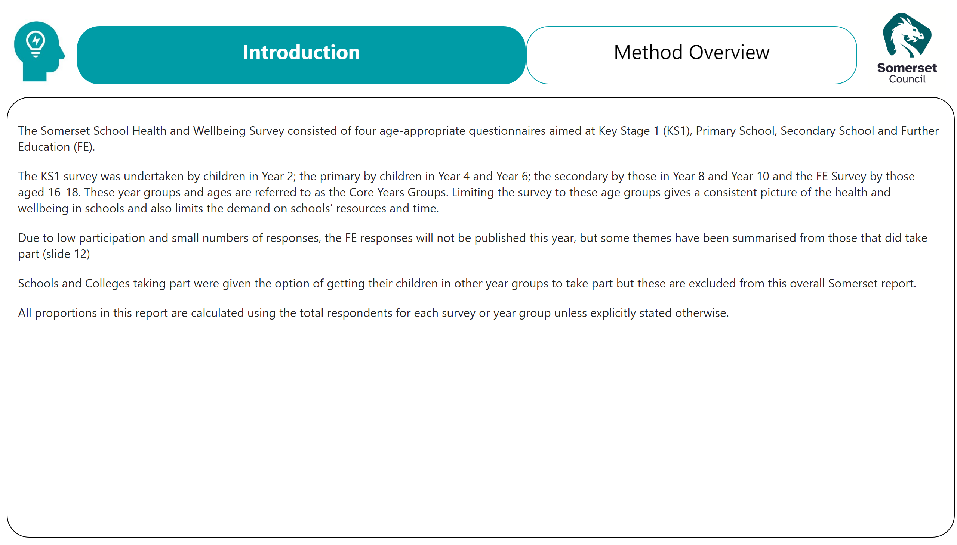
Method Overview
Notes:
textbox
No alt text provided
textbox
No alt text provided
textbox
No alt text provided
image
No alt text provided
image
No alt text provided

Slide 7
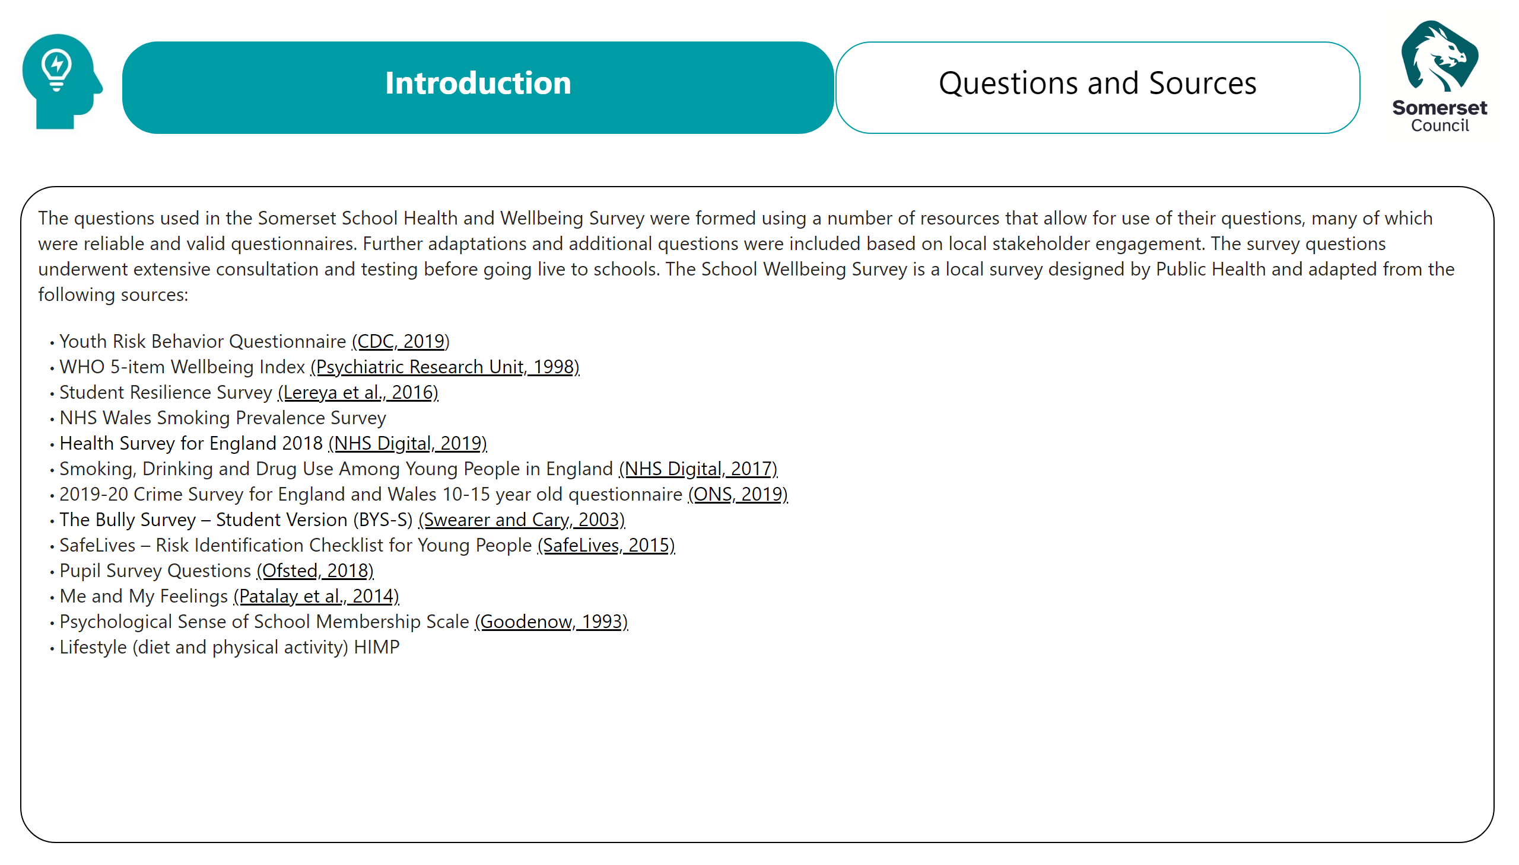
Method Questions and sources
Notes:
textbox
No alt text provided
textbox
No alt text provided
textbox
No alt text provided
image
No alt text provided
image
No alt text provided

Slide 8
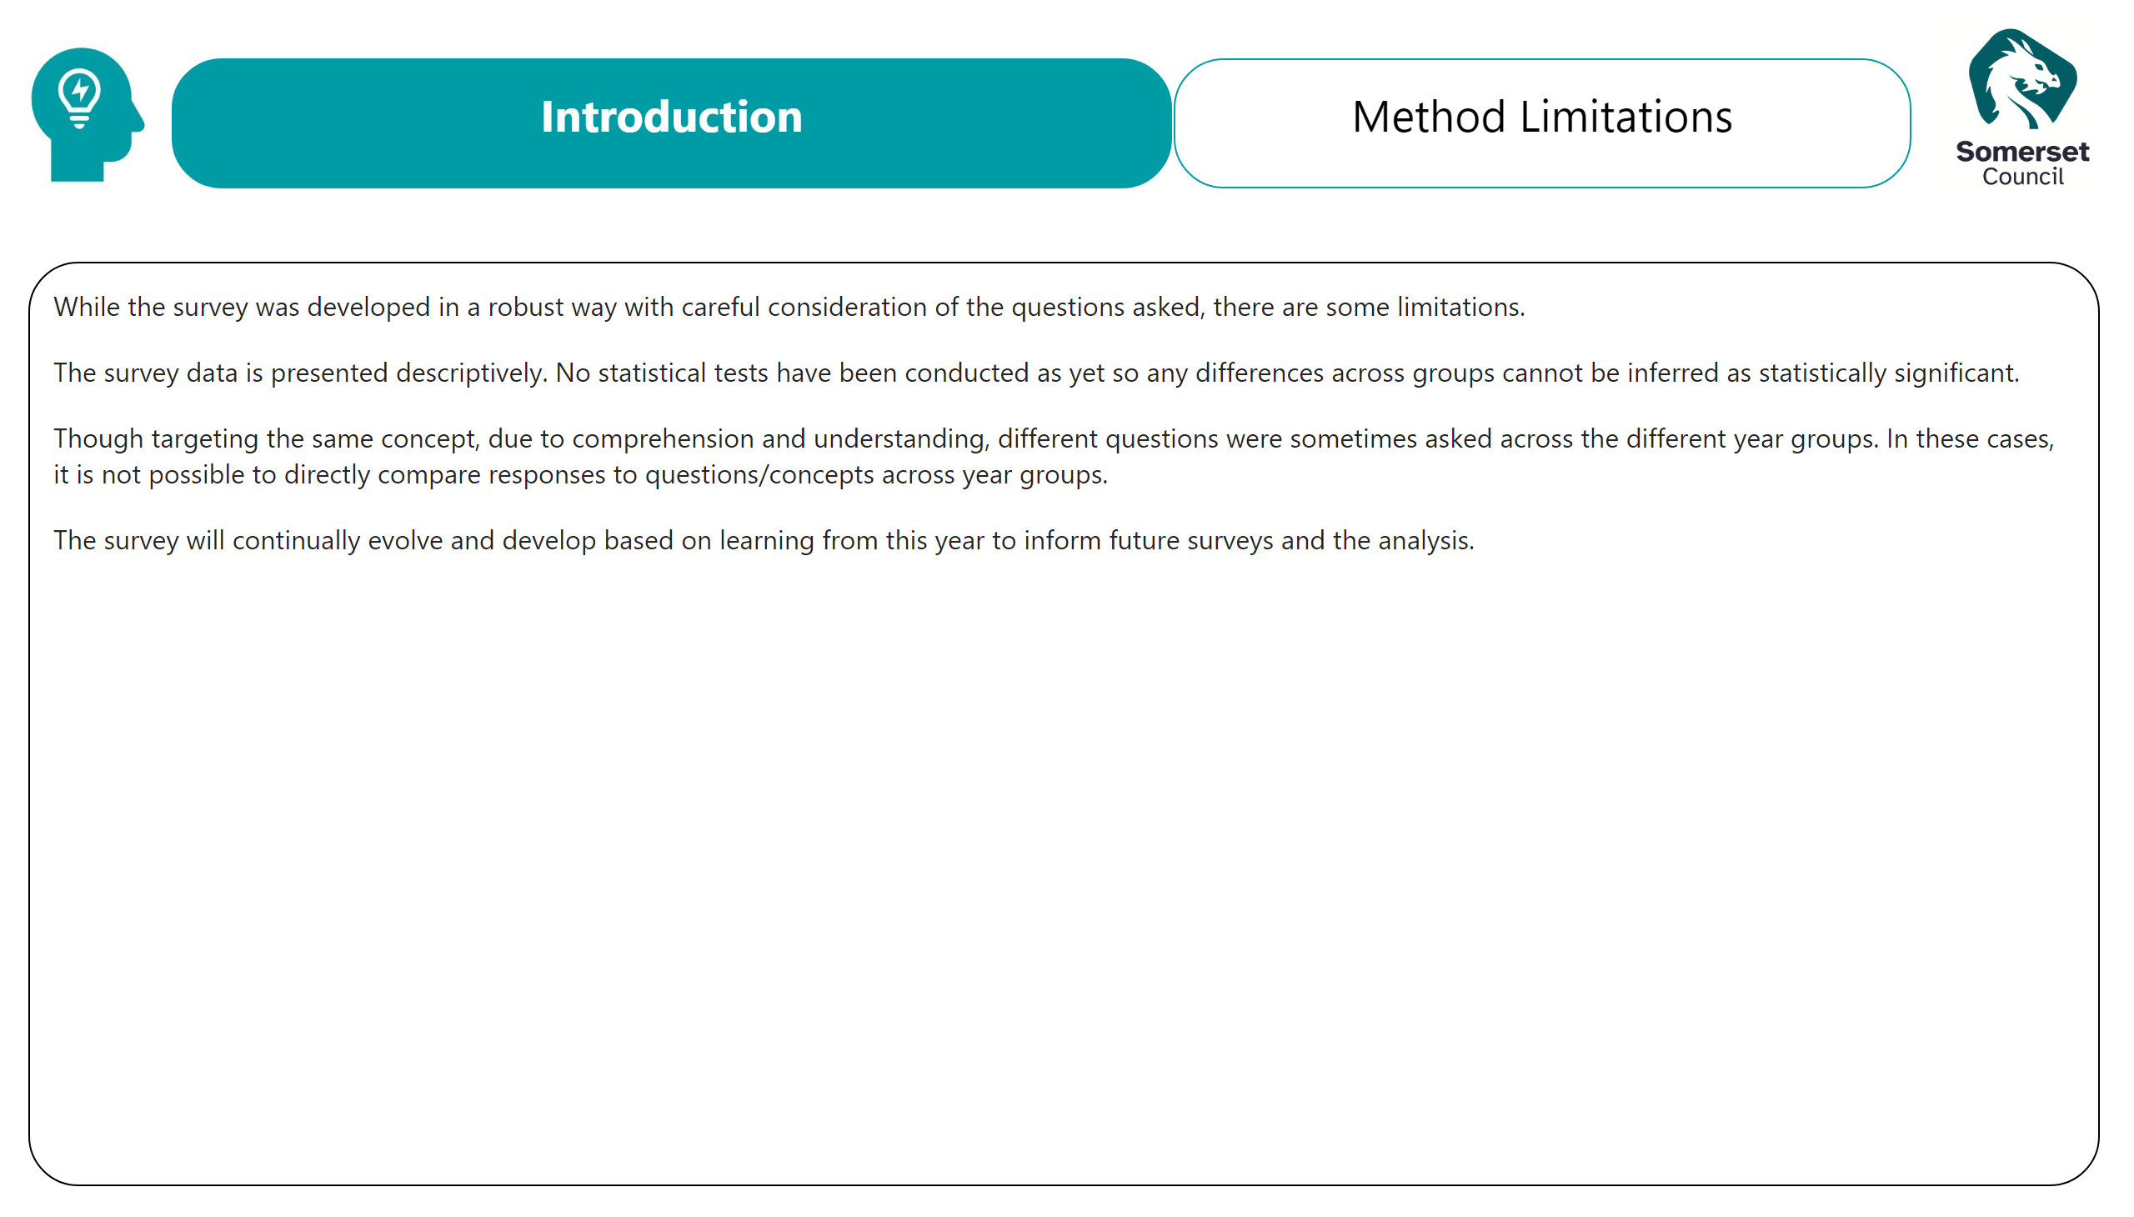
Method Limitations
Notes:
textbox
No alt text provided
textbox
No alt text provided
textbox
No alt text provided
image
No alt text provided
image
No alt text provided

Slide 9
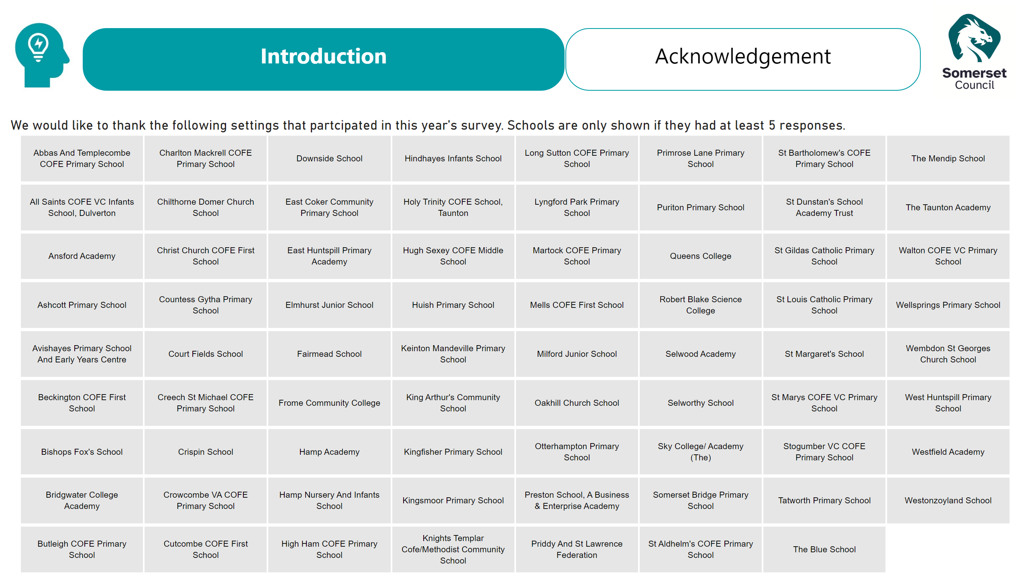
Acknowledgement
Notes:
textbox
No alt text provided
textbox
No alt text provided
Schools
No alt text provided
image
No alt text provided
image
No alt text provided

Slide 10
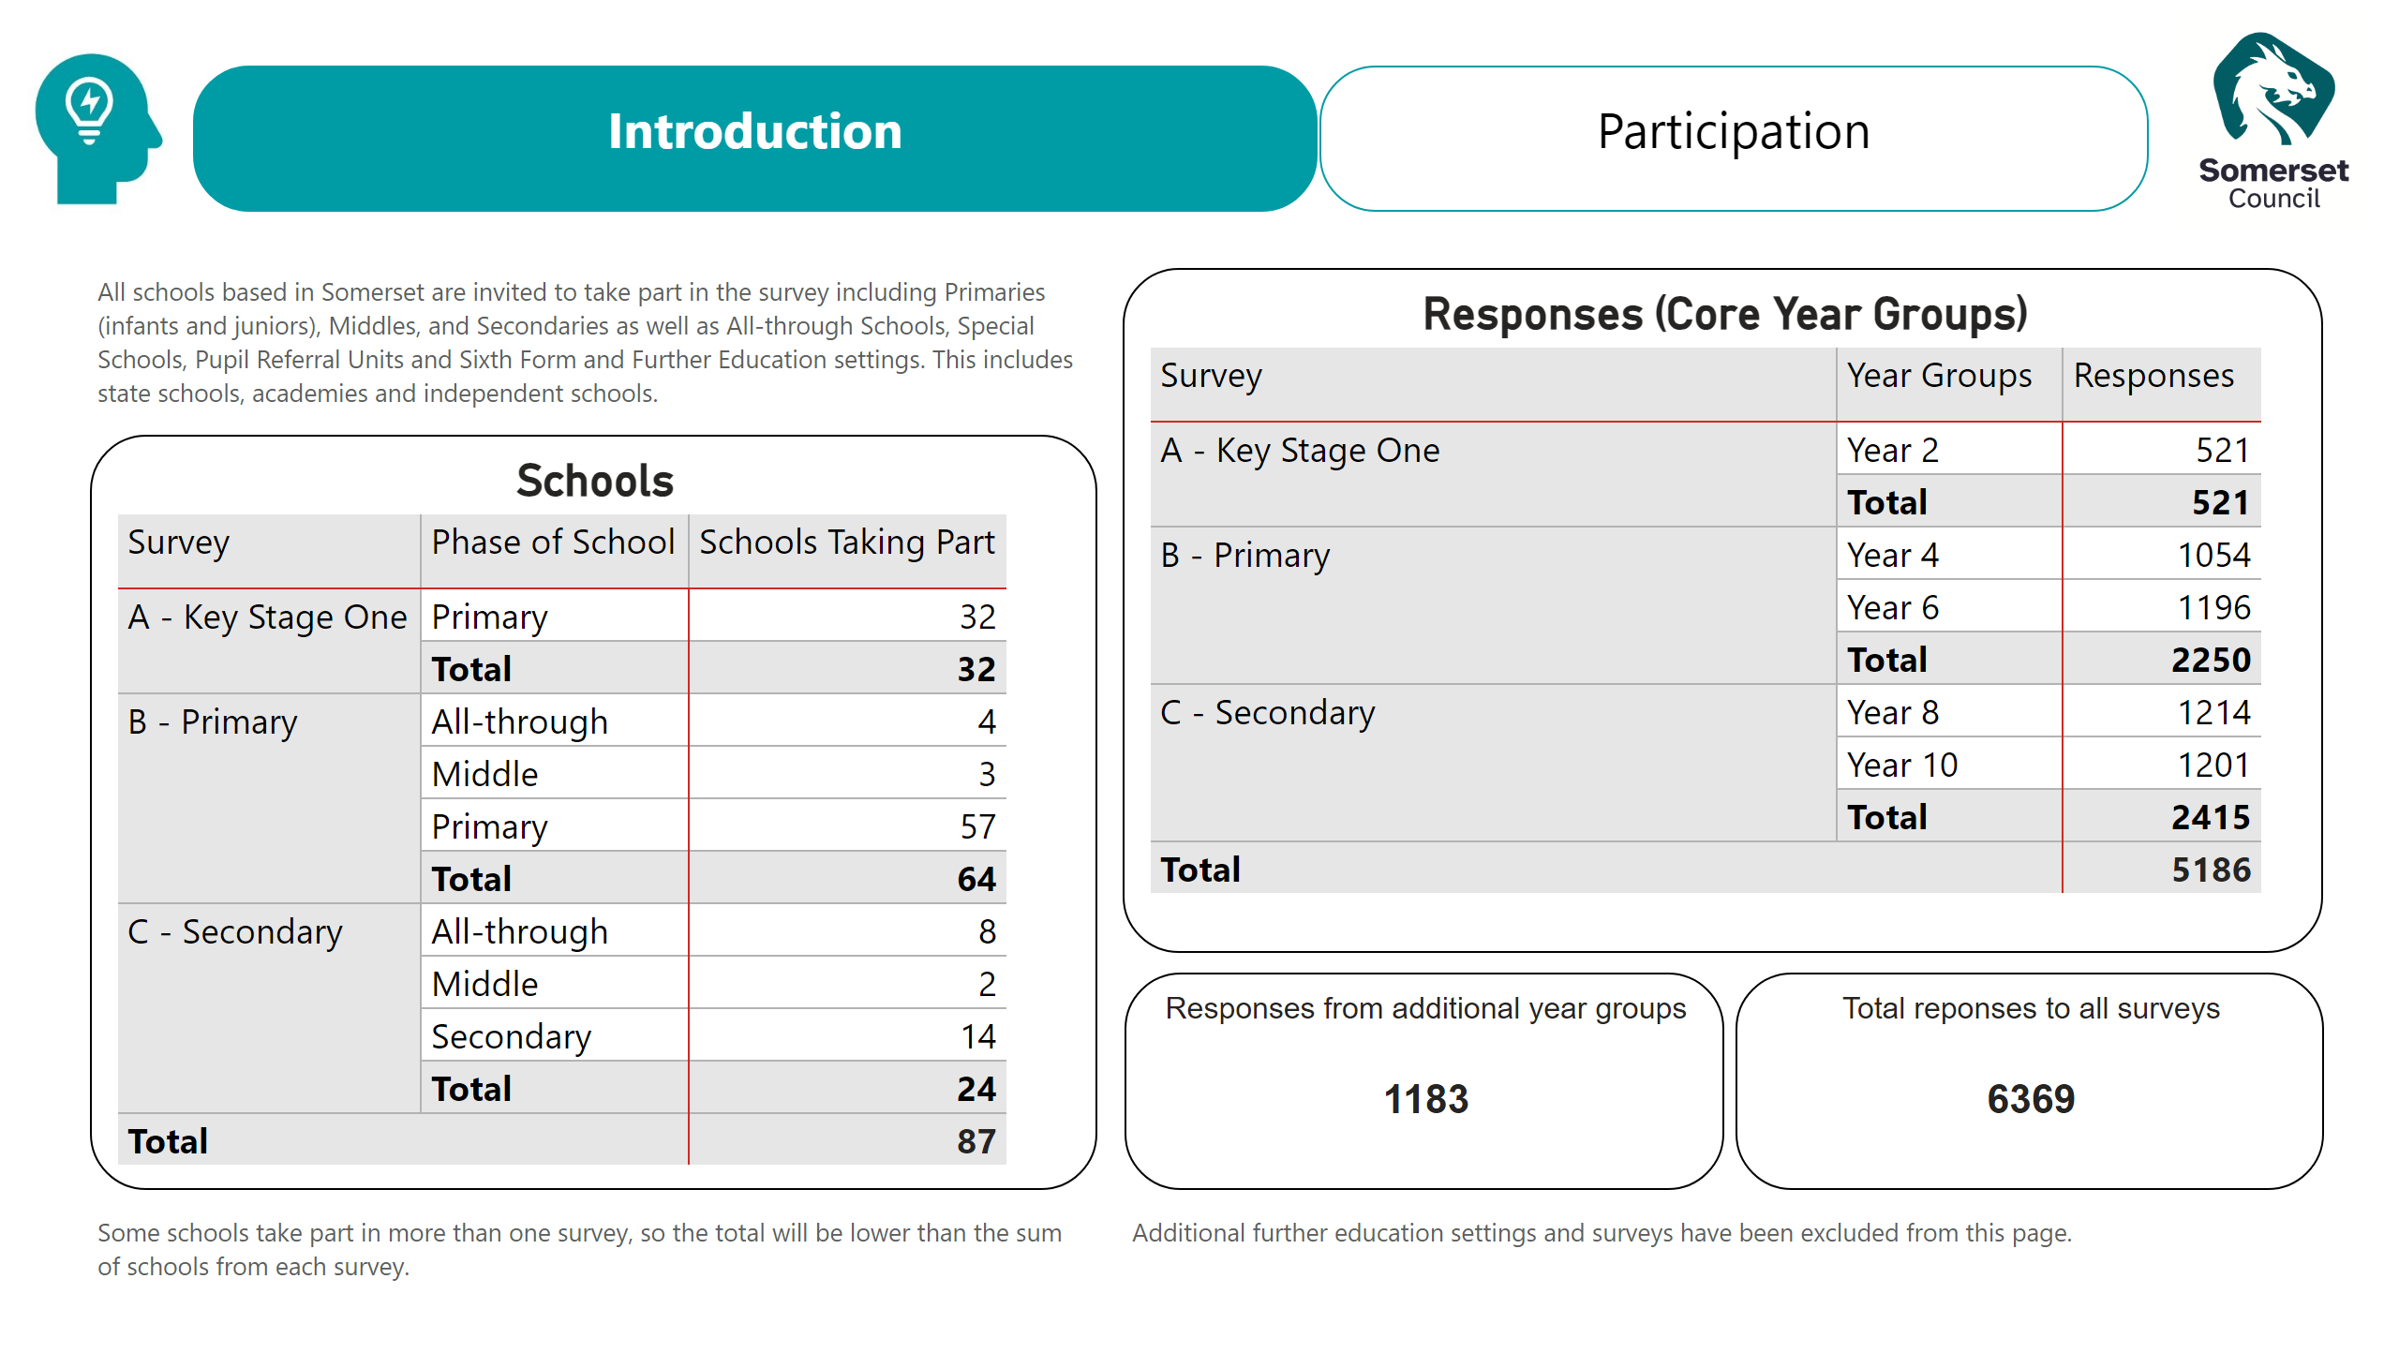
Participation
Notes:
Responses (Core Year Groups)
No alt text provided
actionButton
No alt text provided
Schools
No alt text provided
Responses from additional year groups
No alt text provided
Total reponses to all surveys
No alt text provided
textbox
No alt text provided
textbox
No alt text provided
actionButton
No alt text provided
actionButton
No alt text provided
image
No alt text provided
image
No alt text provided

Slide 11
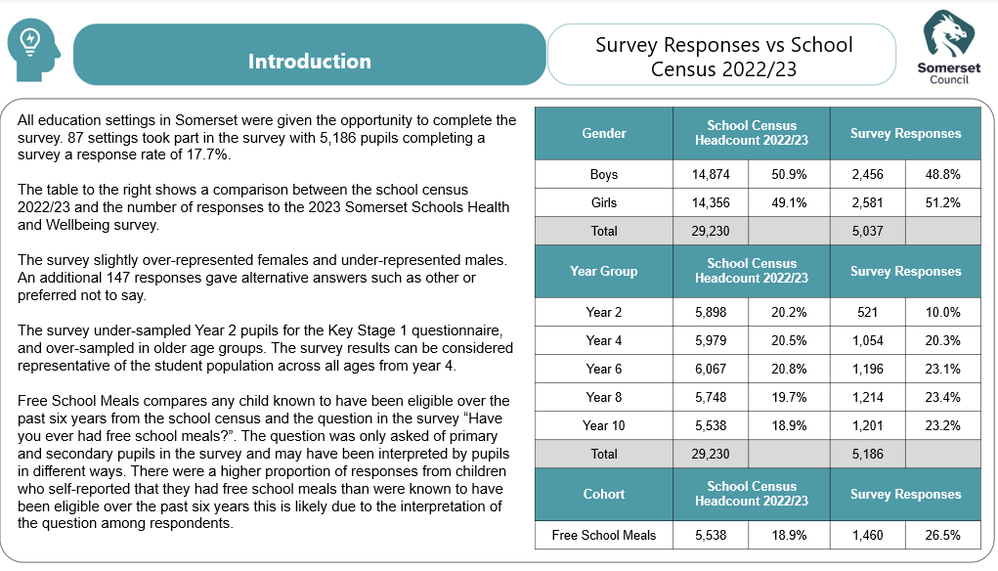

Slide 12
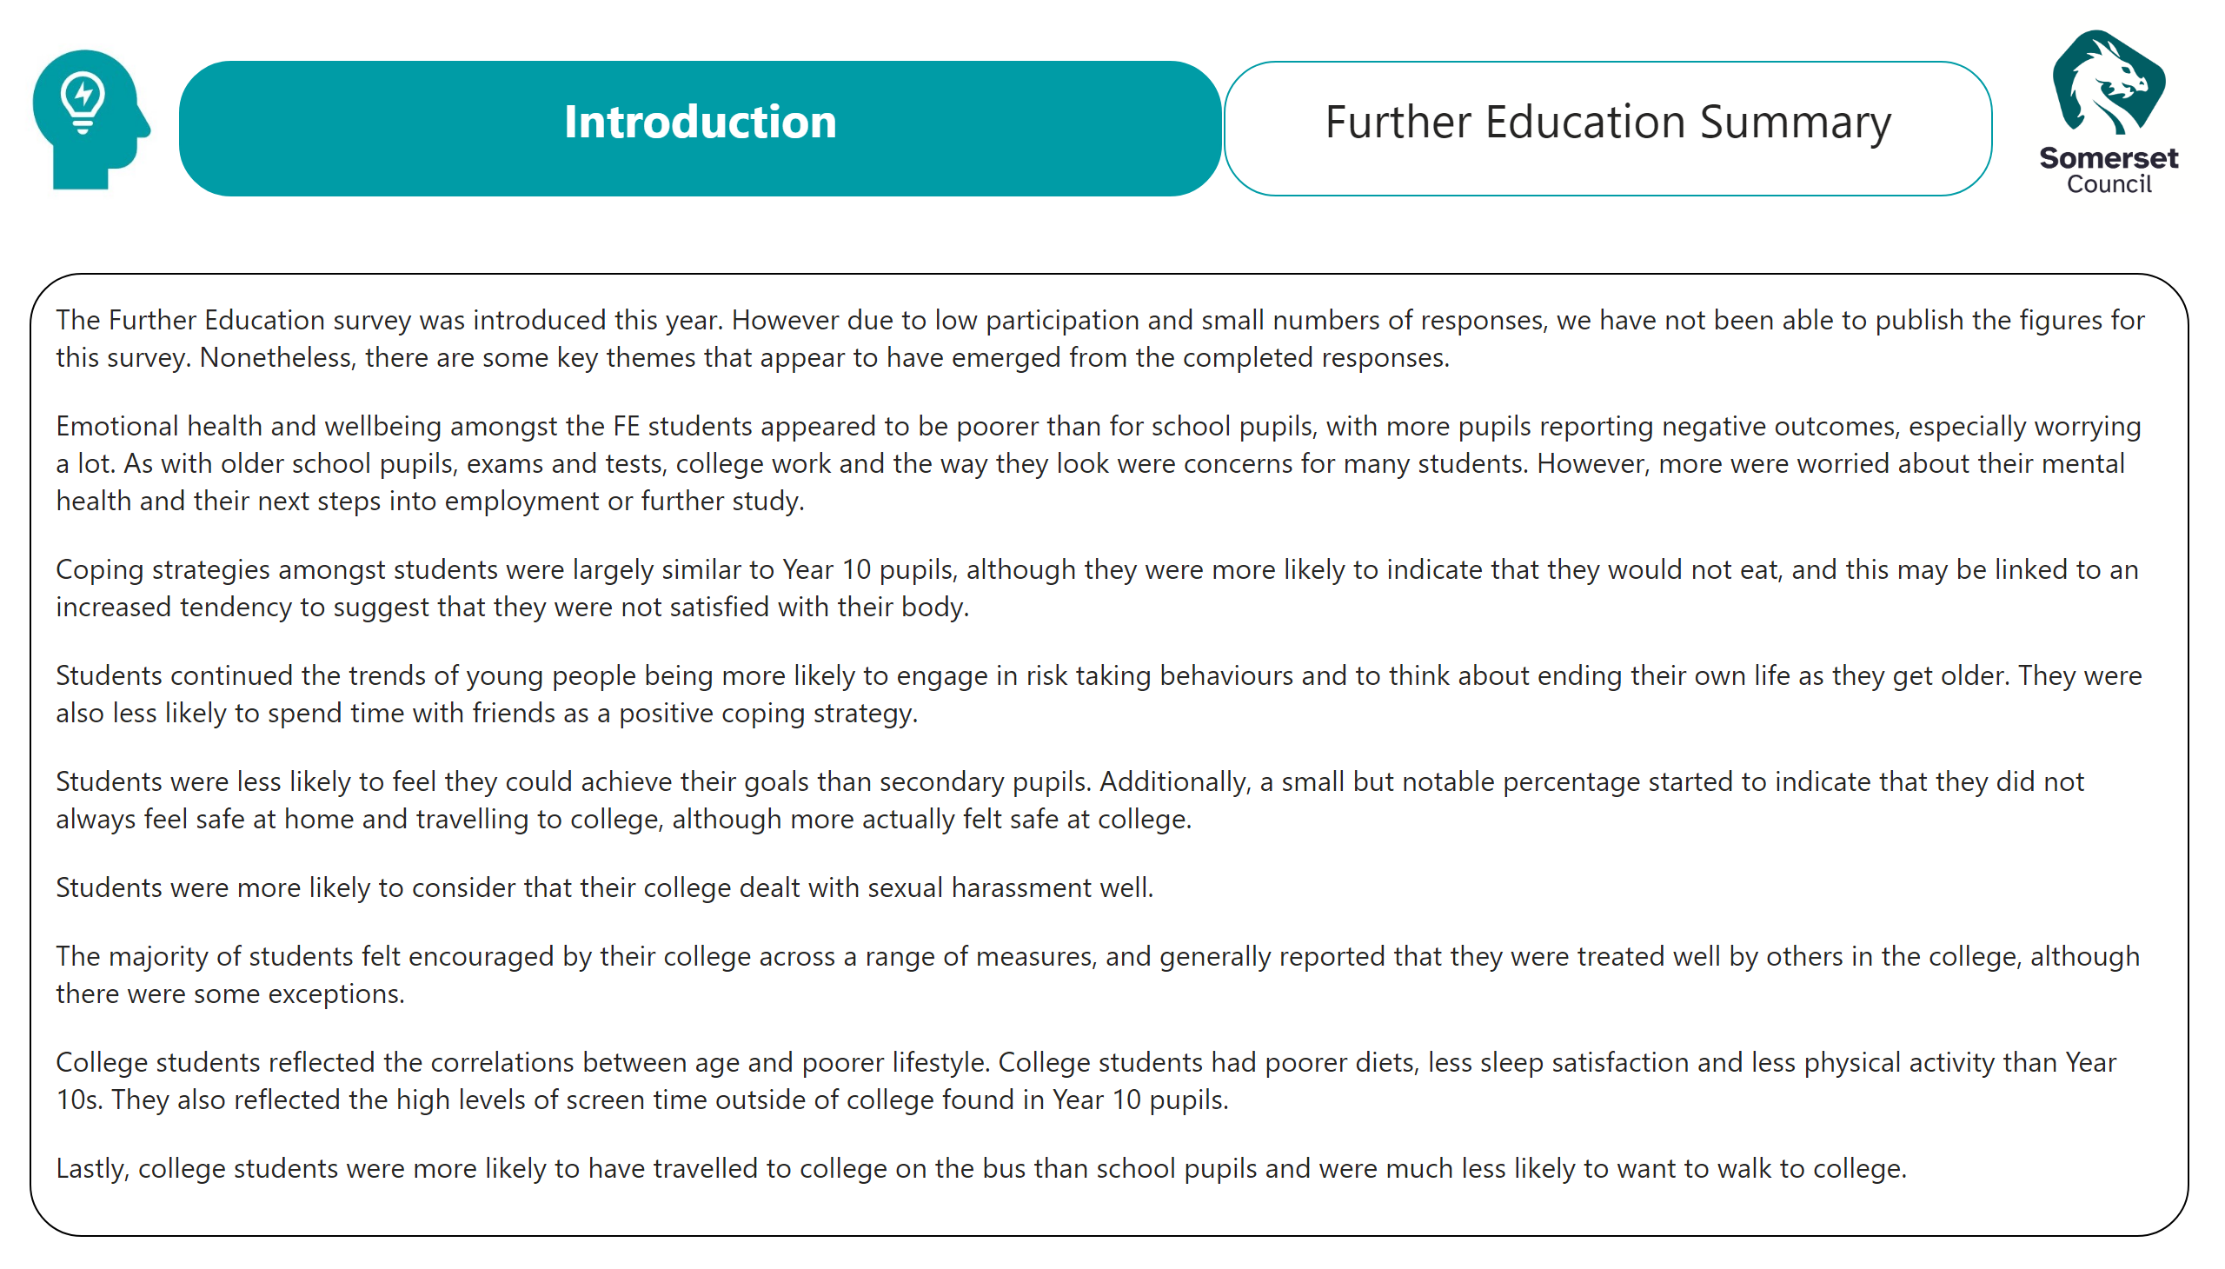
Further Education
Notes:
textbox
No alt text provided
textbox
No alt text provided
image
No alt text provided
image
No alt text provided
textbox
No alt text provided

Slide 13

Title - Key Themes
Notes:
image
No alt text provided
ReportNameSHAPE
No alt text provided
shape
No alt text provided
image
No alt text provided
ReportNameSHAPE
No alt text provided

Slide 14
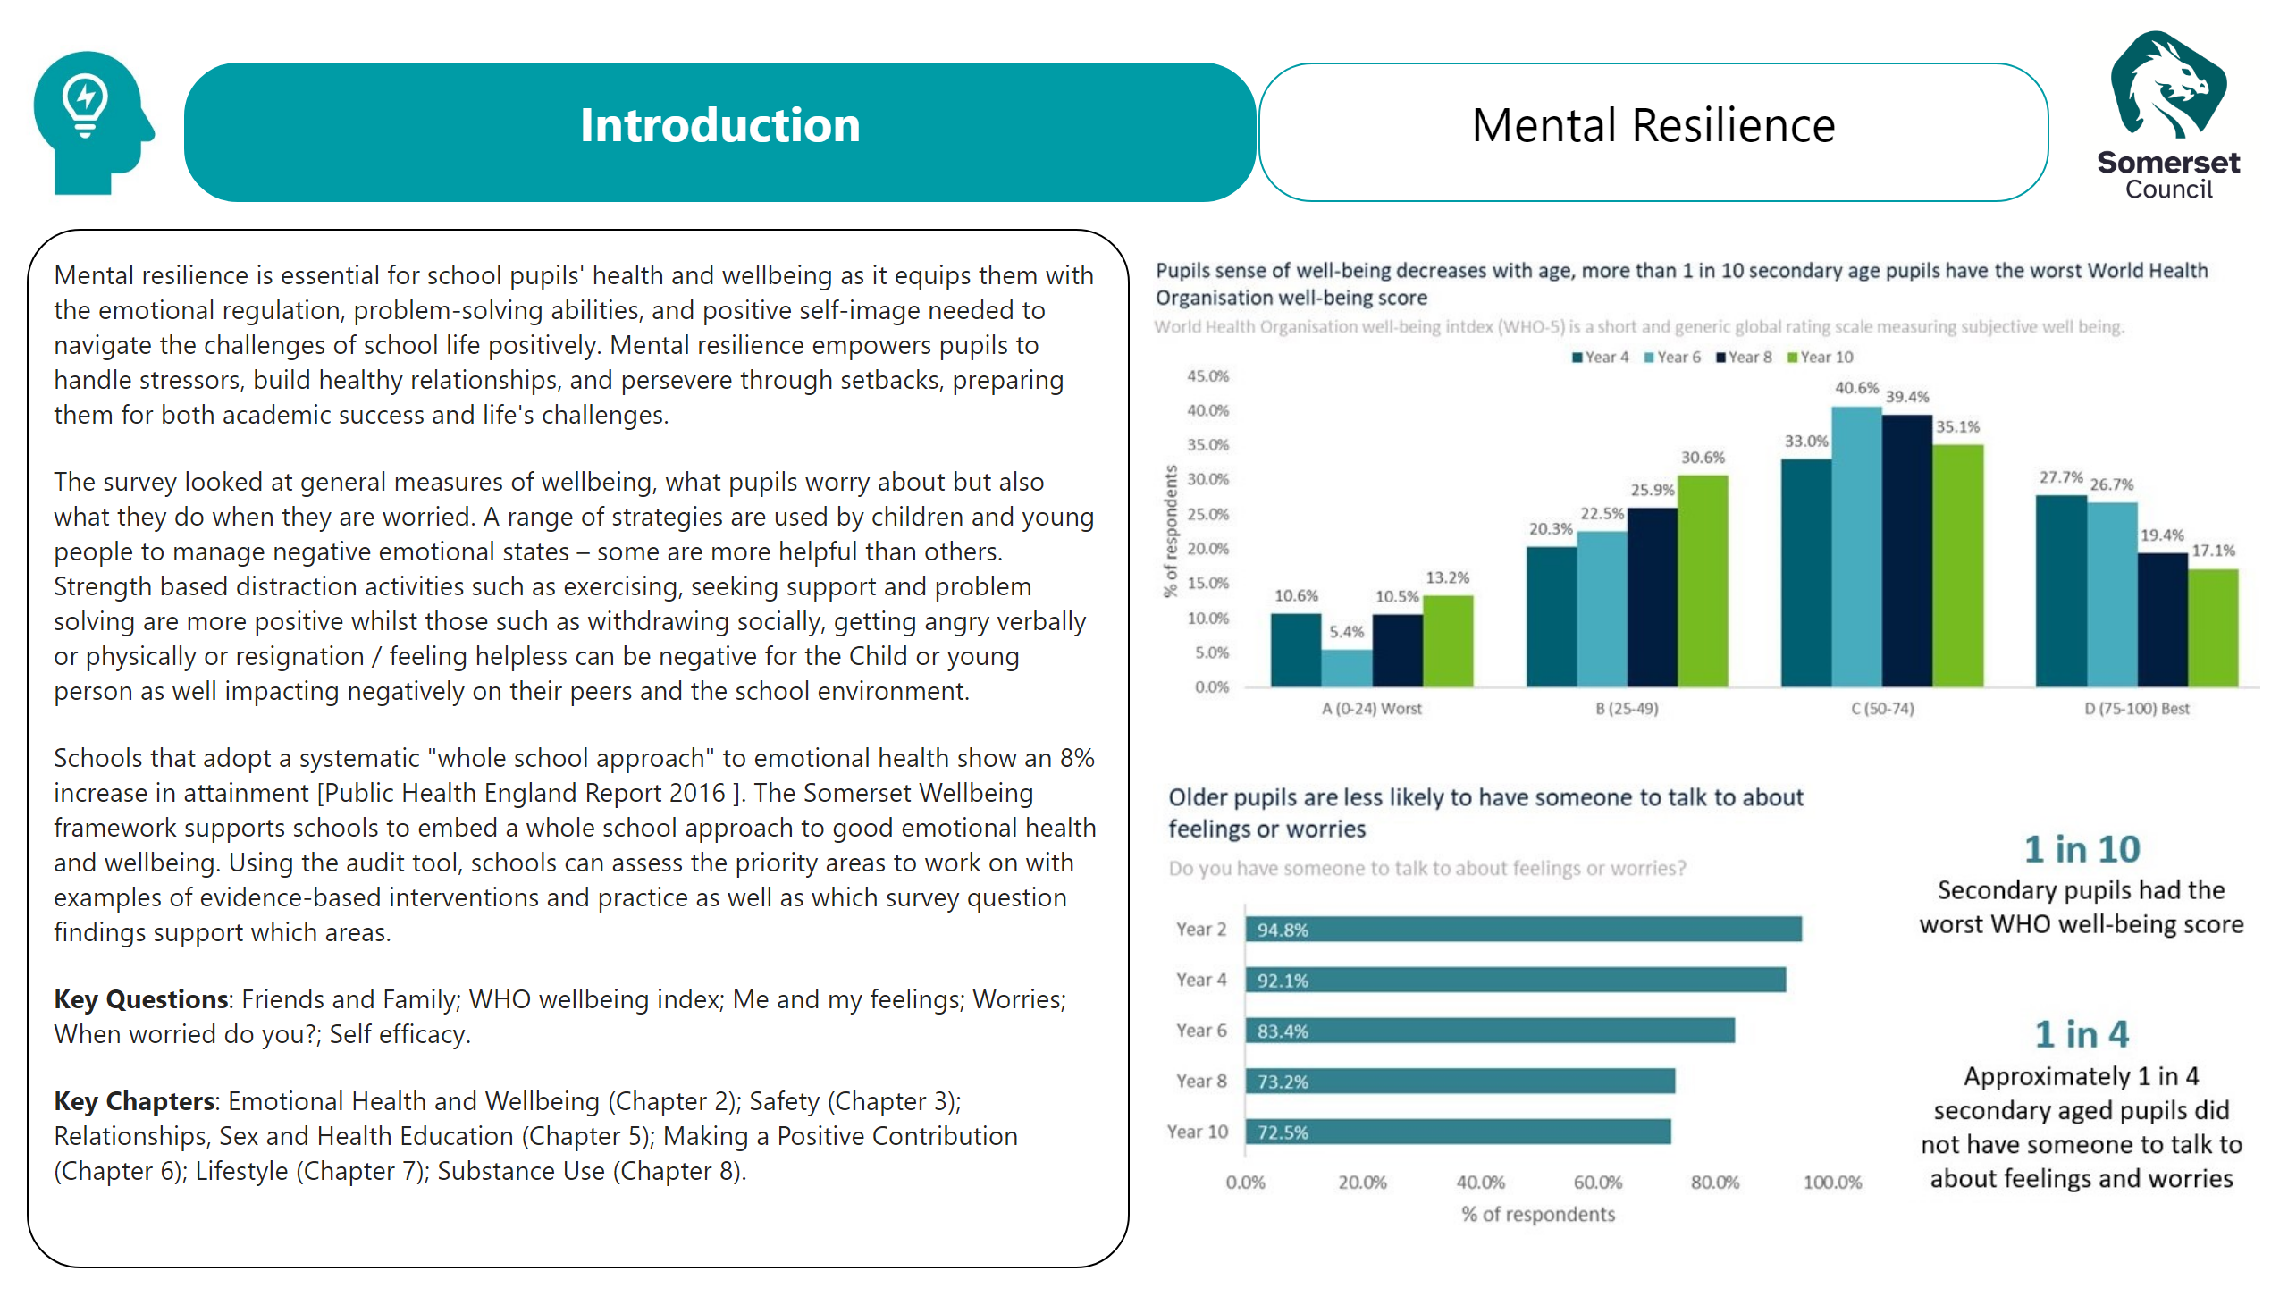
Mental Res
Notes:
image
No alt text provided
textbox
No alt text provided
textbox
No alt text provided
image
No alt text provided
textbox
No alt text provided
image
No alt text provided
image
No alt text provided
image
No alt text provided

Slide 15
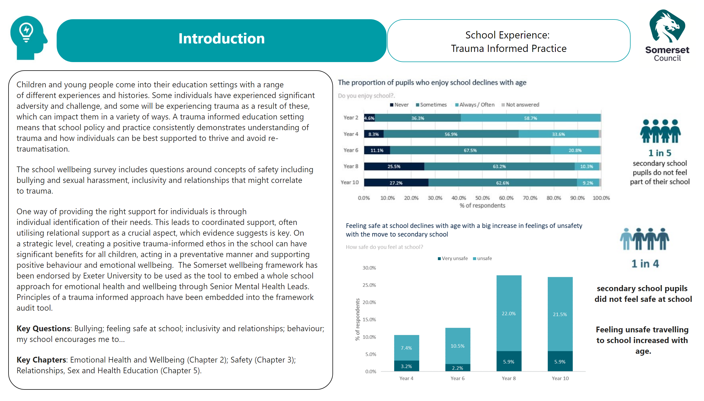
Trauma Informed Practice
Notes:
image
No alt text provided
textbox
No alt text provided
textbox
No alt text provided
image
No alt text provided
textbox
No alt text provided
image
No alt text provided
textbox
No alt text provided
image
No alt text provided
image
No alt text provided

Slide 16
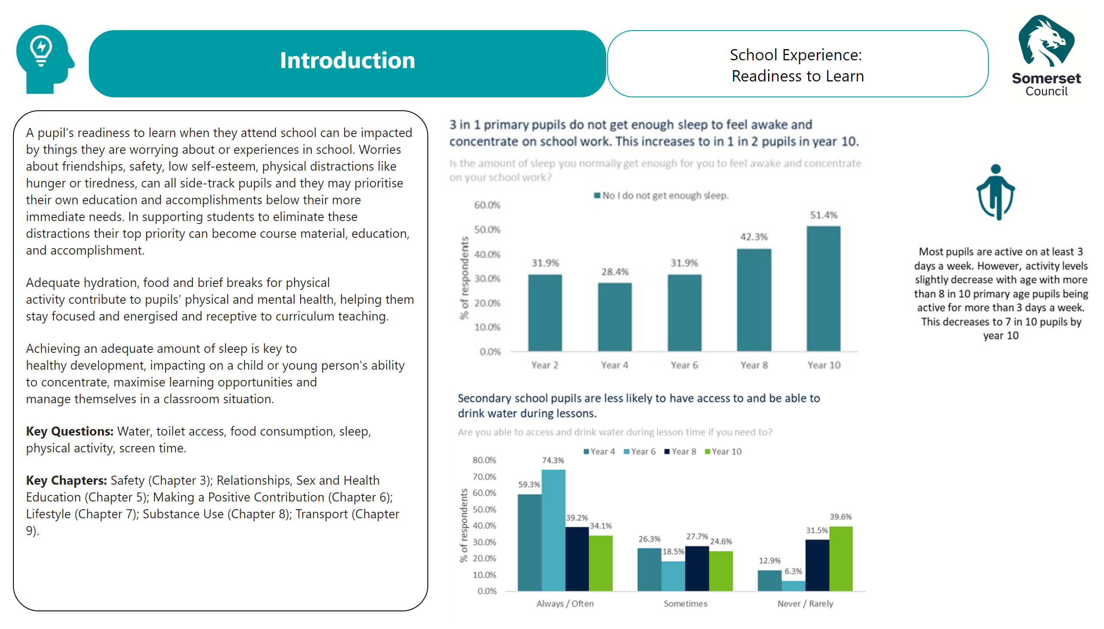
School Exp
Notes:
image
No alt text provided
textbox
No alt text provided
textbox
No alt text provided
image
No alt text provided
textbox
No alt text provided
image
No alt text provided
image
No alt text provided
image
No alt text provided

Slide 17

Title - Demographics
Notes:
image
No alt text provided
shape
No alt text provided
ReportNameSHAPE
No alt text provided
image
No alt text provided

Slide 18
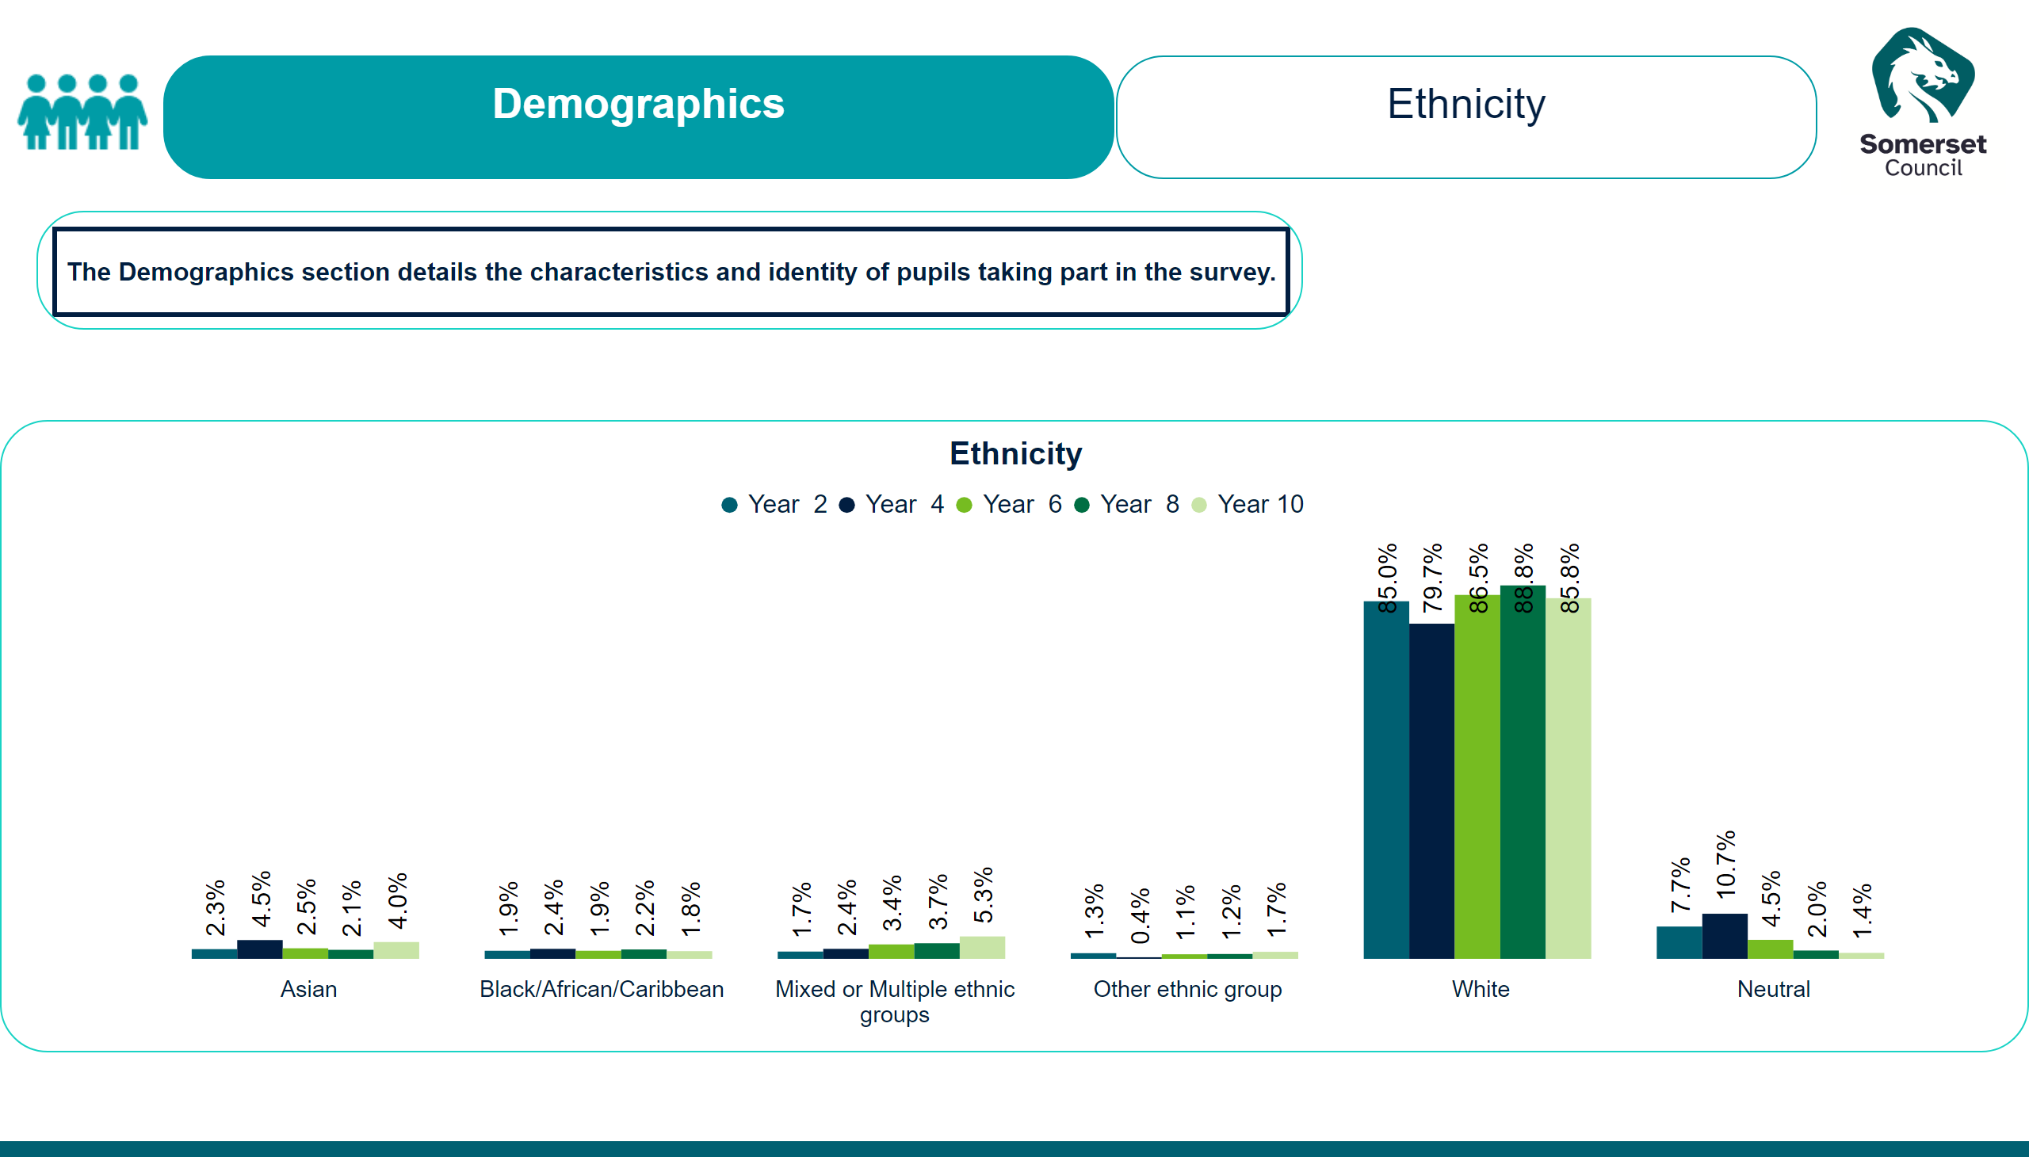
Demographics - Ethnicity
Notes:
textbox
No alt text provided
textbox
No alt text provided
image
No alt text provided
Ethnicity
No alt text provided
actionButton
No alt text provided
image
No alt text provided

Slide 19
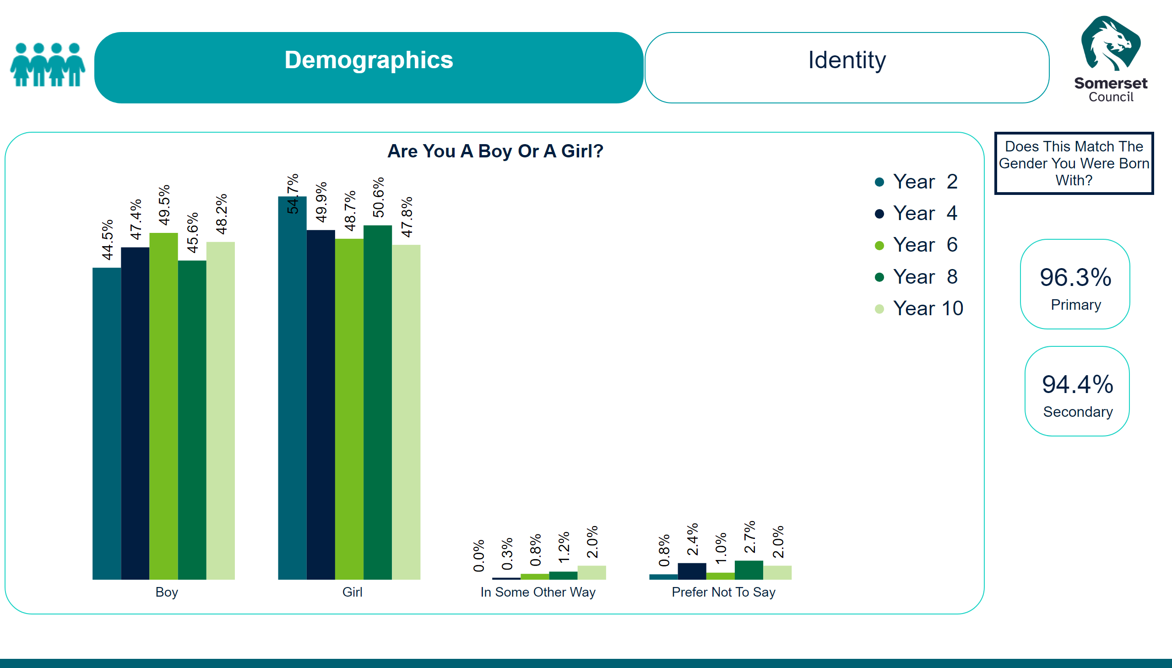
Demographics - Identity
Notes:
textbox
No alt text provided
image
No alt text provided
Are You A Boy Or A Girl?
No alt text provided
image
No alt text provided
textbox
No alt text provided
actionButton
No alt text provided
card
No alt text provided
card
No alt text provided

Slide 20
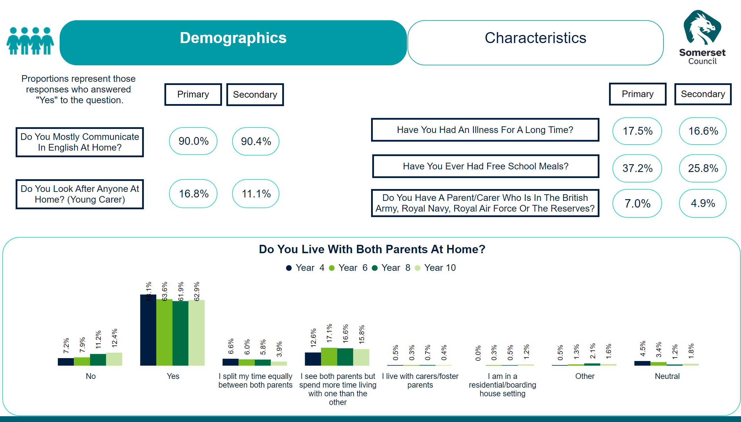
Demographics - Characteristics
Notes:
textbox
No alt text provided
textbox
No alt text provided
image
No alt text provided
actionButton
No alt text provided
actionButton
No alt text provided
actionButton
No alt text provided
actionButton
No alt text provided
card
No alt text provided
card
No alt text provided
card
No alt text provided
card
No alt text provided
card
No alt text provided
card
No alt text provided
card
No alt text provided
card
No alt text provided
card
No alt text provided
card
No alt text provided
Do You Live With Both Parents At Home?
No alt text provided
actionButton
No alt text provided
actionButton
No alt text provided
actionButton
No alt text provided
actionButton
No alt text provided
actionButton
No alt text provided
textbox
No alt text provided
image
No alt text provided

Slide 21
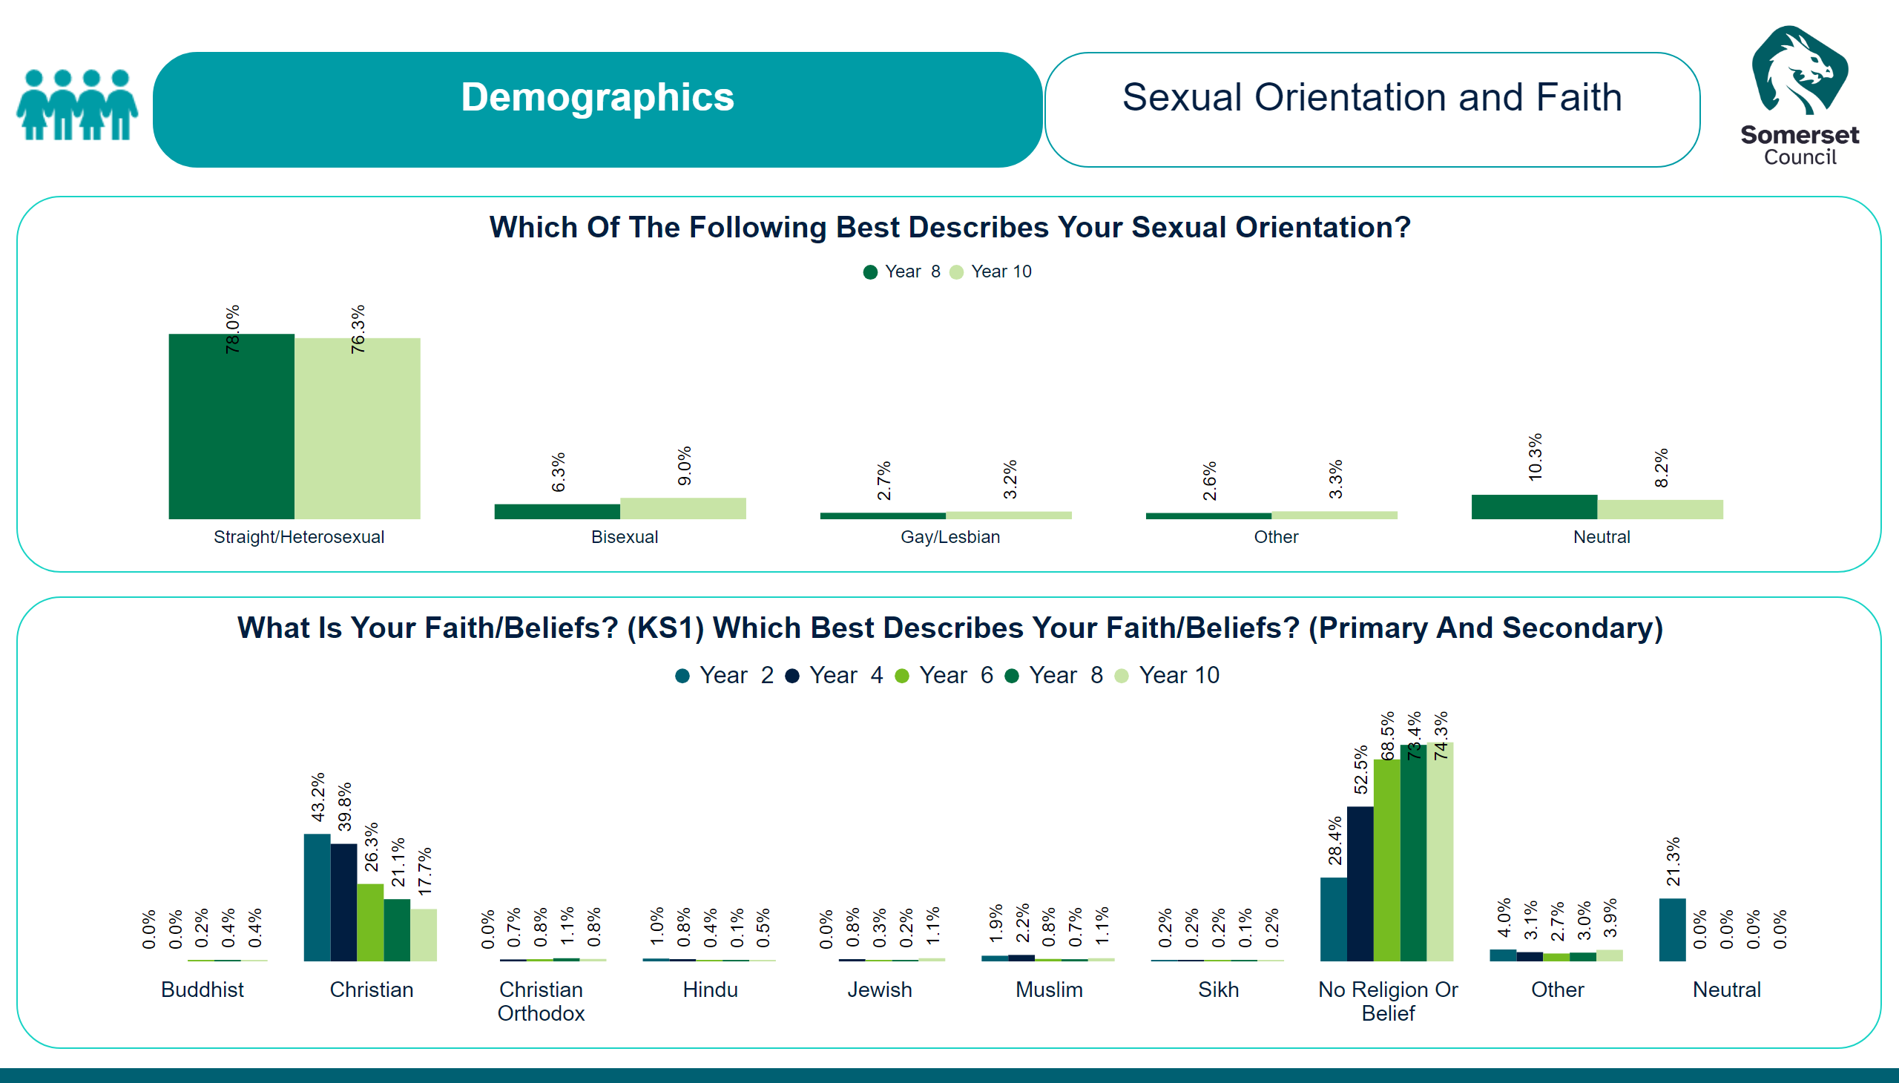
Demographics - Faith and Sexual Orientation
Notes:
textbox
No alt text provided
image
No alt text provided
Which Of The Following Best Describes Your Sexual Orientation?
No alt text provided
What Is Your Faith/Beliefs? (KS1) Which Best Describes Your Faith/Beliefs? (Primary And Secondary)
No alt text provided
textbox
No alt text provided
image
No alt text provided

Slide 22
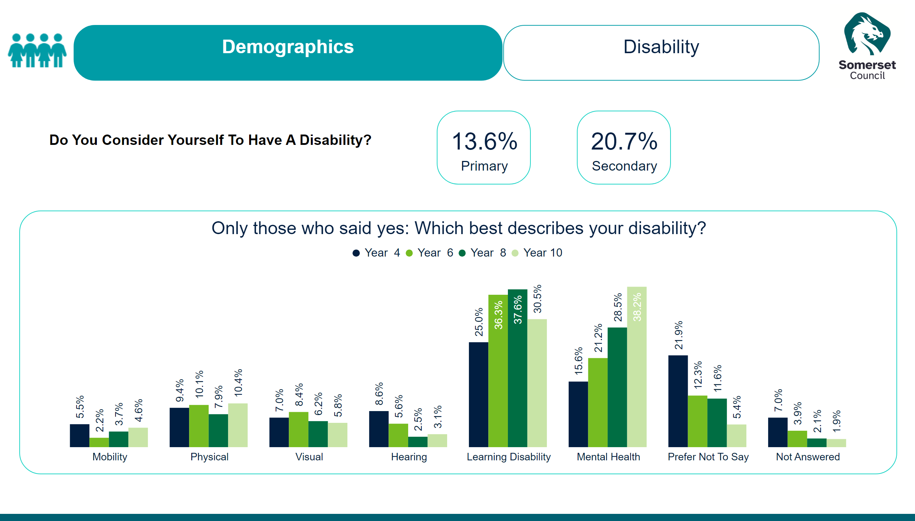
Demographics - Disability
Notes:
textbox
No alt text provided
image
No alt text provided
actionButton
No alt text provided
card
No alt text provided
card
No alt text provided
Only those who said yes: Which best describes your disability?
No alt text provided
textbox
No alt text provided
image
No alt text provided

Slide 23

Title - EHWB
Notes:
image
No alt text provided
ReportNameSHAPE
No alt text provided
image
No alt text provided
shape
No alt text provided

Slide 24
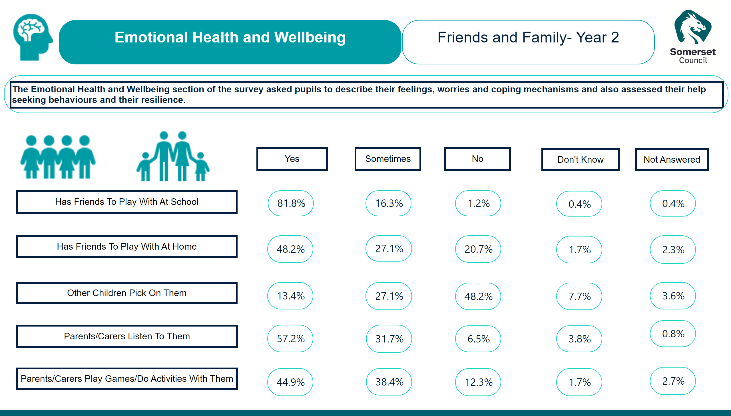
EHWB - Friends and Family
Notes:
image
No alt text provided
textbox
No alt text provided
textbox
No alt text provided
card
No alt text provided
image
No alt text provided
image
No alt text provided
card
No alt text provided
card
No alt text provided
card
No alt text provided
card
No alt text provided
card
No alt text provided
card
No alt text provided
card
No alt text provided
card
No alt text provided
card
No alt text provided
card
No alt text provided
card
No alt text provided
card
No alt text provided
card
No alt text provided
card
No alt text provided
actionButton
No alt text provided
actionButton
No alt text provided
actionButton
No alt text provided
actionButton
No alt text provided
actionButton
No alt text provided
actionButton
No alt text provided
actionButton
No alt text provided
actionButton
No alt text provided
actionButton
No alt text provided
actionButton
No alt text provided
card
No alt text provided
card
No alt text provided
card
No alt text provided
card
No alt text provided
card
No alt text provided
card
No alt text provided
card
No alt text provided
card
No alt text provided
card
No alt text provided
card
No alt text provided
actionButton
No alt text provided
image
No alt text provided

Slide 25
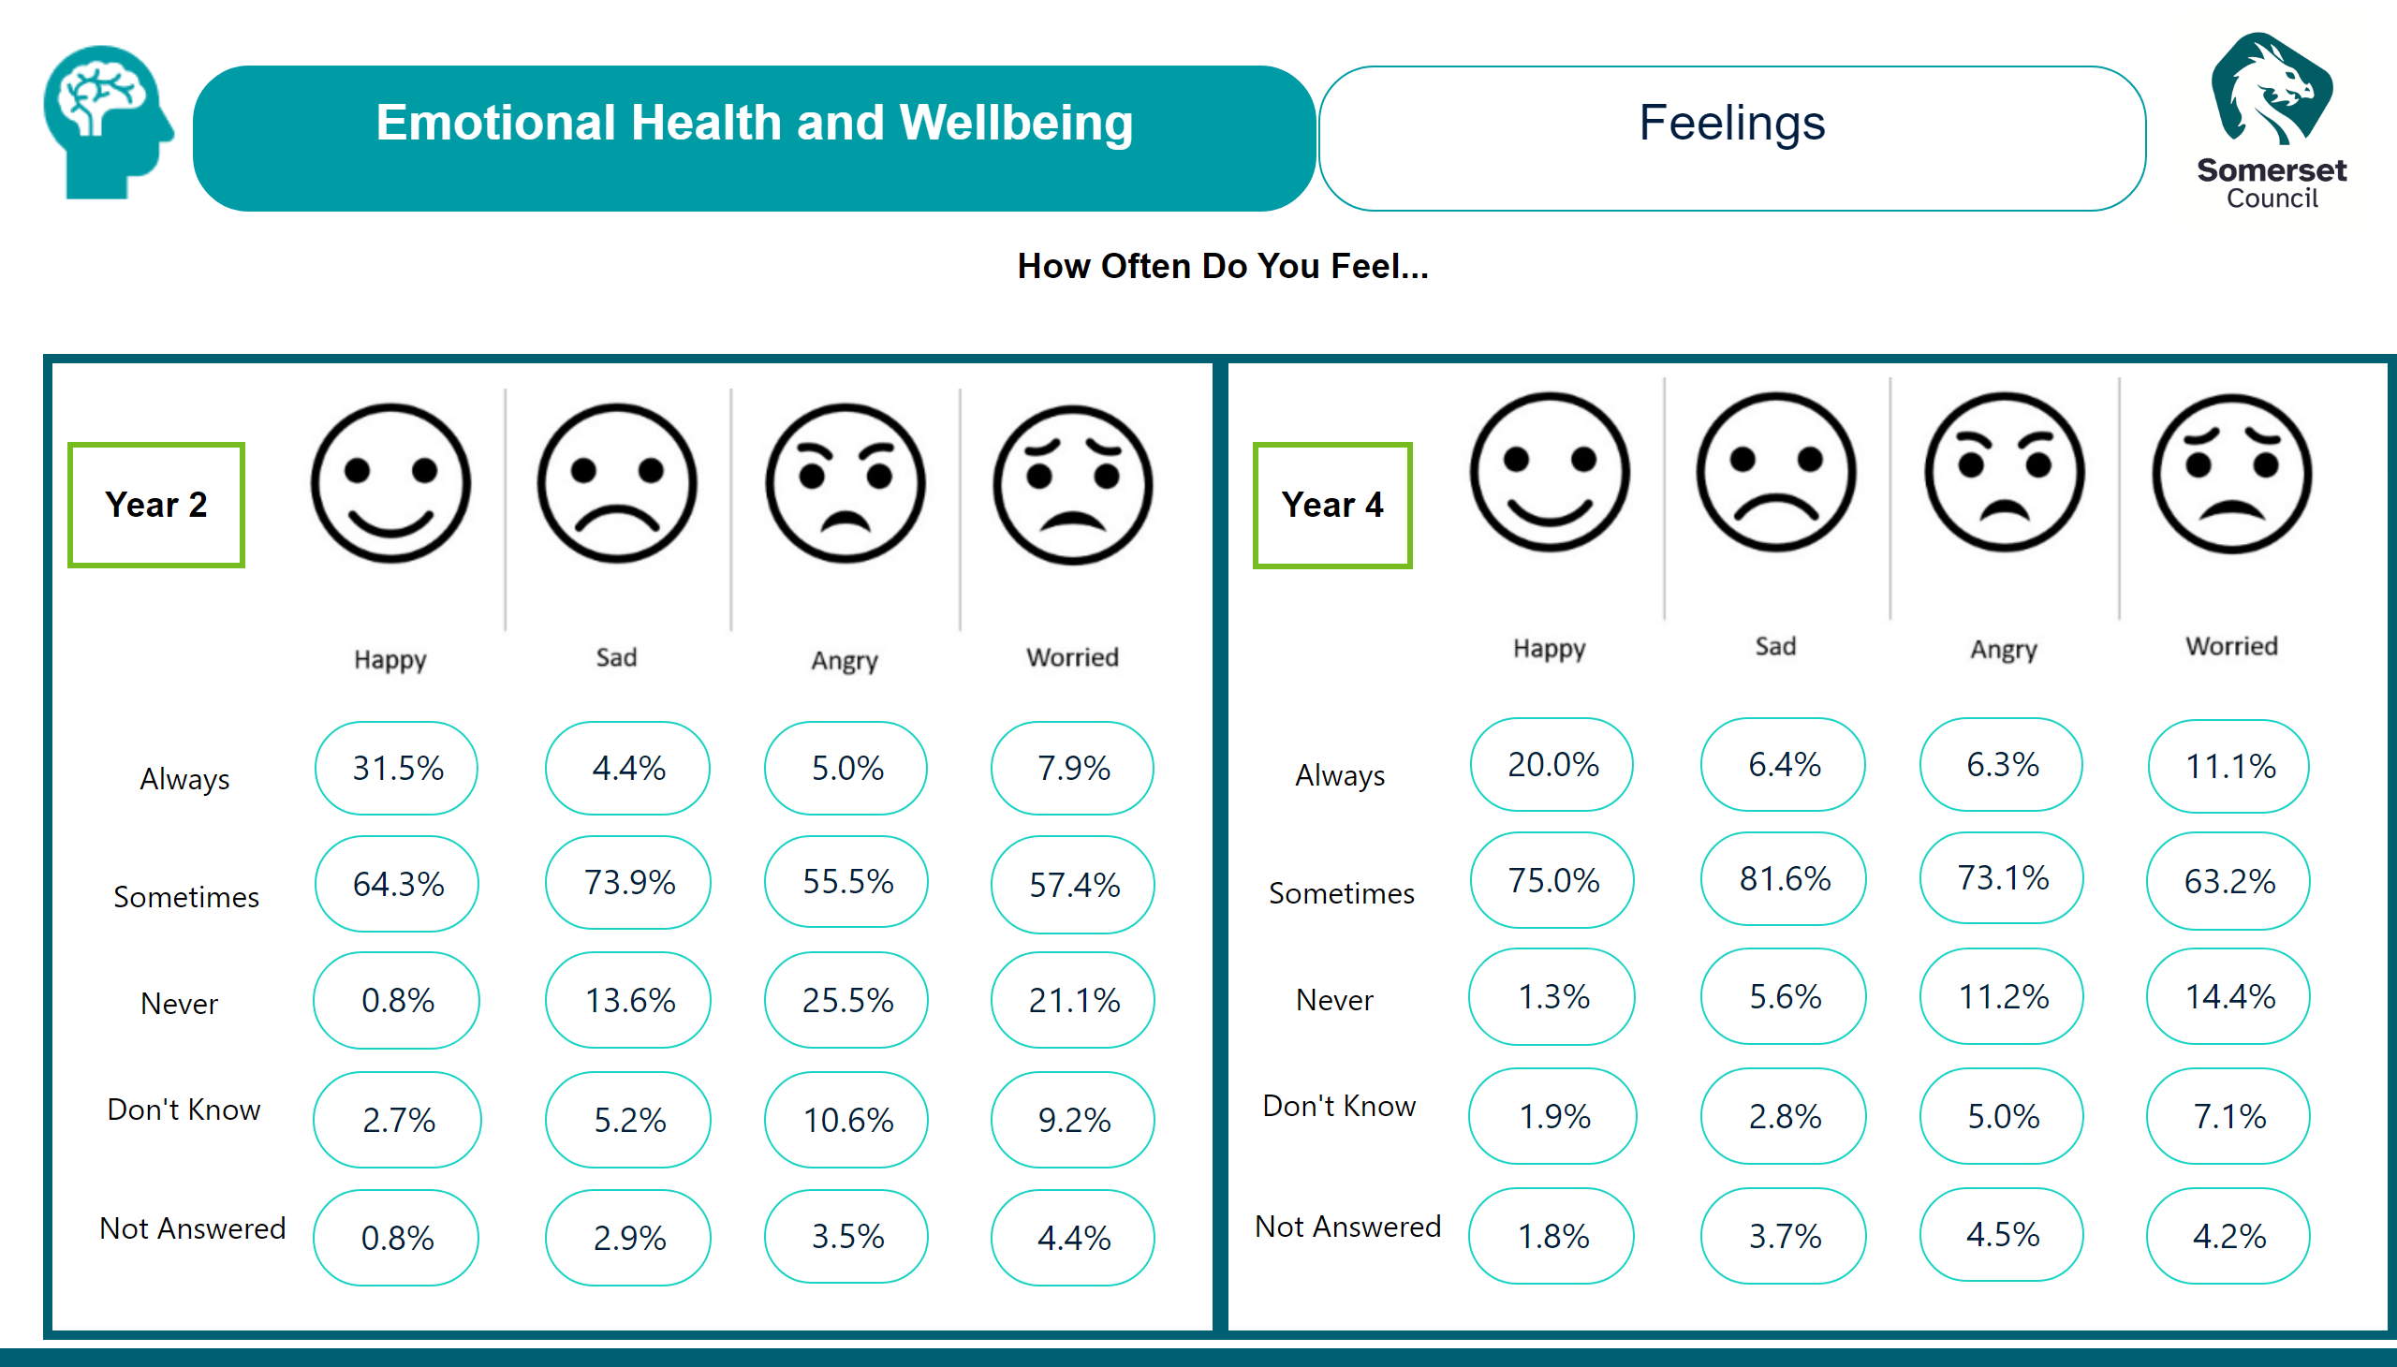
EHWB - Feelings
Notes:
image
No alt text provided
card
No alt text provided
card
No alt text provided
card
No alt text provided
textbox
No alt text provided
card
No alt text provided
card
No alt text provided
card
No alt text provided
card
No alt text provided
shape
No alt text provided
actionButton
No alt text provided
actionButton
No alt text provided
actionButton
No alt text provided
actionButton
No alt text provided
actionButton
No alt text provided
card
No alt text provided
card
No alt text provided
card
No alt text provided
card
No alt text provided
card
No alt text provided
image
No alt text provided
actionButton
No alt text provided
actionButton
No alt text provided
actionButton
No alt text provided
card
No alt text provided
card
No alt text provided
card
No alt text provided
card
No alt text provided
card
No alt text provided
card
No alt text provided
card
No alt text provided
card
No alt text provided
image
No alt text provided
card
No alt text provided
card
No alt text provided
card
No alt text provided
card
No alt text provided
card
No alt text provided
card
No alt text provided
card
No alt text provided
card
No alt text provided
card
No alt text provided
card
No alt text provided
card
No alt text provided
card
No alt text provided
actionButton
No alt text provided
actionButton
No alt text provided
card
No alt text provided
card
No alt text provided
card
No alt text provided
card
No alt text provided
card
No alt text provided
card
No alt text provided
card
No alt text provided
card
No alt text provided
actionButton
No alt text provided
actionButton
No alt text provided
actionButton
No alt text provided
shape
No alt text provided
image
No alt text provided
textbox
No alt text provided

Slide 26
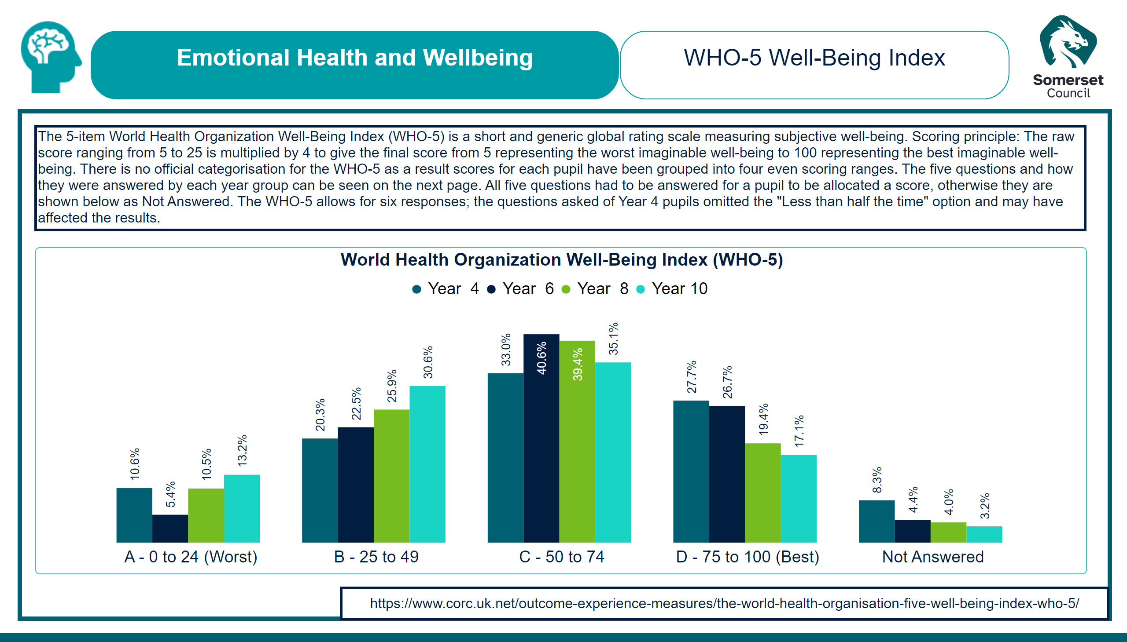
EHWB = WHO5 Wellbeing Index Overall
Notes:
image
No alt text provided
shape
No alt text provided
textbox
No alt text provided
actionButton
No alt text provided
World Health Organization Well-Being Index (WHO-5)
No alt text provided
actionButton
No alt text provided
image
No alt text provided
textbox
No alt text provided

Slide 27
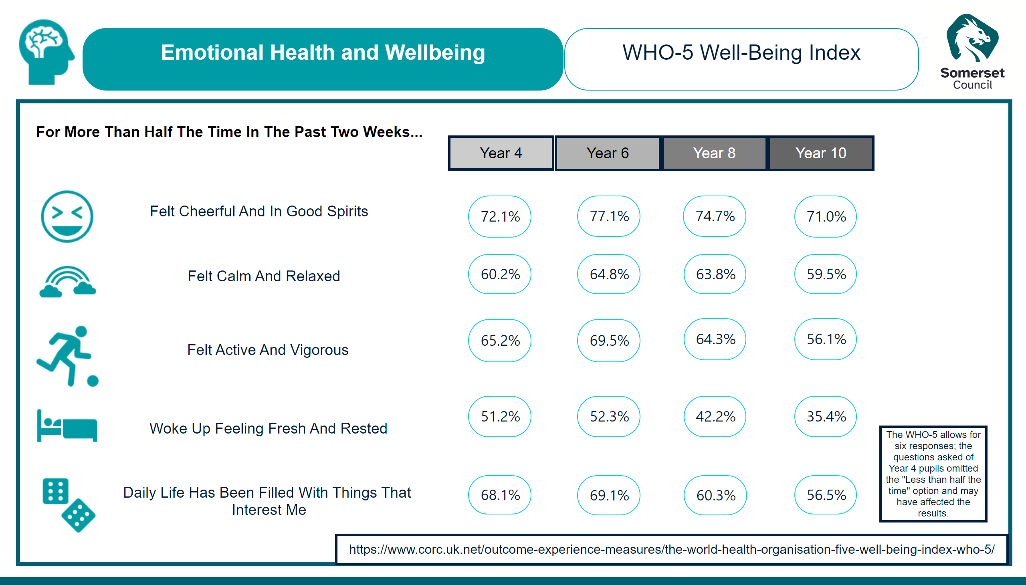
EHWB - WHO5 Wellbeing Index
Notes:
image
No alt text provided
image
No alt text provided
image
No alt text provided
image
No alt text provided
image
No alt text provided
image
No alt text provided
textbox
No alt text provided
textbox
No alt text provided
textbox
No alt text provided
textbox
No alt text provided
textbox
No alt text provided
shape
No alt text provided
card
No alt text provided
card
No alt text provided
card
No alt text provided
card
No alt text provided
card
No alt text provided
actionButton
No alt text provided
card
No alt text provided
card
No alt text provided
card
No alt text provided
card
No alt text provided
card
No alt text provided
actionButton
No alt text provided
actionButton
No alt text provided
actionButton
No alt text provided
card
No alt text provided
card
No alt text provided
card
No alt text provided
card
No alt text provided
card
No alt text provided
card
No alt text provided
card
No alt text provided
card
No alt text provided
card
No alt text provided
card
No alt text provided
textbox
No alt text provided
actionButton
No alt text provided
actionButton
No alt text provided
actionButton
No alt text provided
image
No alt text provided
textbox
No alt text provided

Slide 28
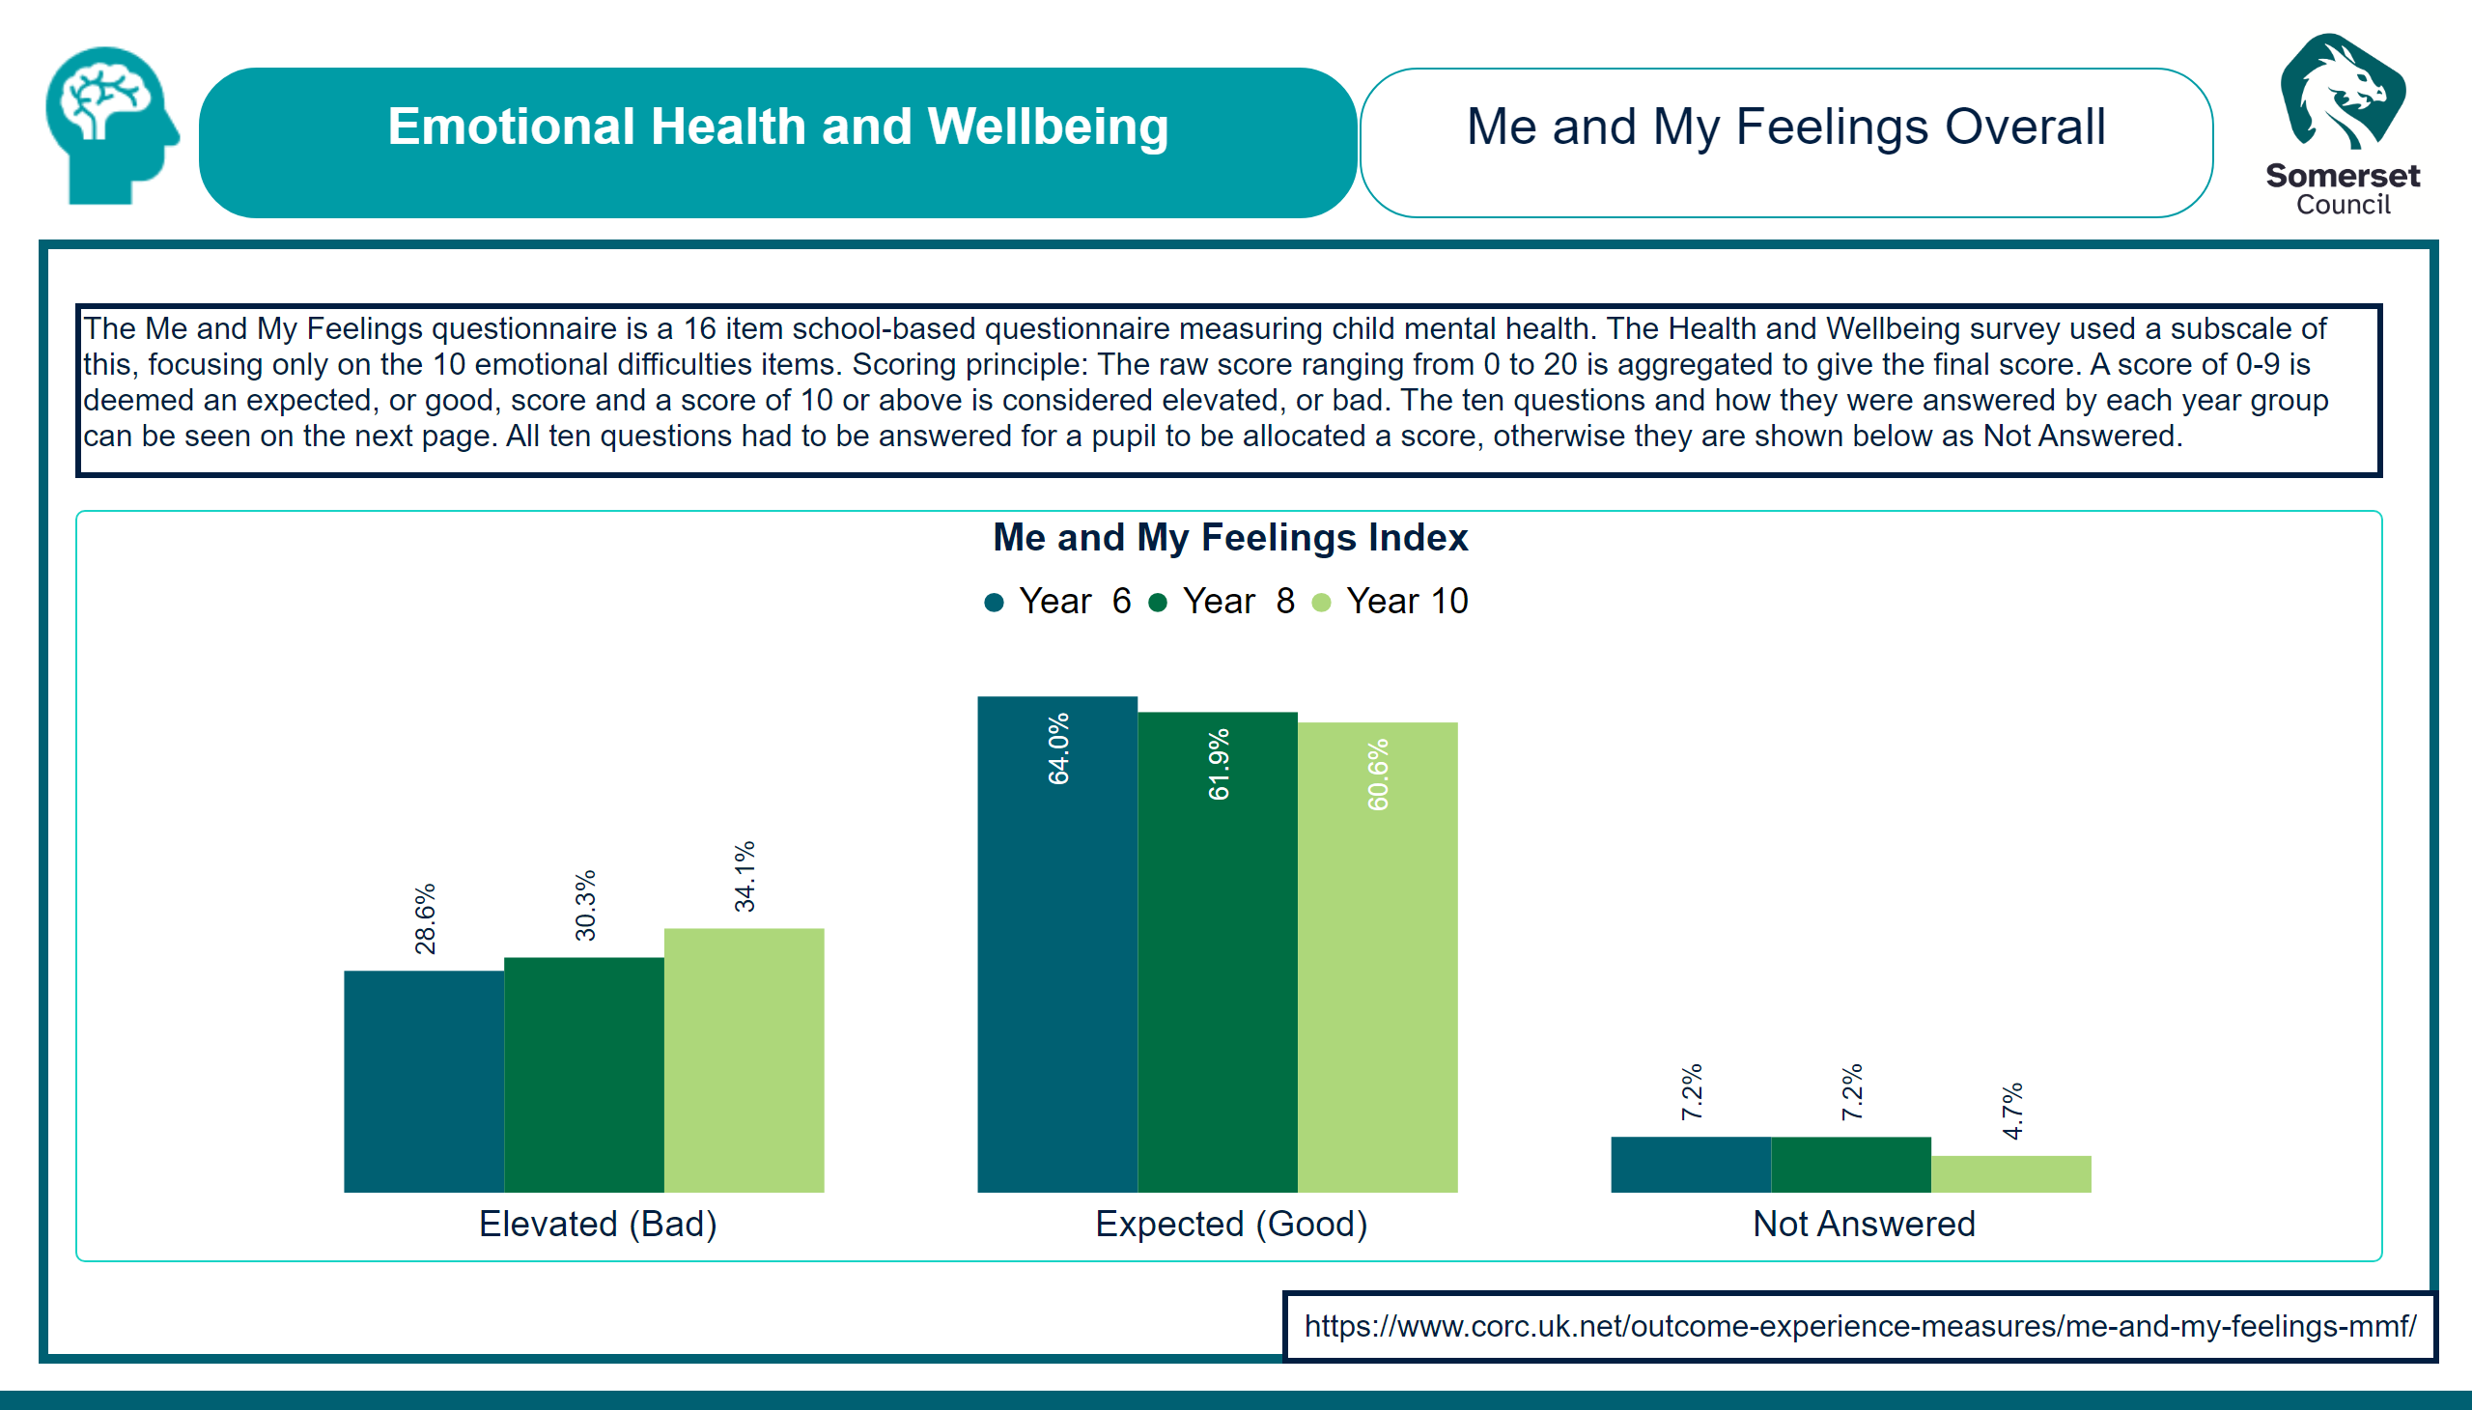
EHWB = Me and My Feelings Overall
Notes:
image
No alt text provided
shape
No alt text provided
textbox
No alt text provided
Me and My Feelings Index
No alt text provided
actionButton
No alt text provided
actionButton
No alt text provided
image
No alt text provided
textbox
No alt text provided

Slide 29
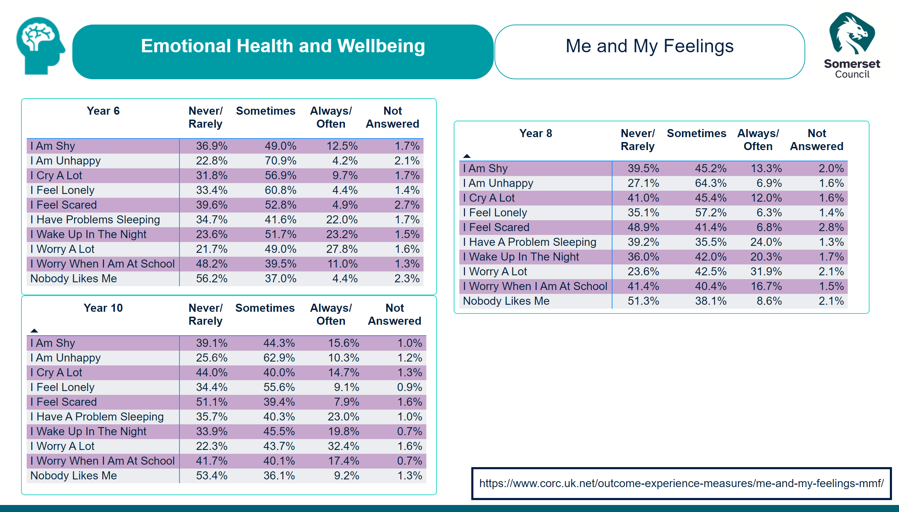
EHWB - Me and My Feelings
Notes:
textbox
No alt text provided
image
No alt text provided
Year 6
No alt text provided
Year 8
No alt text provided
Year 10
No alt text provided
actionButton
No alt text provided
image
No alt text provided
textbox
No alt text provided

Slide 30
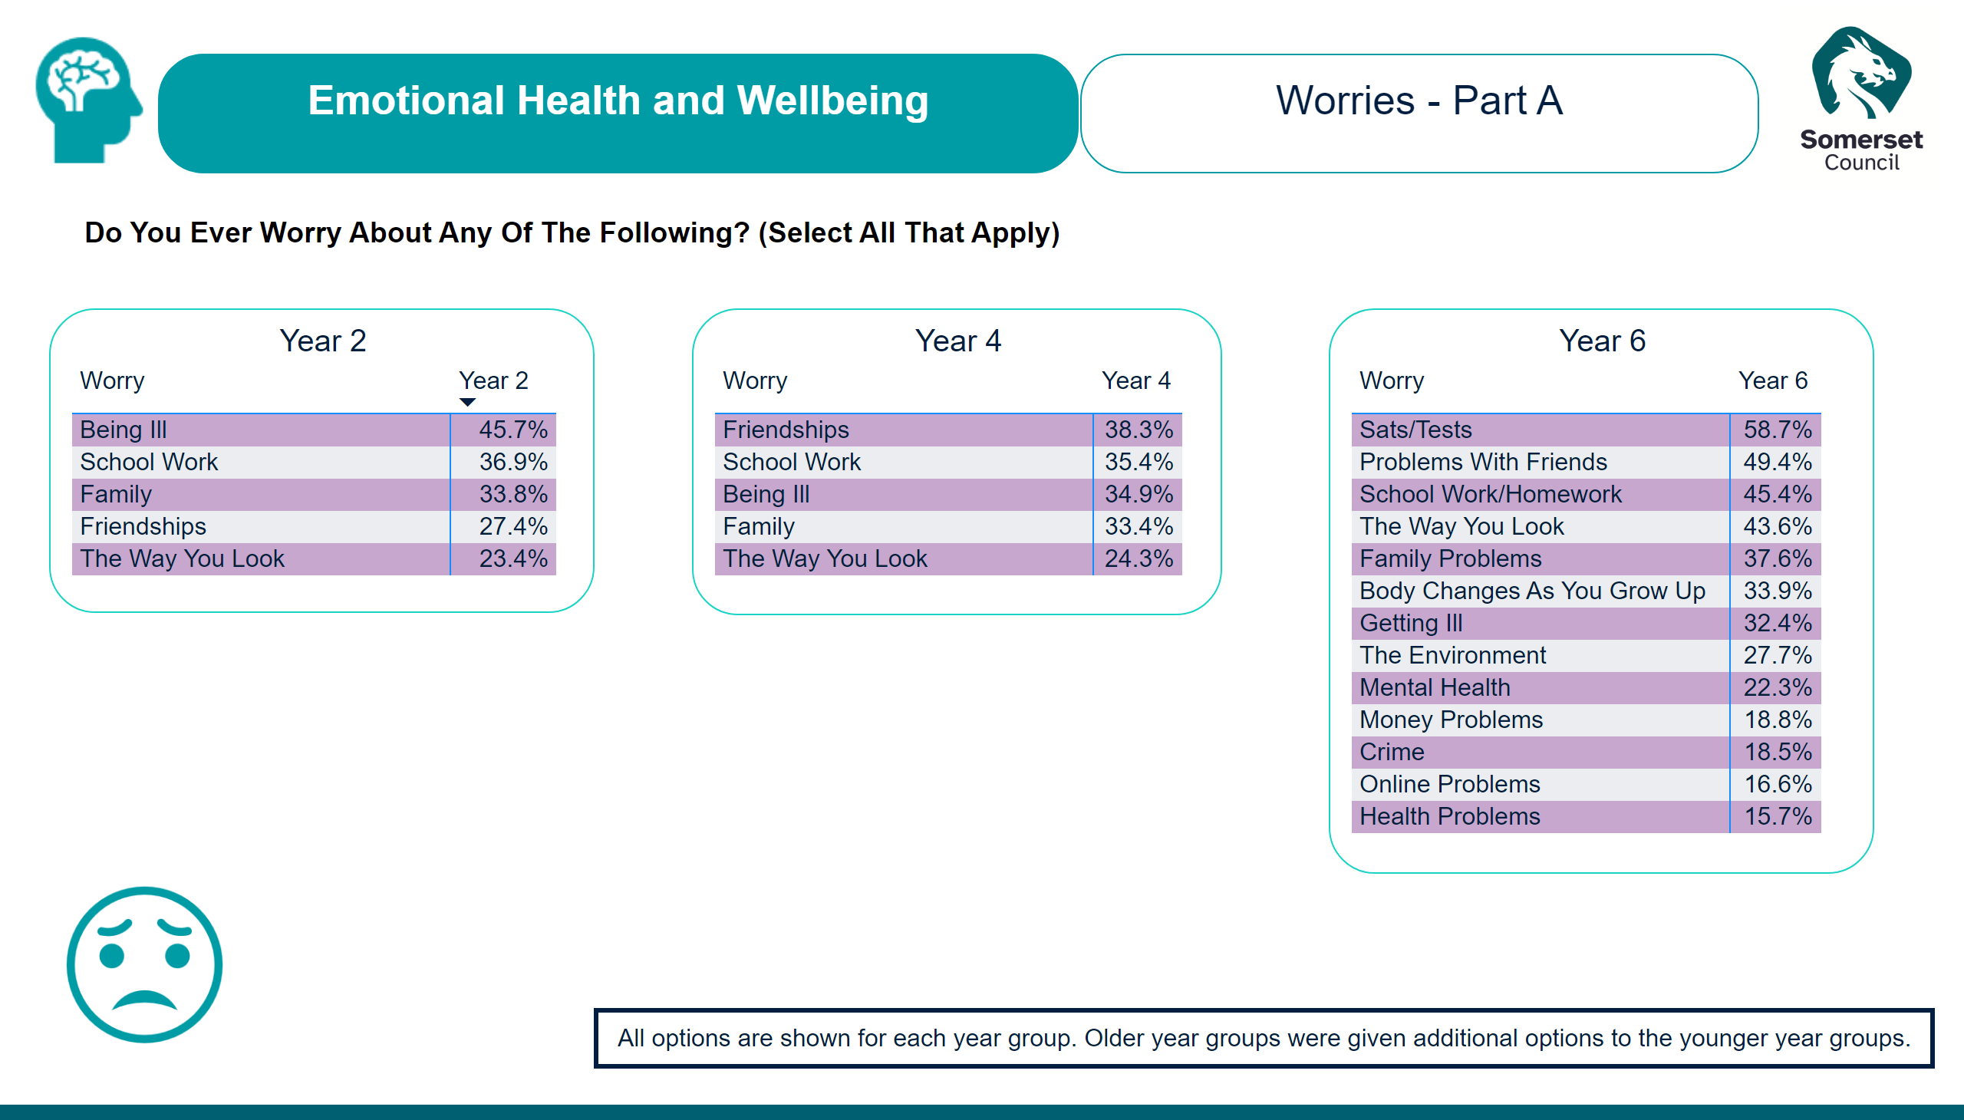
EHWB - Worries Part A
Notes:
image
No alt text provided
textbox
No alt text provided
Year 4
No alt text provided
Year 2
No alt text provided
Year 6
No alt text provided
actionButton
No alt text provided
image
No alt text provided
actionButton
No alt text provided
image
No alt text provided
textbox
No alt text provided

Slide 31
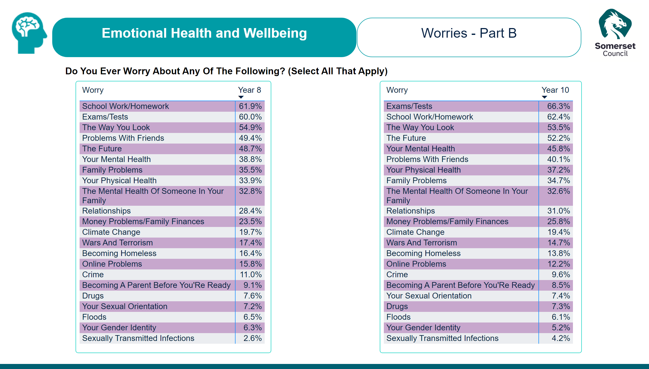
EHWB - Worries Part B
Notes:
image
No alt text provided
textbox
No alt text provided
Year 10
No alt text provided
Year 8
No alt text provided
actionButton
No alt text provided
image
No alt text provided
textbox
No alt text provided

Slide 32
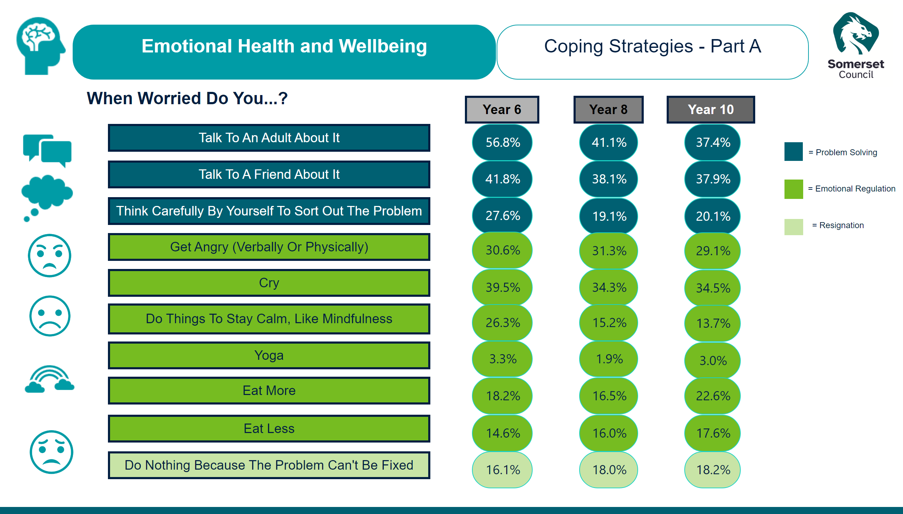
EHWB - Coping Strategies Part A
Notes:
textbox
No alt text provided
image
No alt text provided
textbox
No alt text provided
image
No alt text provided
image
No alt text provided
card
No alt text provided
image
No alt text provided
image
No alt text provided
actionButton
No alt text provided
actionButton
No alt text provided
actionButton
No alt text provided
actionButton
No alt text provided
actionButton
No alt text provided
actionButton
No alt text provided
actionButton
No alt text provided
actionButton
No alt text provided
actionButton
No alt text provided
actionButton
No alt text provided
actionButton
No alt text provided
actionButton
No alt text provided
actionButton
No alt text provided
card
No alt text provided
card
No alt text provided
card
No alt text provided
card
No alt text provided
card
No alt text provided
card
No alt text provided
card
No alt text provided
card
No alt text provided
card
No alt text provided
card
No alt text provided
card
No alt text provided
card
No alt text provided
card
No alt text provided
card
No alt text provided
card
No alt text provided
card
No alt text provided
card
No alt text provided
card
No alt text provided
card
No alt text provided
card
No alt text provided
card
No alt text provided
card
No alt text provided
card
No alt text provided
card
No alt text provided
card
No alt text provided
card
No alt text provided
card
No alt text provided
card
No alt text provided
card
No alt text provided
image
No alt text provided
image
No alt text provided
actionButton
No alt text provided
actionButton
No alt text provided
actionButton
No alt text provided
actionButton
No alt text provided
actionButton
No alt text provided
actionButton
No alt text provided
image
No alt text provided
textbox
No alt text provided

Slide 33
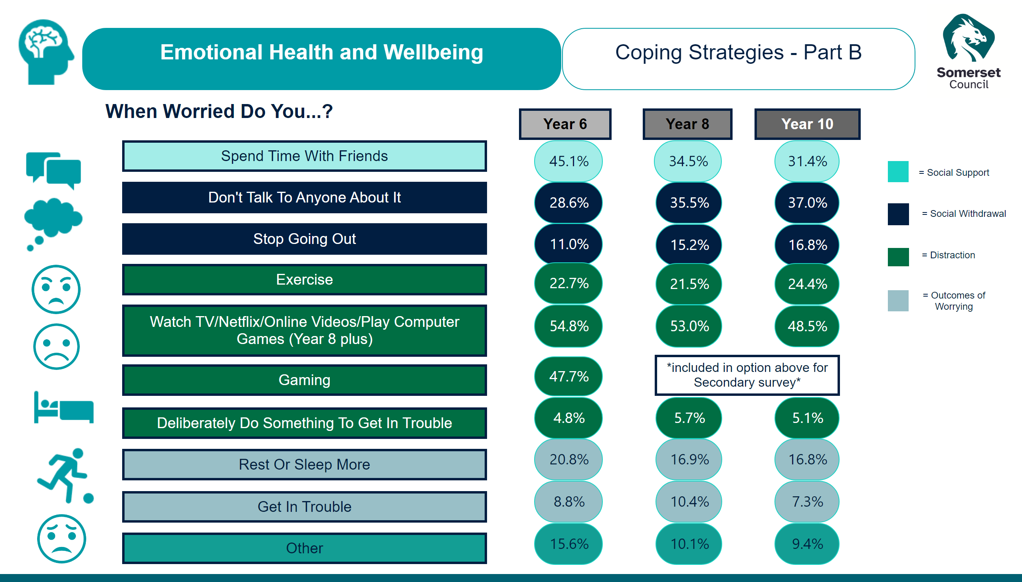
EHWB - Coping Strategies Part B
Notes:
textbox
No alt text provided
image
No alt text provided
textbox
No alt text provided
image
No alt text provided
image
No alt text provided
image
No alt text provided
image
No alt text provided
card
No alt text provided
image
No alt text provided
image
No alt text provided
actionButton
No alt text provided
actionButton
No alt text provided
actionButton
No alt text provided
actionButton
No alt text provided
actionButton
No alt text provided
actionButton
No alt text provided
actionButton
No alt text provided
actionButton
No alt text provided
actionButton
No alt text provided
actionButton
No alt text provided
card
No alt text provided
card
No alt text provided
card
No alt text provided
card
No alt text provided
card
No alt text provided
card
No alt text provided
card
No alt text provided
card
No alt text provided
card
No alt text provided
image
No alt text provided
card
No alt text provided
card
No alt text provided
card
No alt text provided
card
No alt text provided
card
No alt text provided
card
No alt text provided
card
No alt text provided
card
No alt text provided
card
No alt text provided
card
No alt text provided
actionButton
No alt text provided
card
No alt text provided
card
No alt text provided
card
No alt text provided
card
No alt text provided
card
No alt text provided
card
No alt text provided
card
No alt text provided
card
No alt text provided
actionButton
No alt text provided
actionButton
No alt text provided
actionButton
No alt text provided
actionButton
No alt text provided
actionButton
No alt text provided
actionButton
No alt text provided
actionButton
No alt text provided
actionButton
No alt text provided
actionButton
No alt text provided
actionButton
No alt text provided
actionButton
No alt text provided
image
No alt text provided
textbox
No alt text provided

Slide 34
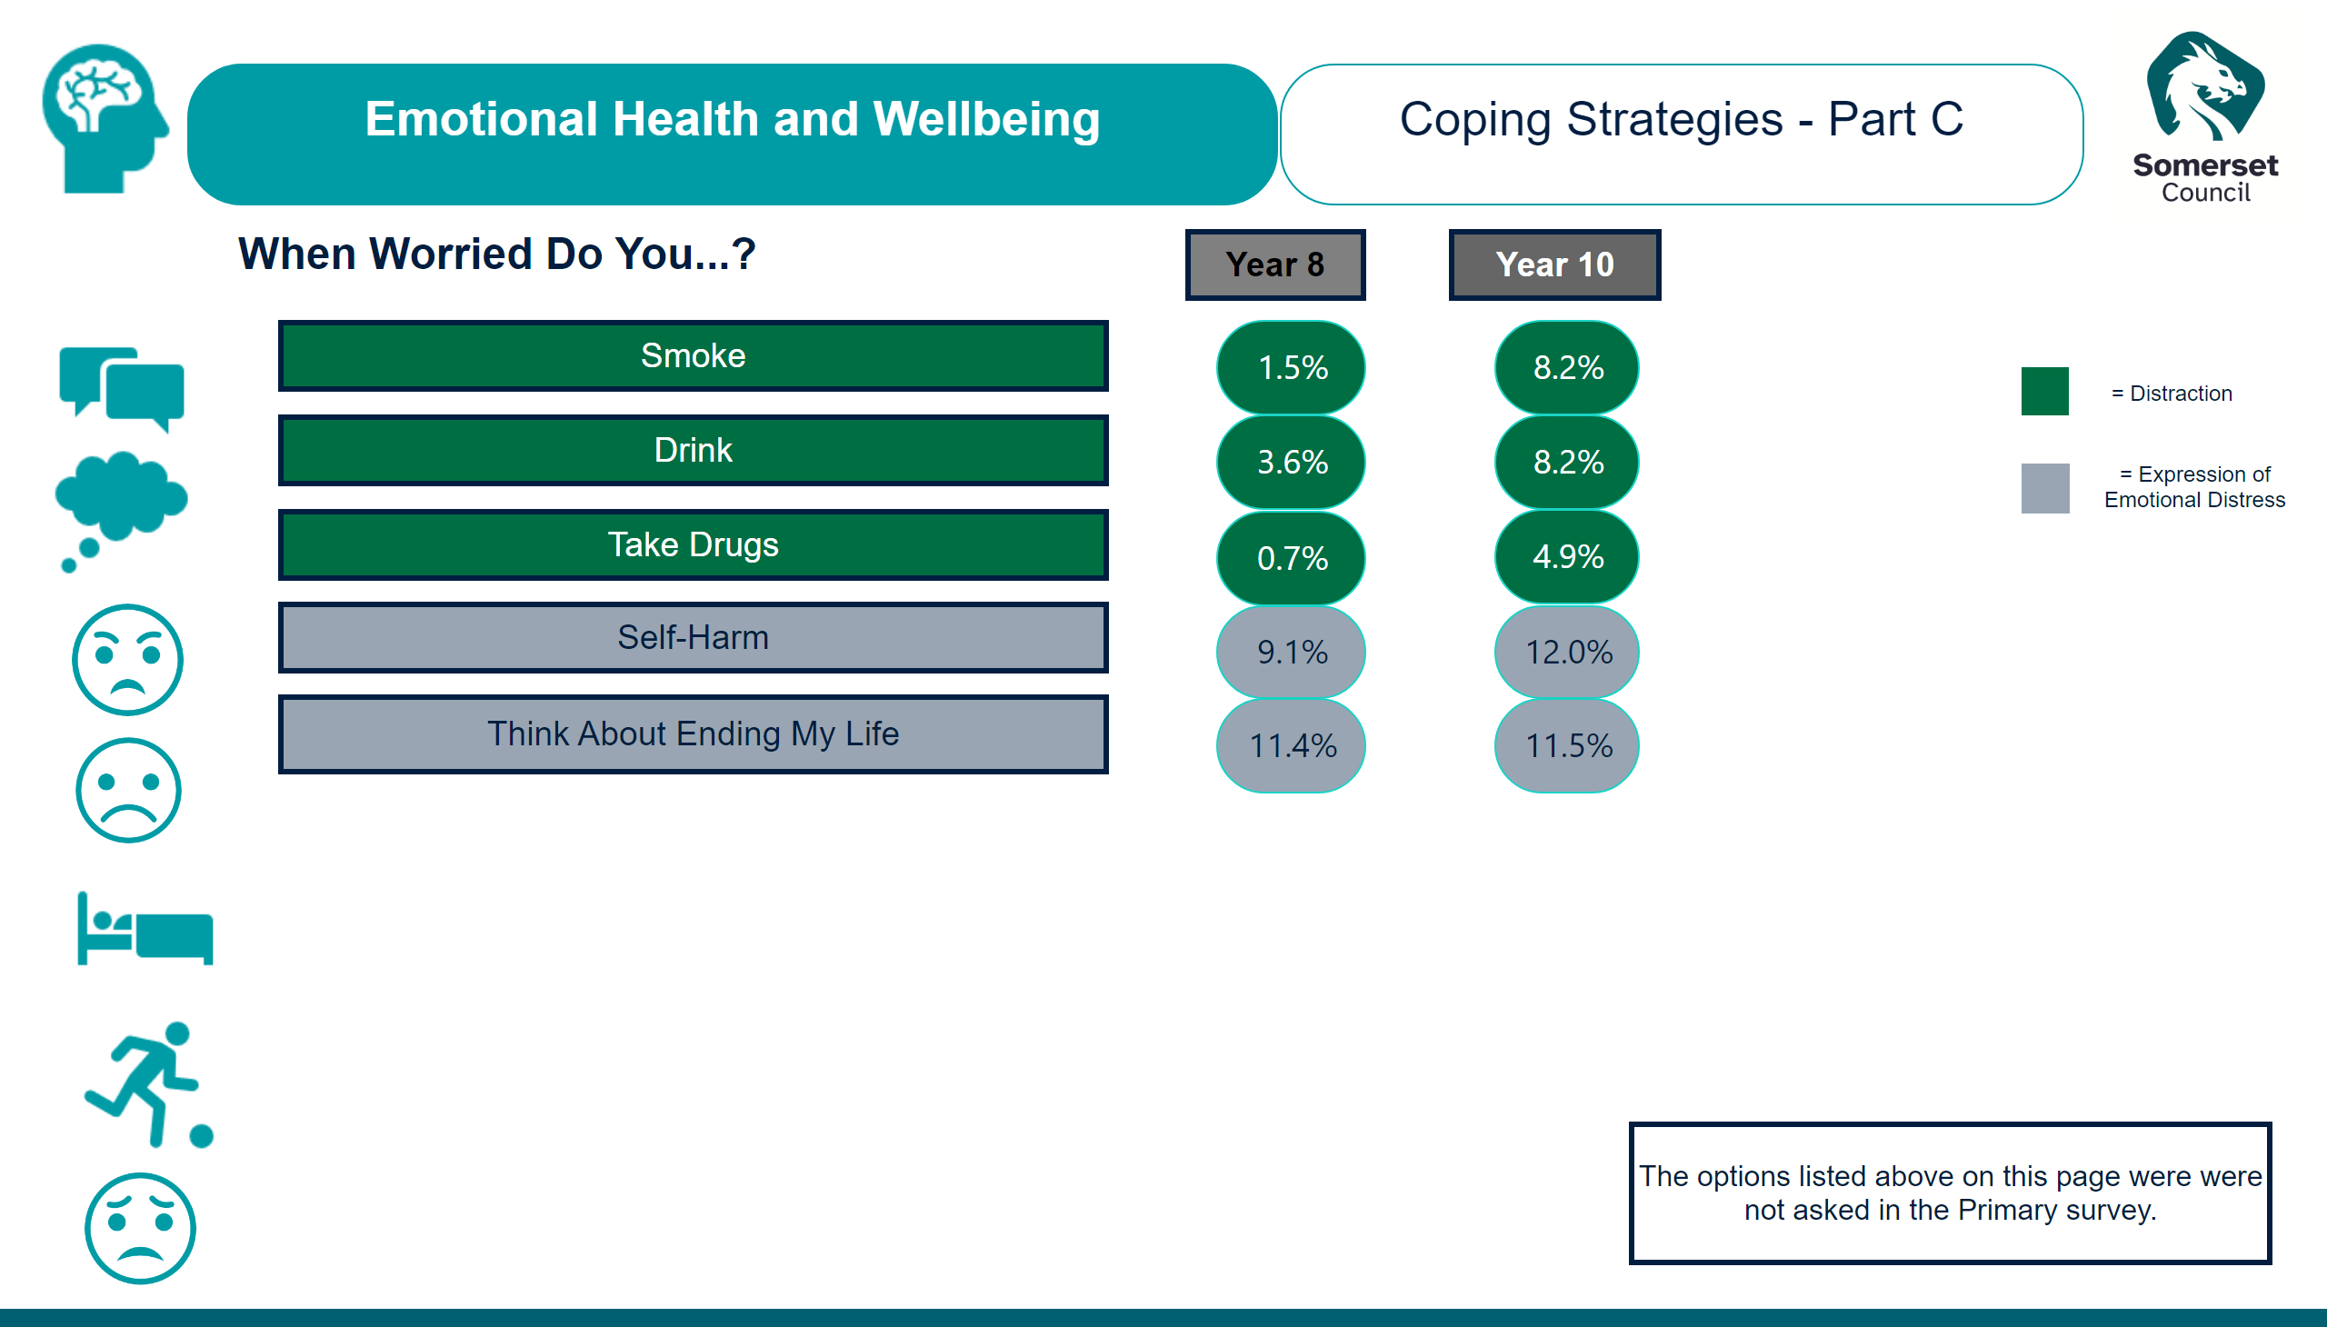
EHWB - Coping Strategies Part C
Notes:
textbox
No alt text provided
image
No alt text provided
textbox
No alt text provided
image
No alt text provided
image
No alt text provided
image
No alt text provided
image
No alt text provided
card
No alt text provided
image
No alt text provided
image
No alt text provided
actionButton
No alt text provided
actionButton
No alt text provided
actionButton
No alt text provided
actionButton
No alt text provided
actionButton
No alt text provided
image
No alt text provided
card
No alt text provided
card
No alt text provided
card
No alt text provided
card
No alt text provided
card
No alt text provided
card
No alt text provided
card
No alt text provided
card
No alt text provided
card
No alt text provided
actionButton
No alt text provided
actionButton
No alt text provided
actionButton
No alt text provided
actionButton
No alt text provided
actionButton
No alt text provided
actionButton
No alt text provided
actionButton
No alt text provided
image
No alt text provided
textbox
No alt text provided

Slide 35
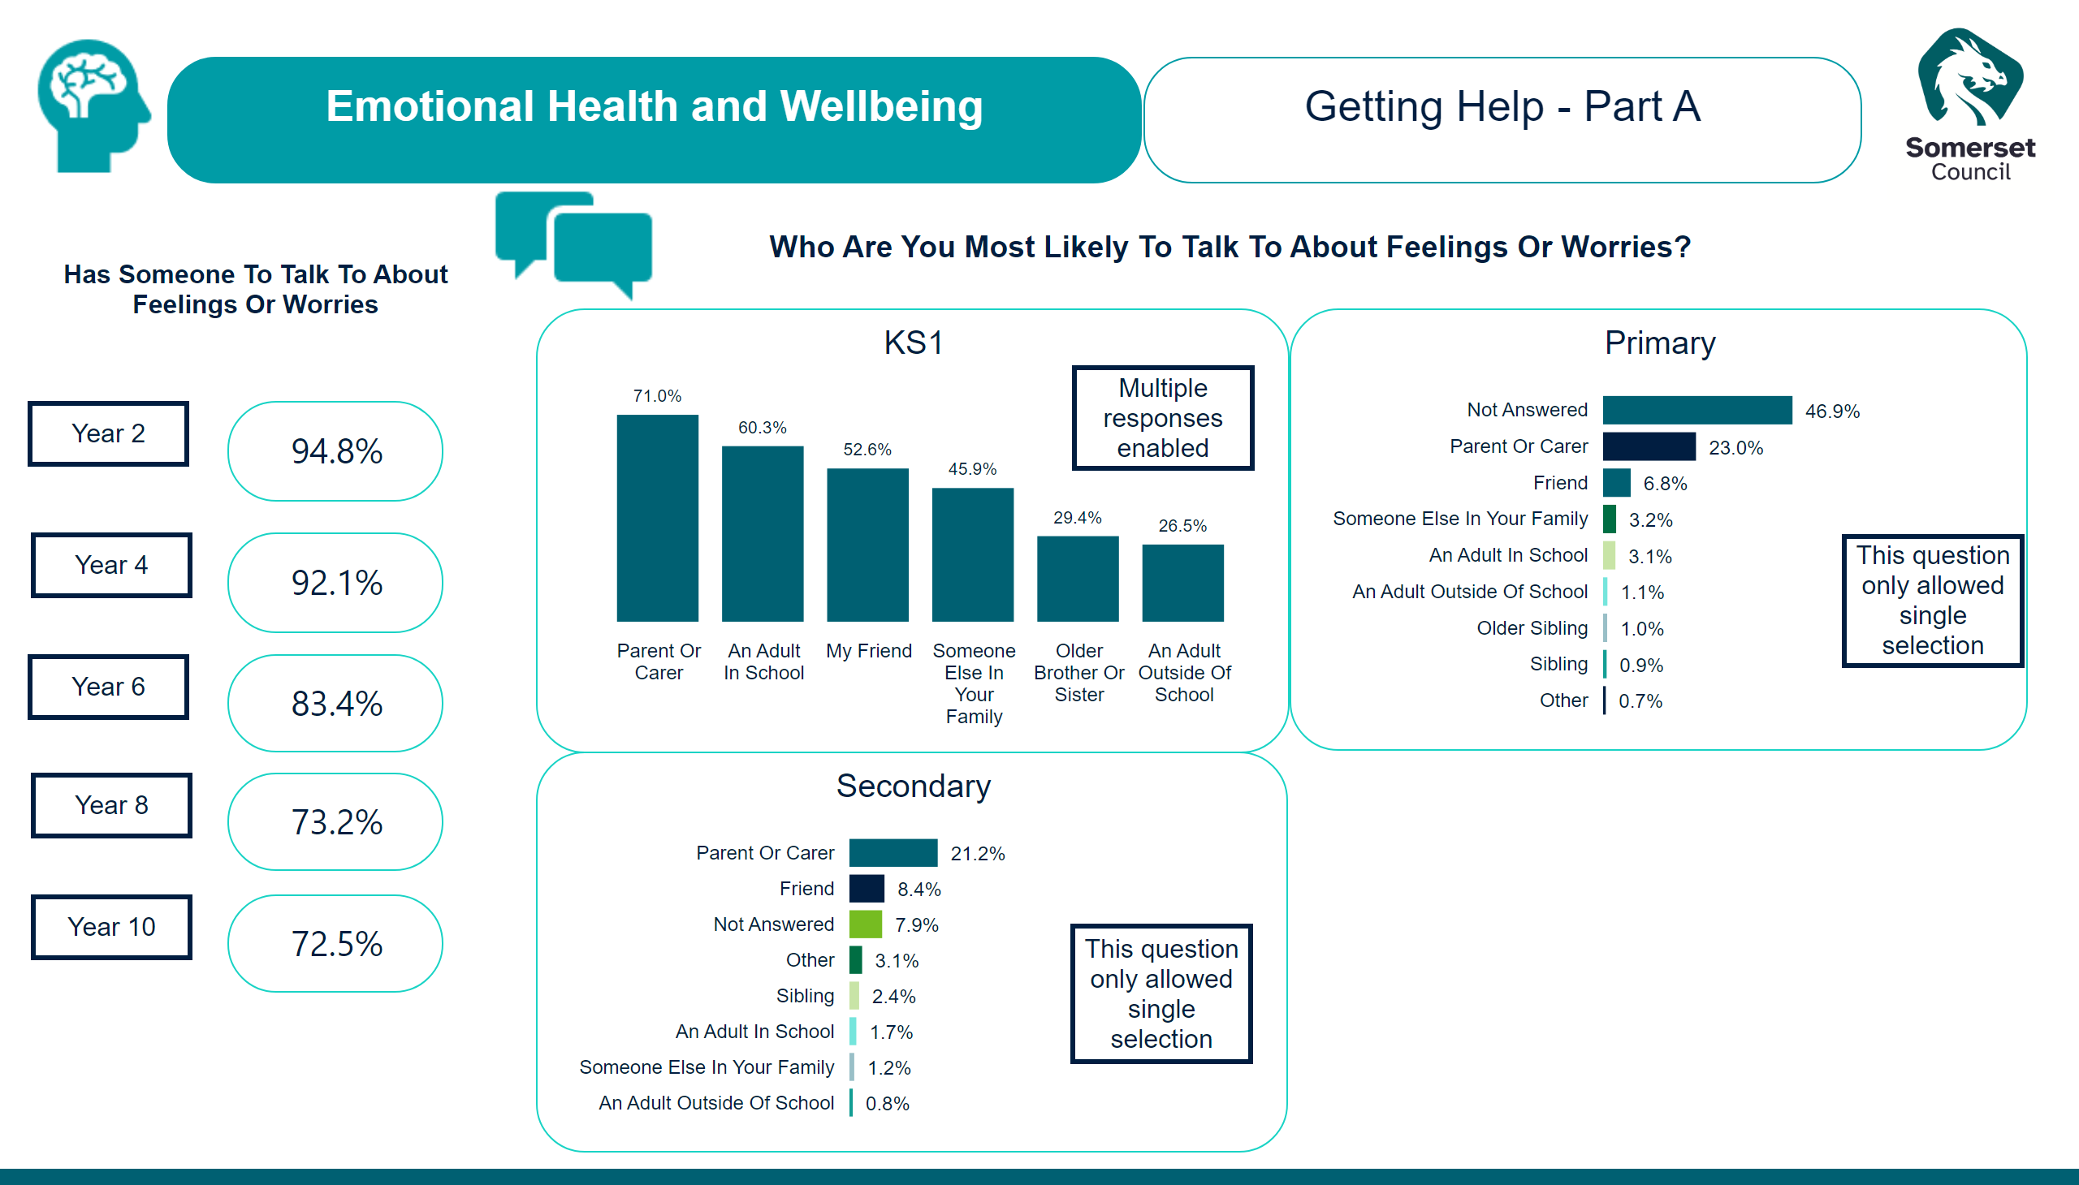
EHWB - Getting Help Part A
Notes:
textbox
No alt text provided
image
No alt text provided
card
No alt text provided
image
No alt text provided
KS1
No alt text provided
card
No alt text provided
card
No alt text provided
actionButton
No alt text provided
actionButton
No alt text provided
Secondary
No alt text provided
Primary
No alt text provided
actionButton
No alt text provided
actionButton
No alt text provided
actionButton
No alt text provided
card
No alt text provided
card
No alt text provided
actionButton
No alt text provided
actionButton
No alt text provided
actionButton
No alt text provided
actionButton
No alt text provided
actionButton
No alt text provided
image
No alt text provided
textbox
No alt text provided

Slide 36
EHWB - Getting Help Part B
Notes:
image
No alt text provided
Year 8
No alt text provided
Year 10
No alt text provided
actionButton
No alt text provided
textbox
No alt text provided
actionButton
No alt text provided
Year 8
No alt text provided
Year 10
No alt text provided
image
No alt text provided
textbox
No alt text provided

Slide 37
EHWB - Self Efficacy
Notes:
textbox
No alt text provided
image
No alt text provided
textbox
No alt text provided
Year 6
No alt text provided
Year 8
No alt text provided
Year 10
No alt text provided
image
No alt text provided
textbox
No alt text provided

Slide 38
EHWB - Body Image
Notes:
textbox
No alt text provided
image
No alt text provided
I Feel Satisfied With My Body...
No alt text provided
Which Of The Following Influence How You Feel About Your Body? (Select All That Apply)
No alt text provided
image
No alt text provided
textbox
No alt text provided

Slide 39
Title - Safety
Notes:
image
No alt text provided
ReportNameSHAPE
No alt text provided
image
No alt text provided
shape
No alt text provided

Slide 40
Safety - Overview
Notes:
image
No alt text provided
textbox
No alt text provided
image
No alt text provided
image
No alt text provided
image
No alt text provided
How Often Do You Feel Pressured By Someone To Do Something You Don't Want To Do In Your Neighbourhood?
No alt text provided
Year 2
No alt text provided
How Safe Do You Feel At Home?
No alt text provided
How Safe Do You Feel In The Park?
No alt text provided
actionButton
No alt text provided
image
No alt text provided
textbox
No alt text provided

Slide 41
Safety - Community
Notes:
How Safe Do You Feel At School/College?
No alt text provided
How Safe Do You Feel Whilst Travelling To/From School/College?
No alt text provided
image
No alt text provided
textbox
No alt text provided
image
No alt text provided
image
No alt text provided
image
No alt text provided
image
No alt text provided
textbox
No alt text provided

Slide 42
Safety - Discrimination & Abuse
Notes:
image
No alt text provided
textbox
No alt text provided
image
No alt text provided
In My School, People With Different Backgrounds Are Valued
No alt text provided
Has Anyone Ever Treated You Unfairly Because Of Who You Are? (Discriminated Against You)
No alt text provided
card
No alt text provided
actionButton
No alt text provided
actionButton
No alt text provided
actionButton
No alt text provided
actionButton
No alt text provided
actionButton
No alt text provided
actionButton
No alt text provided
card
No alt text provided
actionButton
No alt text provided
image
No alt text provided
textbox
No alt text provided
card
No alt text provided
card
No alt text provided
card
No alt text provided
card
No alt text provided
card
No alt text provided
card
No alt text provided

Slide 43
Safety - Discrimination & Abuse -B
Notes:
image
No alt text provided
textbox
No alt text provided
image
No alt text provided
In My School, People With Different Backgrounds Are Valued
No alt text provided
Has Anyone Ever Treated You Unfairly Because Of Who You Are? (Discriminated Against You)
No alt text provided
card
No alt text provided
actionButton
No alt text provided
actionButton
No alt text provided
actionButton
No alt text provided
actionButton
No alt text provided
actionButton
No alt text provided
actionButton
No alt text provided
card
No alt text provided
actionButton
No alt text provided
image
No alt text provided
textbox
No alt text provided
card
No alt text provided
card
No alt text provided
card
No alt text provided
card
No alt text provided
card
No alt text provided
card
No alt text provided
actionButton
No alt text provided

Slide 44
Safety - Discrimination & Abuse - C
Notes:
image
No alt text provided
textbox
No alt text provided
image
No alt text provided
In My School, People With Different Backgrounds Are Valued
No alt text provided
Has Anyone Ever Treated You Unfairly Because Of Who You Are? (Discriminated Against You)
No alt text provided
card
No alt text provided
actionButton
No alt text provided
actionButton
No alt text provided
actionButton
No alt text provided
actionButton
No alt text provided
actionButton
No alt text provided
actionButton
No alt text provided
card
No alt text provided
actionButton
No alt text provided
image
No alt text provided
textbox
No alt text provided
card
No alt text provided
card
No alt text provided
card
No alt text provided
card
No alt text provided
card
No alt text provided
card
No alt text provided
actionButton
No alt text provided

Slide 45
Safety - Bullying Prevalence
Notes:
image
No alt text provided
textbox
No alt text provided
image
No alt text provided
card
No alt text provided
actionButton
No alt text provided
During This School Year, How Often Have You Been Bullied At School?
No alt text provided
card
No alt text provided
card
No alt text provided
actionButton
No alt text provided
How Well Do You Think That Your School Deals With Bullying?
No alt text provided
How Often Do You Feel Pressured To Do Something You Don't Want To Do In School?
No alt text provided
image
No alt text provided
textbox
No alt text provided

Slide 46
Safety - Bullying Experienced Part A
Notes:
textbox
No alt text provided
image
No alt text provided
textbox
No alt text provided
image
No alt text provided
image
No alt text provided
card
No alt text provided
card
No alt text provided
actionButton
No alt text provided
actionButton
No alt text provided
actionButton
No alt text provided
actionButton
No alt text provided
actionButton
No alt text provided
actionButton
No alt text provided
actionButton
No alt text provided
actionButton
No alt text provided
actionButton
No alt text provided
actionButton
No alt text provided
actionButton
No alt text provided
actionButton
No alt text provided
card
No alt text provided
card
No alt text provided
card
No alt text provided
card
No alt text provided
card
No alt text provided
card
No alt text provided
card
No alt text provided
card
No alt text provided
card
No alt text provided
card
No alt text provided
card
No alt text provided
card
No alt text provided
card
No alt text provided
card
No alt text provided
card
No alt text provided
card
No alt text provided
card
No alt text provided
card
No alt text provided
card
No alt text provided
card
No alt text provided
card
No alt text provided
card
No alt text provided
card
No alt text provided
card
No alt text provided
card
No alt text provided
card
No alt text provided
card
No alt text provided
card
No alt text provided
card
No alt text provided
card
No alt text provided
actionButton
No alt text provided
actionButton
No alt text provided
actionButton
No alt text provided
actionButton
No alt text provided
textbox
No alt text provided
textbox
No alt text provided
textbox
No alt text provided
textbox
No alt text provided
image
No alt text provided
textbox
No alt text provided

Slide 47
Safety - Bullying Experienced Part B
Notes:
textbox
No alt text provided
image
No alt text provided
textbox
No alt text provided
card
No alt text provided
card
No alt text provided
actionButton
No alt text provided
actionButton
No alt text provided
actionButton
No alt text provided
actionButton
No alt text provided
actionButton
No alt text provided
actionButton
No alt text provided
actionButton
No alt text provided
actionButton
No alt text provided
actionButton
No alt text provided
actionButton
No alt text provided
actionButton
No alt text provided
card
No alt text provided
card
No alt text provided
card
No alt text provided
card
No alt text provided
card
No alt text provided
card
No alt text provided
card
No alt text provided
card
No alt text provided
card
No alt text provided
card
No alt text provided
card
No alt text provided
card
No alt text provided
card
No alt text provided
card
No alt text provided
card
No alt text provided
card
No alt text provided
card
No alt text provided
card
No alt text provided
card
No alt text provided
card
No alt text provided
card
No alt text provided
card
No alt text provided
card
No alt text provided
card
No alt text provided
image
No alt text provided
actionButton
No alt text provided
actionButton
No alt text provided
actionButton
No alt text provided
actionButton
No alt text provided
textbox
No alt text provided
textbox
No alt text provided
textbox
No alt text provided
image
No alt text provided
textbox
No alt text provided

Slide 48
Safety - Bullying Reasons - A
Notes:
textbox
No alt text provided
image
No alt text provided
textbox
No alt text provided
image
No alt text provided
image
No alt text provided
actionButton
No alt text provided
actionButton
No alt text provided
actionButton
No alt text provided
actionButton
No alt text provided
card
No alt text provided
actionButton
No alt text provided
actionButton
No alt text provided
actionButton
No alt text provided
actionButton
No alt text provided
actionButton
No alt text provided
actionButton
No alt text provided
card
No alt text provided
card
No alt text provided
card
No alt text provided
card
No alt text provided
card
No alt text provided
card
No alt text provided
card
No alt text provided
card
No alt text provided
card
No alt text provided
card
No alt text provided
card
No alt text provided
card
No alt text provided
card
No alt text provided
card
No alt text provided
card
No alt text provided
card
No alt text provided
card
No alt text provided
card
No alt text provided
card
No alt text provided
card
No alt text provided
card
No alt text provided
card
No alt text provided
card
No alt text provided
image
No alt text provided
textbox
No alt text provided

Slide 49
Safety - Bullying Reasons - B
Notes:
image
No alt text provided
textbox
No alt text provided
actionButton
No alt text provided
actionButton
No alt text provided
actionButton
No alt text provided
actionButton
No alt text provided
card
No alt text provided
actionButton
No alt text provided
actionButton
No alt text provided
actionButton
No alt text provided
actionButton
No alt text provided
actionButton
No alt text provided
actionButton
No alt text provided
card
No alt text provided
card
No alt text provided
card
No alt text provided
card
No alt text provided
card
No alt text provided
card
No alt text provided
card
No alt text provided
card
No alt text provided
card
No alt text provided
card
No alt text provided
card
No alt text provided
card
No alt text provided
card
No alt text provided
card
No alt text provided
card
No alt text provided
card
No alt text provided
card
No alt text provided
card
No alt text provided
card
No alt text provided
card
No alt text provided
card
No alt text provided
card
No alt text provided
card
No alt text provided
image
No alt text provided
image
No alt text provided
textbox
No alt text provided
image
No alt text provided
textbox
No alt text provided

Slide 50
Safety - Bullying Effects
Notes:
image
No alt text provided
textbox
No alt text provided
Worries
No alt text provided
Worries
No alt text provided
Worries
No alt text provided
Worries
No alt text provided
actionButton
No alt text provided
actionButton
No alt text provided
actionButton
No alt text provided
actionButton
No alt text provided
image
No alt text provided
textbox
No alt text provided

Slide 51
Safety - Online Safety
Notes:
How Often Have You Been Upset By Something You Have Seen Or Has Happened Online?
No alt text provided
How Often Do You Feel Pressured By Someone To Do Something You Don't Want To Do Online?
No alt text provided
image
No alt text provided
textbox
No alt text provided
image
No alt text provided
textbox
No alt text provided

Slide 52
Title - Sexual Health
Notes:
image
No alt text provided
ReportNameSHAPE
No alt text provided
image
No alt text provided
shape
No alt text provided

Slide 53
Sexual Health - Overview
Notes:
image
No alt text provided
textbox
No alt text provided
textbox
No alt text provided
Sexual Experience
No alt text provided
In The Uk, What Age Do You Think The Majority Of Young People Have Sex For The First Time?
No alt text provided
actionButton
No alt text provided
image
No alt text provided

Slide 54
Sexual Health - Sexual Harassment
Notes:
How Often Have You Experienced Sexual Harassment At School?
No alt text provided
How Well Do You Feel Your School Deals With Sexual Harassment That Has Been Experienced At School/College?
No alt text provided
image
No alt text provided
textbox
No alt text provided
image
No alt text provided
textbox
No alt text provided

Slide 55
Sexual Health - Sexual Harassment - B
Notes:
How Often Have You Experienced Sexual Harassment At School?
No alt text provided
How Well Do You Feel Your School Deals With Sexual Harassment That Has Been Experienced At School?
No alt text provided
image
No alt text provided
textbox
No alt text provided
actionButton
No alt text provided
image
No alt text provided
textbox
No alt text provided

Slide 56
Title - RHSE
Notes:
image
No alt text provided
ReportNameSHAPE
No alt text provided
image
No alt text provided
shape
No alt text provided

Slide 57
RHSE - Relationships
Notes:
image
No alt text provided
textbox
No alt text provided
textbox
No alt text provided
Have You Ever Been In A Relationship Where...? (Years 8 and 10)
No alt text provided
actionButton
No alt text provided
image
No alt text provided

Slide 58
RHSE - Relationships - B
Notes:
image
No alt text provided
textbox
No alt text provided
textbox
No alt text provided
Have You Ever Been In A Relationship Where...? (Years 8 and 10 and identify as having a disability)
No alt text provided
actionButton
No alt text provided
image
No alt text provided

Slide 59
Title - MPC
Notes:
image
No alt text provided
ReportNameSHAPE
No alt text provided
image
No alt text provided
shape
No alt text provided

Slide 60
MPC - Belonging
Notes:
textbox
No alt text provided
image
No alt text provided
textbox
No alt text provided
Do You Enjoy School?
No alt text provided
I Feel Like Part Of My School
No alt text provided
actionButton
No alt text provided
Year 2
No alt text provided
image
No alt text provided

Slide 61
MPC - Access
Notes:
image
No alt text provided
textbox
No alt text provided
Are You Allowed To Go To The Toilet In Lesson Time If You Need To?
No alt text provided
How Clean Do You Think The Toilets At School Are?
No alt text provided
Are You Able To Access And Drink Water During Lesson Time If You Need To?
No alt text provided
At School, How Easy Or Difficult Is It For You To Get Products To Manage Your Period? (Females Only)
No alt text provided
image
No alt text provided
textbox
No alt text provided

Slide 62
MPC - Encouragement - Primary
Notes:
image
No alt text provided
textbox
No alt text provided
Year 6
No alt text provided
Year 4
No alt text provided
image
No alt text provided
textbox
No alt text provided

Slide 63
MPC - Encouragement - Secondary
Notes:
image
No alt text provided
textbox
No alt text provided
Year 8
No alt text provided
Year 10
No alt text provided
image
No alt text provided
textbox
No alt text provided

Slide 64
MPC - Behaviour
Notes:
image
No alt text provided
textbox
No alt text provided
Primary
No alt text provided
Secondary
No alt text provided
image
No alt text provided
textbox
No alt text provided

Slide 65
MPC - School Experience - Primary
Notes:
image
No alt text provided
textbox
No alt text provided
Year 4
No alt text provided
Year 6
No alt text provided
image
No alt text provided
textbox
No alt text provided

Slide 66
MPC - School Experience - Secondary
Notes:
image
No alt text provided
textbox
No alt text provided
Year 10
No alt text provided
Year 8
No alt text provided
image
No alt text provided
textbox
No alt text provided

Slide 67
Title - Lifestyle
Notes:
image
No alt text provided
ReportNameSHAPE
No alt text provided
image
No alt text provided
shape
No alt text provided

Slide 68
Lifestyle - Breakfast
Notes:
In The Past Week, How Often Did You Eat Breakfast?
No alt text provided
image
No alt text provided
textbox
No alt text provided
textbox
No alt text provided
image
No alt text provided
actionButton
No alt text provided
image
No alt text provided

Slide 69
Lifestyle - Diet
Notes:
How Many Days A Week Do You Usually Eat Fruit And Vegetables?
No alt text provided
How Many Times A Week Do You Usually Eat Sweets, Chocolate, Crisps, Or Have Fizzy Drinks?
No alt text provided
image
No alt text provided
textbox
No alt text provided
textbox
No alt text provided
image
No alt text provided

Slide 70
Lifestyle - Sleep
Notes:
image
No alt text provided
textbox
No alt text provided
Is The Amount Of Sleep You Normally Get Enough For You To Feel Awake And Concentrate On Your Schoolwork?
No alt text provided
textbox
No alt text provided
image
No alt text provided

Slide 71
Lifestyle - Physical Activity
Notes:
image
No alt text provided
textbox
No alt text provided
How Many Days In A Usual Week Are You Normally Active?
No alt text provided
On The Days That You Were Physically Active, How Long Did You Spend Being Active?
No alt text provided
textbox
No alt text provided
image
No alt text provided

Slide 72
Lifestyle - Barriers to Physical Activity
Notes:
image
No alt text provided
textbox
No alt text provided
Worries
No alt text provided
Worries
No alt text provided
Worries
No alt text provided
Worries
No alt text provided
actionButton
No alt text provided
actionButton
No alt text provided
actionButton
No alt text provided
actionButton
No alt text provided
textbox
No alt text provided
image
No alt text provided

Slide 73
Lifestyle - Technology
Notes:
image
No alt text provided
textbox
No alt text provided
Yesterday, how much time did you spend using screen devices outside of school (years 8 and 10) or college (ages 16-18)?
No alt text provided
Yesterday, how much time did you spend using screen devices outside of school?
No alt text provided
actionButton
No alt text provided
textbox
No alt text provided
image
No alt text provided

Slide 74
Lifestyle - Food Poverty
Notes:
Sometimes I Am Hungry But Didn't Eat Because I Don't Want To Use Up The Food
No alt text provided
Sometimes We Had To Eat Less And Make Food Last Longer Because We Didn't Have The Money To Buy More
No alt text provided
Sometimes We Don't Eat Proper Meals Because We Didn't Have Enough Money To Buy More Food
No alt text provided
Sometimes I Am Hungry But Don't Eat Because We Don't Have Enough Food In The House
No alt text provided
Sometimes I Eat Less So That My Parents/Carers, Brothers and Sisters Can Eat More
No alt text provided
Sometimes I Eat At Family Or Friends Houses Because We Don't Have Enough Food In Our House
No alt text provided
Sometimes I Don't Eat Meals Because I'm Not Hungry
No alt text provided
Sometimes My Meal At School Is My Only Meal Of The Day
No alt text provided
image
No alt text provided
textbox
No alt text provided
textbox
No alt text provided
image
No alt text provided

Slide 75
Title - Substance Use
Notes:
image
No alt text provided
ReportNameSHAPE
No alt text provided
image
No alt text provided
shape
No alt text provided

Slide 76
Substance Use - Smoking and Vaping Status
Notes:
Smoking Status (Secondary only)
No alt text provided
textbox
No alt text provided
image
No alt text provided
textbox
No alt text provided
Vaping Status (Secondary only)
No alt text provided
actionButton
No alt text provided
image
No alt text provided

Slide 77
Substance Use - Smoking and Vaping
Notes:
slicer
No alt text provided
slicer
No alt text provided
slicer
No alt text provided
slicer
No alt text provided
slicer
No alt text provided
slicer
No alt text provided
slicer
No alt text provided
slicer
No alt text provided
slicer
No alt text provided
slicer
No alt text provided
slicer
No alt text provided
slicer
No alt text provided
slicer
No alt text provided
slicer
No alt text provided
image
No alt text provided
textbox
No alt text provided
Do Any Of These People That You Know Vape Or Use E-Cigarettes?
No alt text provided
Do Any Of These People That You Know Smoke Cigarettes?
No alt text provided
textbox
No alt text provided
image
No alt text provided

Slide 78
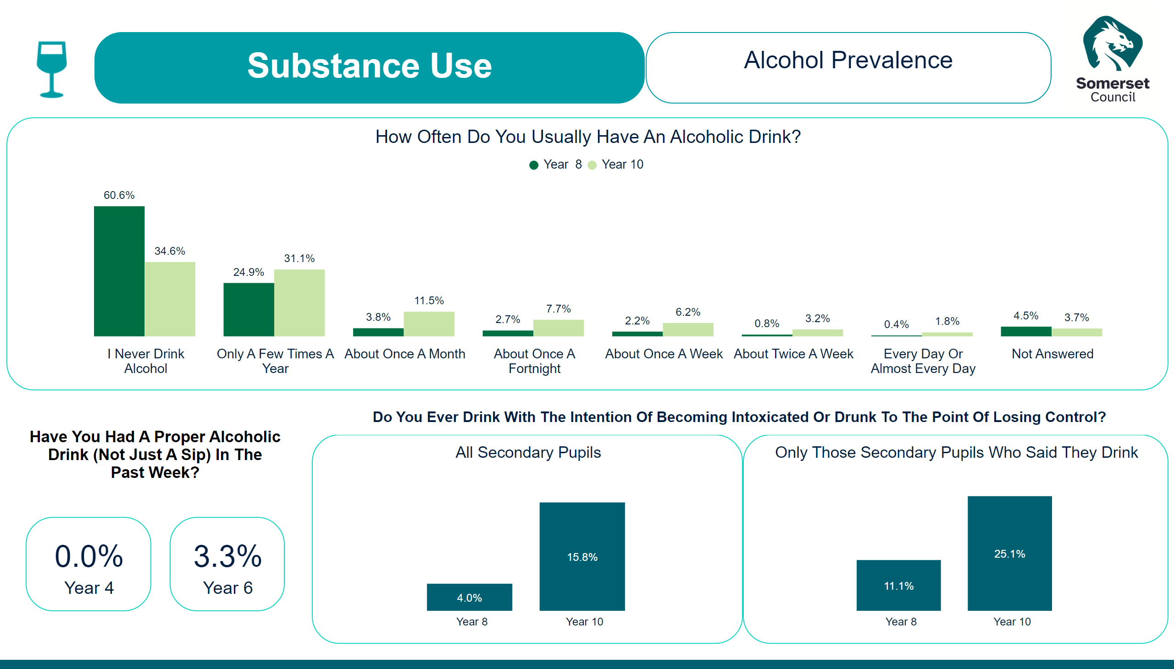
Substance Use - Alcohol
Notes:
image
No alt text provided
textbox
No alt text provided
slicer
No alt text provided
slicer
No alt text provided
slicer
No alt text provided
slicer
No alt text provided
slicer
No alt text provided
slicer
No alt text provided
slicer
No alt text provided
slicer
No alt text provided
How Often Do You Usually Have An Alcoholic Drink?
No alt text provided
Have you had a proper alcoholic drink (not just a sip) in the past week?
No alt text provided
card
No alt text provided
card
No alt text provided
Only Those Secondary Pupils Who Said They Drink
No alt text provided
textbox
No alt text provided
image
No alt text provided
All Secondary Pupils
No alt text provided
actionButton
No alt text provided

Slide 79
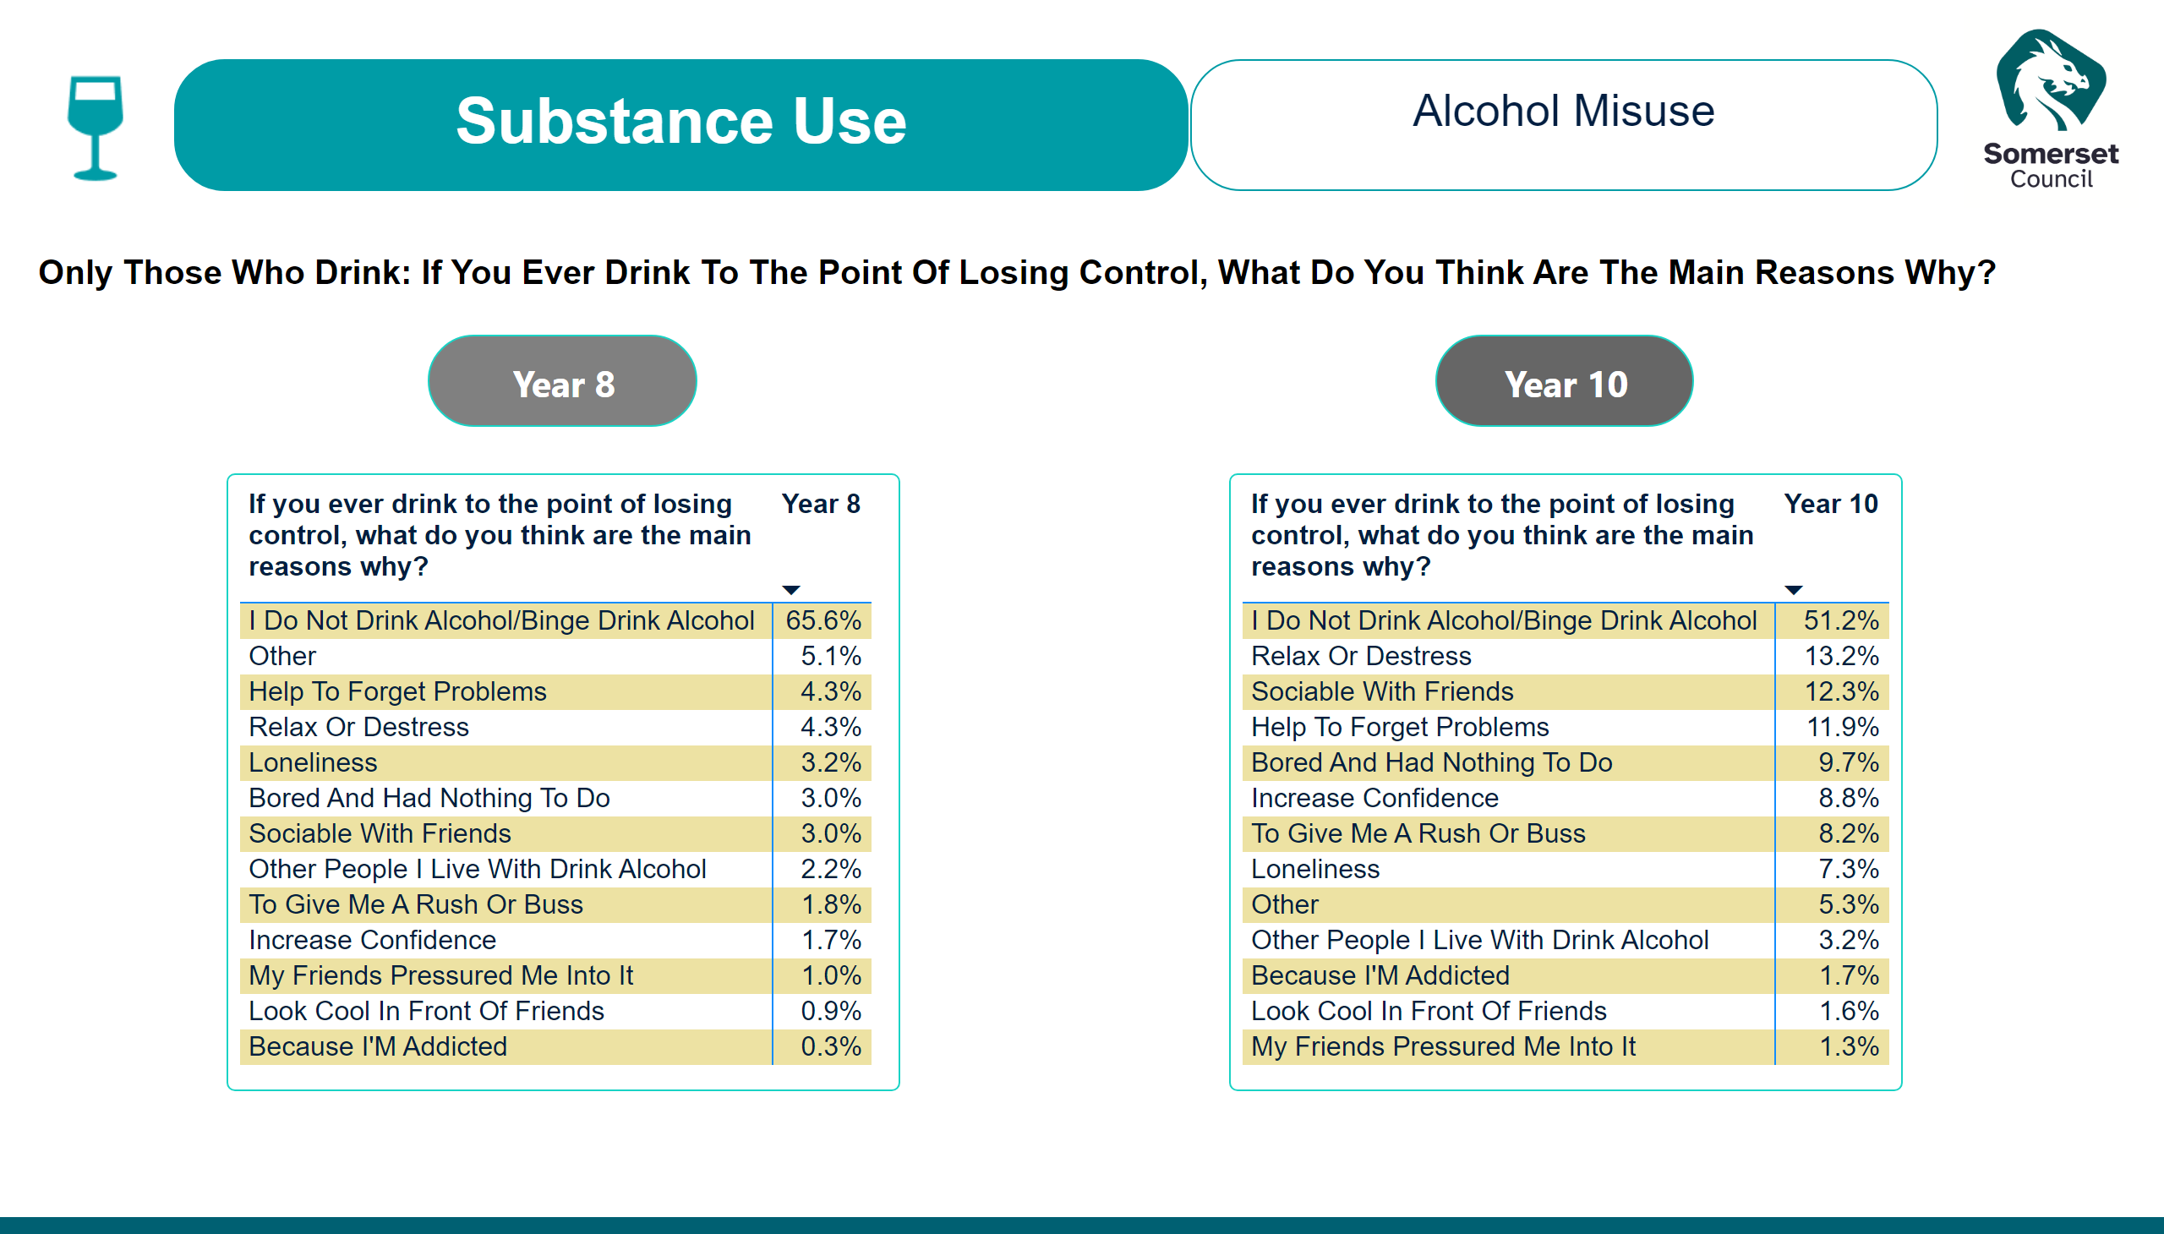
Substance Use - Alcohol Abuse
Notes:
image
No alt text provided
textbox
No alt text provided
actionButton
No alt text provided
actionButton
No alt text provided
actionButton
No alt text provided
pivotTable
No alt text provided
pivotTable
No alt text provided
textbox
No alt text provided
image
No alt text provided

Slide 80
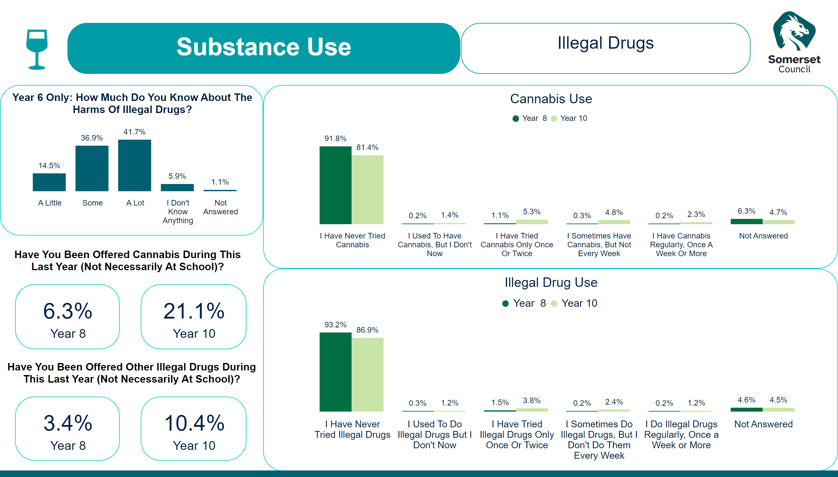
Substance Use - Illegal Drugs
Notes:
image
No alt text provided
textbox
No alt text provided
card
No alt text provided
card
No alt text provided
actionButton
No alt text provided
actionButton
No alt text provided
card
No alt text provided
card
No alt text provided
Cannabis Use
No alt text provided
Illegal Drug Use
No alt text provided
textbox
No alt text provided
image
No alt text provided
Year 6 Only: How Much Do You Know About The Harms Of Illegal Drugs?
No alt text provided

Slide 81

Title - Transport
Notes:
image
No alt text provided
ReportNameSHAPE
No alt text provided
image
No alt text provided
shape
No alt text provided

Slide 82
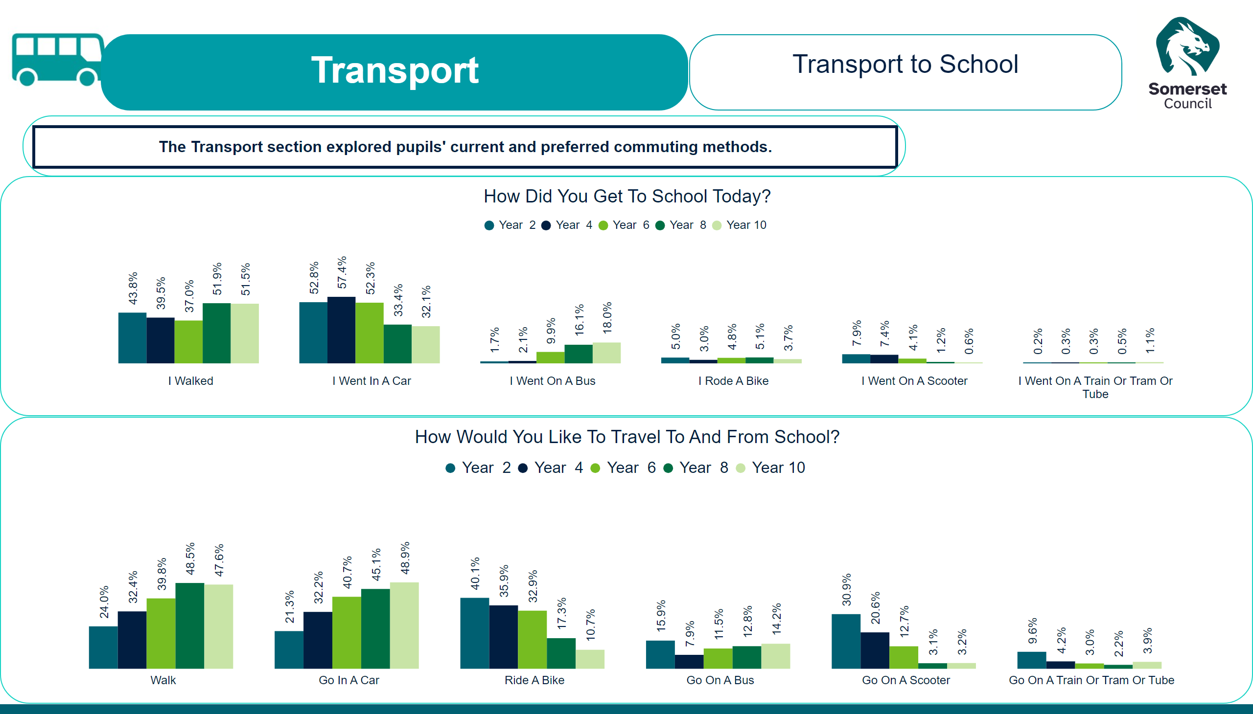
Transport - Travel to School
Notes:
slicer
No alt text provided
slicer
No alt text provided
slicer
No alt text provided
slicer
No alt text provided
slicer
No alt text provided
slicer
No alt text provided
slicer
No alt text provided
slicer
No alt text provided
slicer
No alt text provided
slicer
No alt text provided
slicer
No alt text provided
slicer
No alt text provided
slicer
No alt text provided
slicer
No alt text provided
textbox
No alt text provided
How Did You Get To School Today?
No alt text provided
How Would You Like To Travel To And From School?
No alt text provided
actionButton
No alt text provided
image
No alt text provided
textbox
No alt text provided
image
No alt text provided

Slide 83

Title - Option Sets
Notes:
image
No alt text provided
ReportNameSHAPE
No alt text provided
image
No alt text provided
shape
No alt text provided

Slide 84
Year 2
Notes:
textbox
No alt text provided
textbox
No alt text provided
actionButton
No alt text provided
image
No alt text provided
Worries
No alt text provided
pivotTable
No alt text provided
pivotTable
No alt text provided
pivotTable
No alt text provided
image
No alt text provided
actionButton
No alt text provided

Slide 85
Year 4
Notes:
textbox
No alt text provided
Worries
No alt text provided
image
No alt text provided
Worries
No alt text provided
Worries
No alt text provided
Worries
No alt text provided
image
No alt text provided
actionButton
No alt text provided
textbox
No alt text provided

Slide 86
Year 4 - B
Notes:
textbox
No alt text provided
Worries
No alt text provided
Worries
No alt text provided
image
No alt text provided
pivotTable
No alt text provided
pivotTable
No alt text provided
pivotTable
No alt text provided
image
No alt text provided
actionButton
No alt text provided
actionButton
No alt text provided
actionButton
No alt text provided
actionButton
No alt text provided
actionButton
No alt text provided
textbox
No alt text provided

Slide 87
Year 6
Notes:
textbox
No alt text provided
image
No alt text provided
pivotTable
No alt text provided
Year 6
No alt text provided
image
No alt text provided
actionButton
No alt text provided

Slide 88
Year 6 - B
Notes:
textbox
No alt text provided
image
No alt text provided
image
No alt text provided
actionButton
No alt text provided
Worries
No alt text provided
Worries
No alt text provided
textbox
No alt text provided

Slide 89
Year 6 - C
Notes:
textbox
No alt text provided
image
No alt text provided
pivotTable
No alt text provided
pivotTable
No alt text provided
pivotTable
No alt text provided
actionButton
No alt text provided
actionButton
No alt text provided
actionButton
No alt text provided
actionButton
No alt text provided
pivotTable
No alt text provided
pivotTable
No alt text provided
Worries
No alt text provided
textbox
No alt text provided

Slide 90
Year 8
Notes:
textbox
No alt text provided
image
No alt text provided
pivotTable
No alt text provided
pivotTable
No alt text provided
Year 8
No alt text provided
image
No alt text provided
actionButton
No alt text provided
Worries
No alt text provided

Slide 91
Year 8 - B
Notes:
textbox
No alt text provided
image
No alt text provided
Worries
No alt text provided
Worries
No alt text provided
Worries
No alt text provided
Worries
No alt text provided
Worries
No alt text provided
image
No alt text provided
actionButton
No alt text provided
actionButton
No alt text provided

Slide 92
Year 8 - C
Notes:
textbox
No alt text provided
image
No alt text provided
pivotTable
No alt text provided
pivotTable
No alt text provided
image
No alt text provided
actionButton
No alt text provided
image
No alt text provided
actionButton
No alt text provided
actionButton
No alt text provided
pivotTable
No alt text provided
Worries
No alt text provided
pivotTable
No alt text provided

Slide 93
Year 8 - D
Notes:
textbox
No alt text provided
image
No alt text provided
pivotTable
No alt text provided
pivotTable
No alt text provided
pivotTable
No alt text provided
pivotTable
No alt text provided
image
No alt text provided
Worries
No alt text provided
Worries
No alt text provided
actionButton
No alt text provided
actionButton
No alt text provided
actionButton
No alt text provided

Slide 94
Year 10
Notes:
textbox
No alt text provided
image
No alt text provided
pivotTable
No alt text provided
pivotTable
No alt text provided
Year 8
No alt text provided
image
No alt text provided
actionButton
No alt text provided
Worries
No alt text provided

Slide 95
Year 10 - B
Notes:
textbox
No alt text provided
image
No alt text provided
Worries
No alt text provided
Worries
No alt text provided
Worries
No alt text provided
Worries
No alt text provided
Worries
No alt text provided
image
No alt text provided
actionButton
No alt text provided
actionButton
No alt text provided

Slide 96
Year 10 - C
Notes:
textbox
No alt text provided
image
No alt text provided
pivotTable
No alt text provided
pivotTable
No alt text provided
image
No alt text provided
actionButton
No alt text provided
image
No alt text provided
actionButton
No alt text provided
actionButton
No alt text provided
pivotTable
No alt text provided
Worries
No alt text provided
pivotTable
No alt text provided

Slide 97
Year 10 - D
Notes:
textbox
No alt text provided
image
No alt text provided
pivotTable
No alt text provided
pivotTable
No alt text provided
pivotTable
No alt text provided
image
No alt text provided
image
No alt text provided
Worries
No alt text provided
actionButton
No alt text provided
textbox
No alt text provided

Slide 98
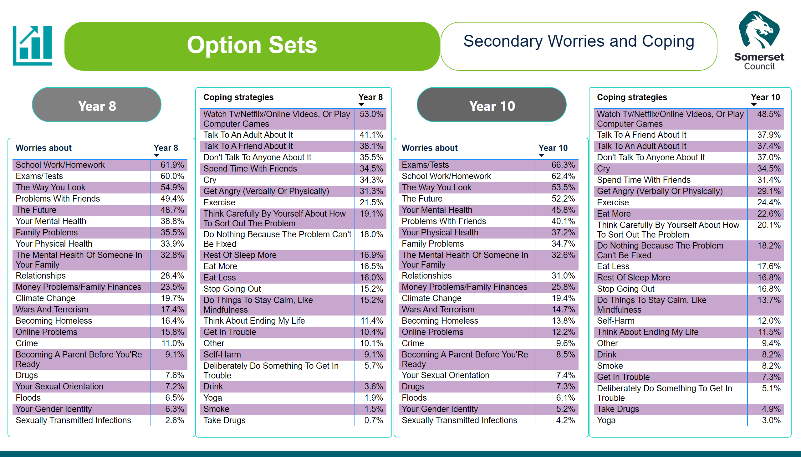
Secondary Worries and Coping
Notes:
textbox
No alt text provided
textbox
No alt text provided
image
No alt text provided
image
No alt text provided
Year 8
No alt text provided
pivotTable
No alt text provided
Year 8
No alt text provided
pivotTable
No alt text provided
actionButton
No alt text provided
actionButton
No alt text provided

Slide 99
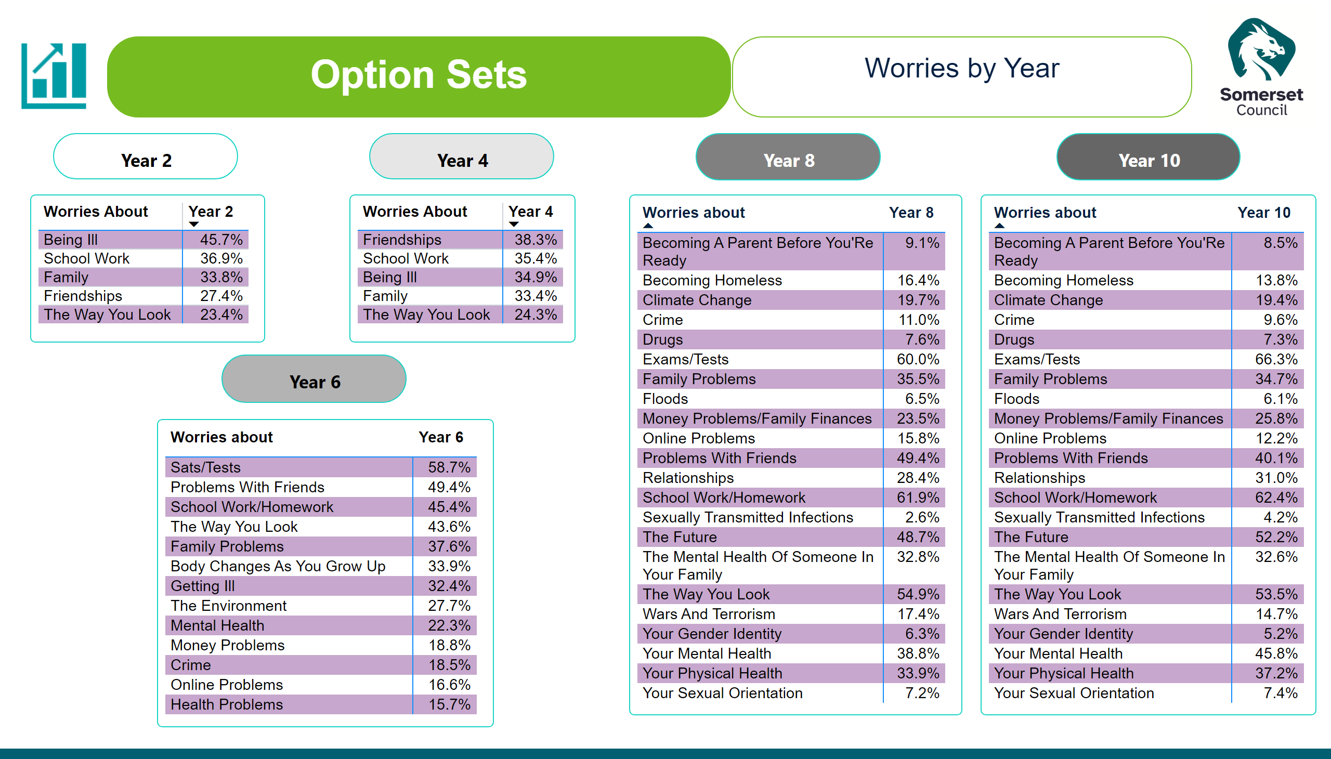
Worries by Year
Notes:
textbox
No alt text provided
actionButton
No alt text provided
actionButton
No alt text provided
actionButton
No alt text provided
actionButton
No alt text provided
image
No alt text provided
image
No alt text provided
Year 8
No alt text provided
Year 8
No alt text provided
actionButton
No alt text provided
Worries
No alt text provided
Worries
No alt text provided
actionButton
No alt text provided
actionButton
No alt text provided
Year 6
No alt text provided

Slide 100
Coping by Year
Notes:
textbox
No alt text provided
image
No alt text provided
image
No alt text provided
pivotTable
No alt text provided
actionButton
No alt text provided
actionButton
No alt text provided
actionButton
No alt text provided
pivotTable
No alt text provided
pivotTable
No alt text provided

Slide 101
Bullying by Year
Notes:
textbox
No alt text provided
image
No alt text provided
image
No alt text provided
actionButton
No alt text provided
actionButton
No alt text provided
actionButton
No alt text provided
actionButton
No alt text provided
Worries
No alt text provided
Worries
No alt text provided
Worries
No alt text provided
Worries
No alt text provided

Slide 102
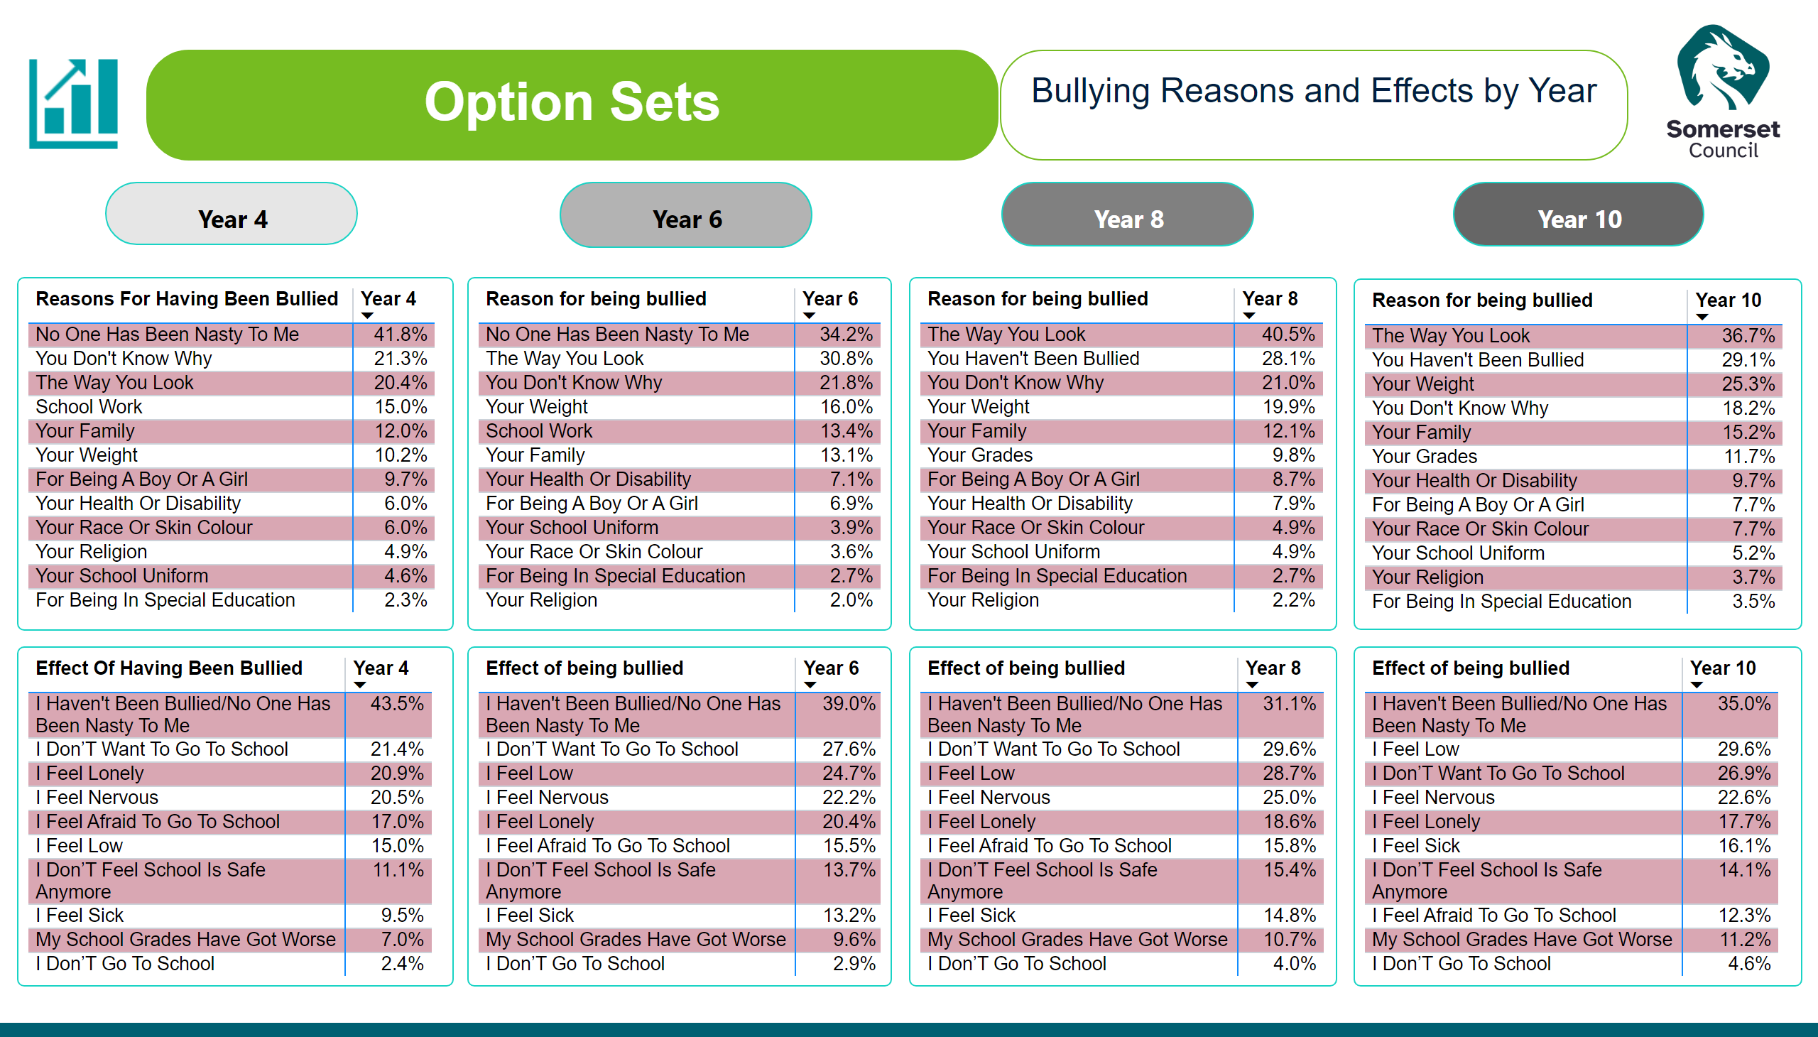
Bullying Reasons and Effects by Year
Notes:
textbox
No alt text provided
image
No alt text provided
image
No alt text provided
actionButton
No alt text provided
actionButton
No alt text provided
actionButton
No alt text provided
actionButton
No alt text provided
Worries
No alt text provided
Worries
No alt text provided
Worries
No alt text provided
Worries
No alt text provided
Worries
No alt text provided
Worries
No alt text provided
Worries
No alt text provided
Worries
No alt text provided
textbox
No alt text provided
Worries
No alt text provided
Worries
No alt text provided
Worries
No alt text provided
Worries
No alt text provided

Slide 103
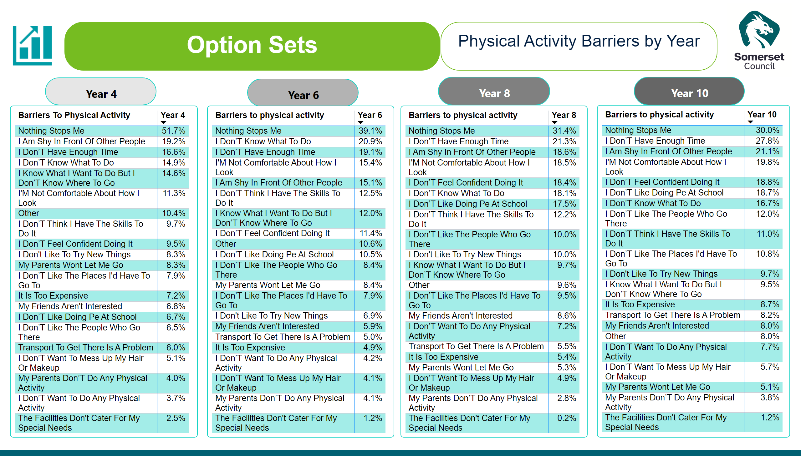
Physical Activity Barriers by Year
Notes:
textbox
No alt text provided
image
No alt text provided
image
No alt text provided
actionButton
No alt text provided
actionButton
No alt text provided
actionButton
No alt text provided
actionButton
No alt text provided
Worries
No alt text provided
Worries
No alt text provided
Worries
No alt text provided
Worries
No alt text provided
textbox
No alt text provided

