Slide 1

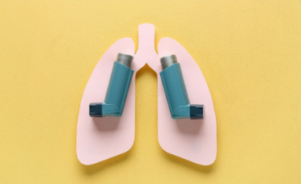


Prepare for the
‘’September Spike ‘’
Is Your SCHOOL Ready For September ?
Asthma Attacks increase 5-fold
More Respiratory Viruses
Autumn Weather Changes
Mould and Weed Pollen Allergies
🌟FREE🌟
School Asthma Training
NHSE elfh Hub
Asthma (Children and young people) - Tier 2

