Slide 1
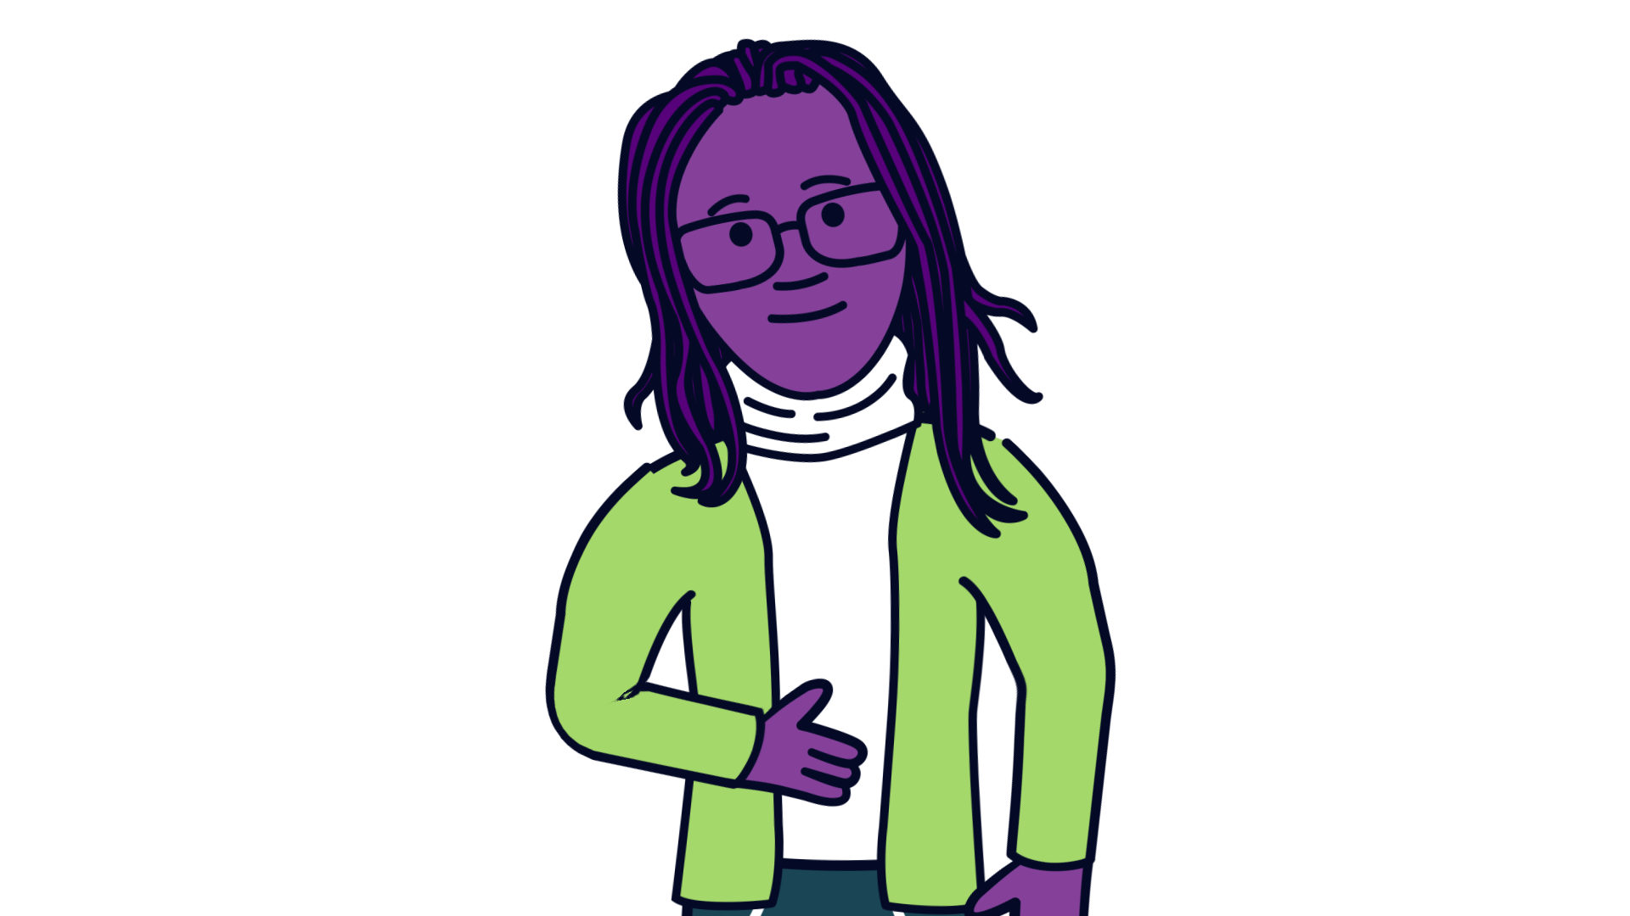
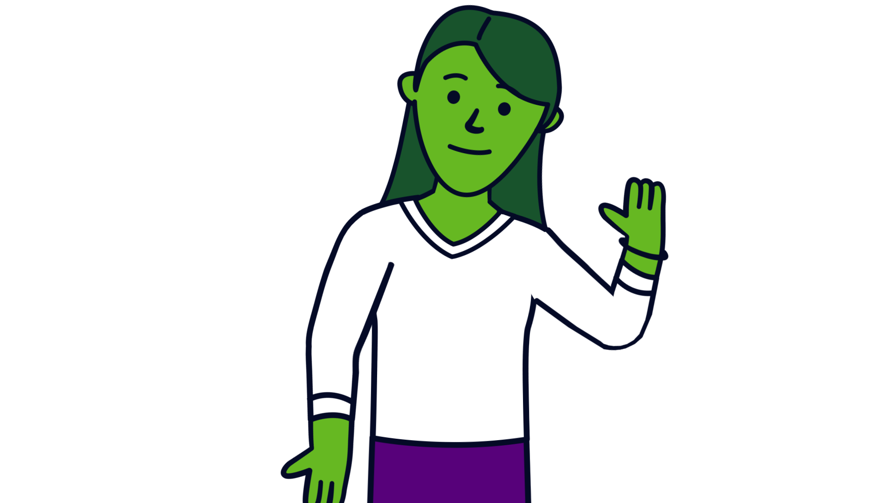
Express Yourself – My voice matters
“To ask for help once is difficult, to ask again, can sadly feel unachievable”
“Adults have to invite young people to speak and listen regularly to build trust and respect”

Slide 2
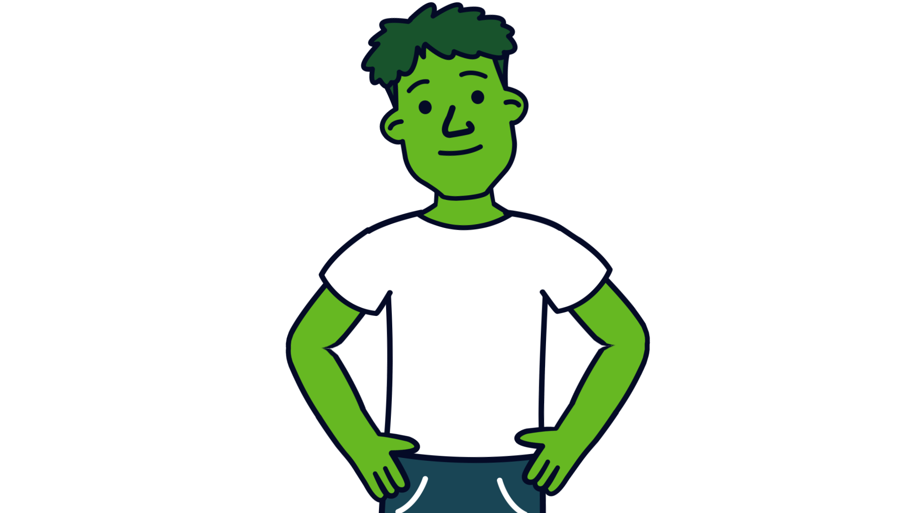
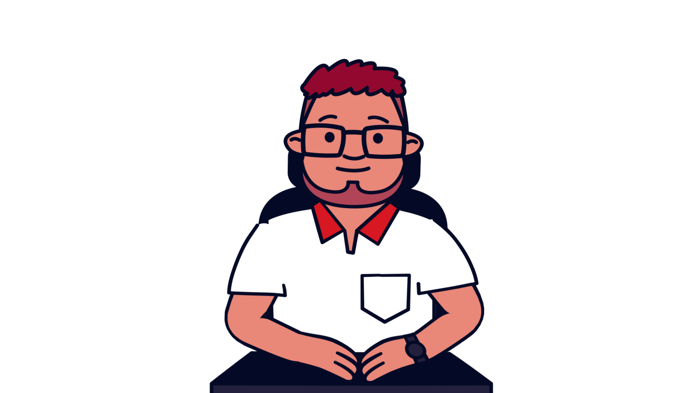
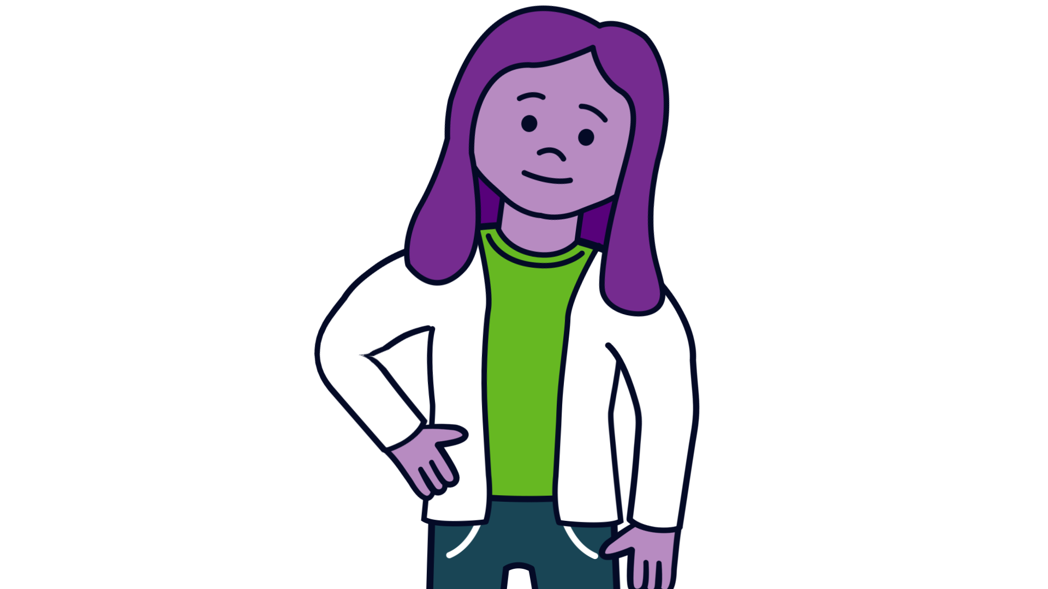
Express Yourself – My voice matters
“Everyone should feel equally important and valued”
“Young people need to see the positive impacts of their words and guidance, the actions adults put into place show that their voices have been considered”
“Bringing people together and being able to make a difference encourages people to appreciate, learn about and celebrate each other”

Slide 3
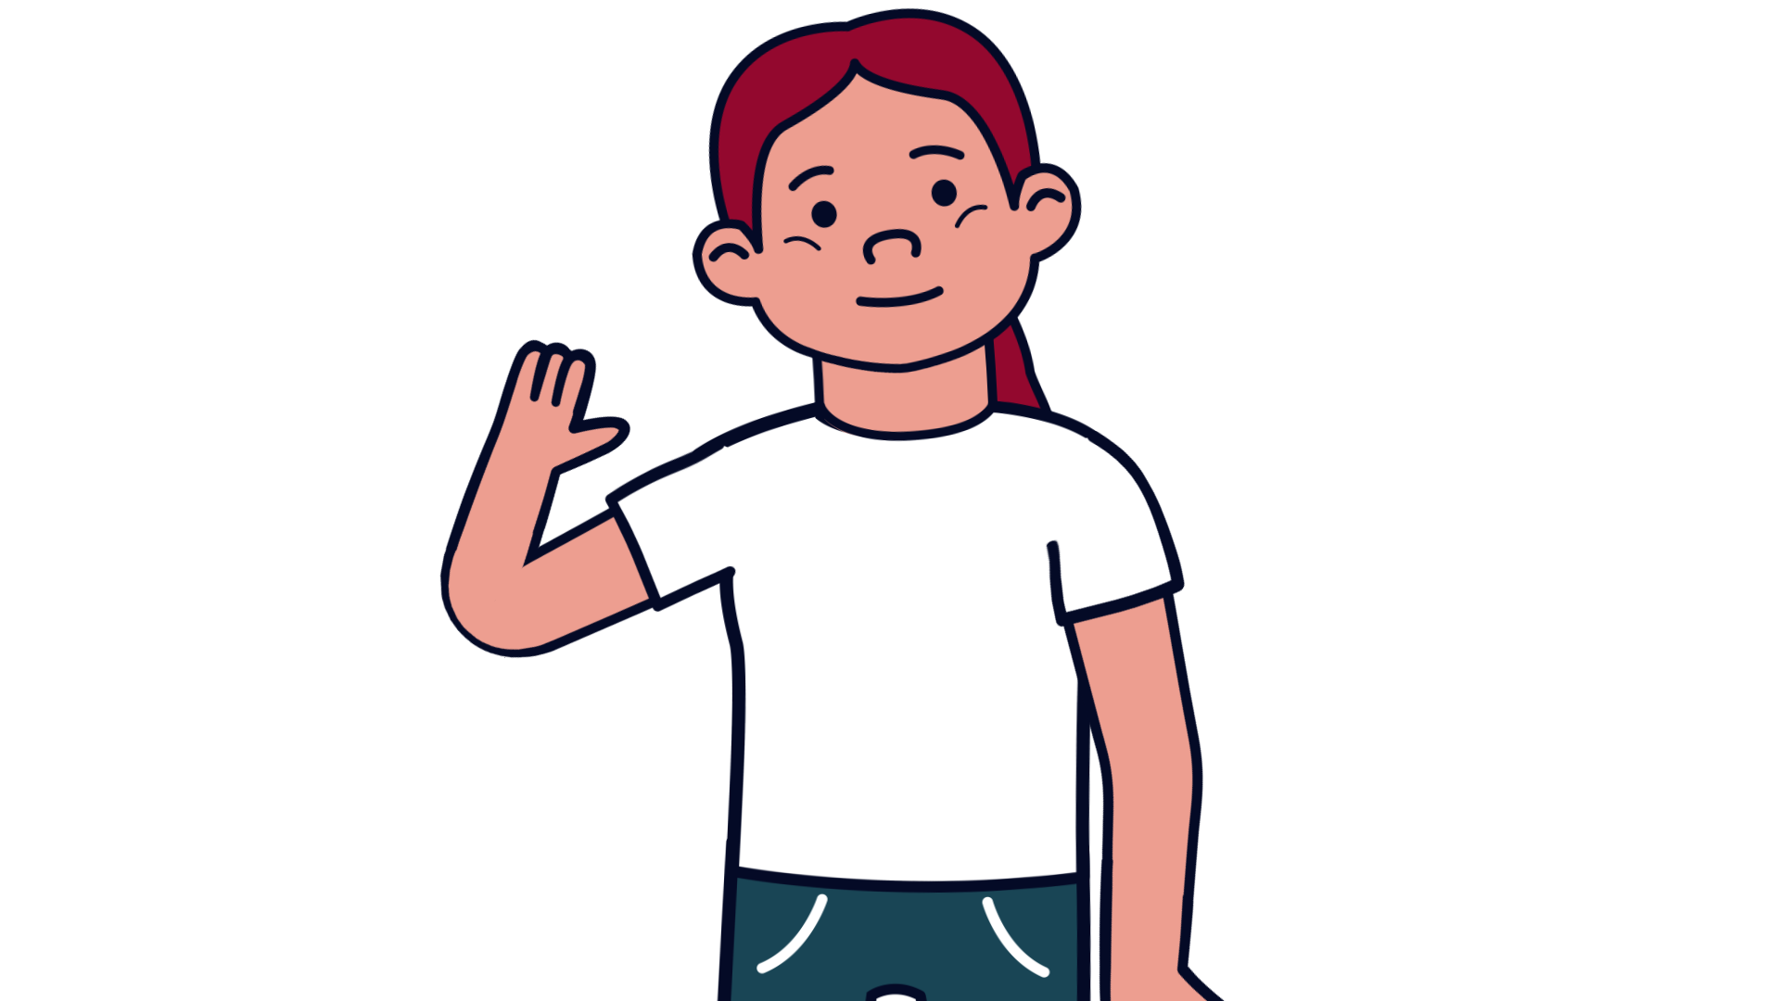
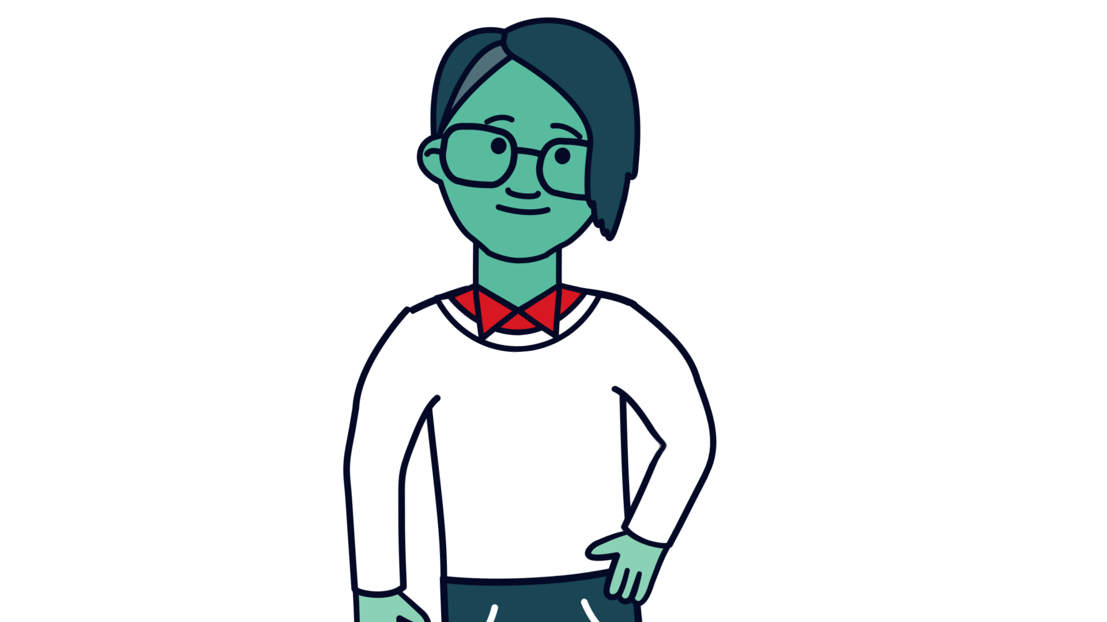
How would young people know that the school, college or adults have listened to them and valued their input?
Through celebration and recognition of participation – certificates/ incentives
Active student council
Offer of skill workshops
Students having evidence/ updates of their influence and change
Regular student consultations, regular meetings & feedback

Slide 4
Campaign interests
Ellie
Healthy choices – eating / Healthy / positive body image/ self-harm/ substance abuse/ positive mental health and wellbeing.
I hope to explore healthy eating and behaviours and seek to understand what can be done to promote better understanding and choices- in particular surrounding body image and eating a well-balanced diet
I would like to take this chance to create change and see a difference for now and the future.

Slide 5
Campaign interests
Emma
Safe spaces for LGBTQ+ in schools, social media and internet safety.
I’d like to provide help and support for schools and youth clubs to address the topic of mental health specifically towards social media.
I feel privileged to have a platform to represent young people, and hope to work with services and decision makers to create lasting change.

Slide 6

Campaign interests
James
Climate & Community/ respect and wellbeing.
I believe that climate change is the most important issue for young people because the whole basis of our future is reliant on our actions now.
Having the chance to experience being involved in community activities such as volunteering and raising awareness for change can really help to feel valued.

Slide 7
Youth Parliament can offer
Youth Parliament can work with schools and services to help improve outcomes for young people
We can invite school’s student council members, or student mental health champions, to a Youth Parliament meeting. We can be contacted via www.somerset.gov.uk/democracy-and-young-people and/ or by emailing youthparliament@somerset.gov.uk

