Slide 1

Smokefree Somerset
School Nurse training:
Information and Brief Interventions for smoking and vaping
Date:

Slide 2

Learning Outcomes
Understand why people start smoking or vaping
Understand some of the physical harm that inhaled tobacco smoke and nicotine causes
Understand the key benefits of stopping smoking or vaping
Offer appropriate, non-confrontational advice about smoking and vaping
Learn about the free and flexible support options offered by Smokefree Somerset for young people and adults
Understand referral and self-referral methods to Smokefree Somerset for free support
Awareness of the INTENT Smoking Prevention Programme

Slide 3
Smokefree Somerset
Service Background
Established and provided by NHS in early 2000’s
Service commissioned and provided by SC (SCC) since 2017
2 programmes offered by the service:
GoSmokefree - provides free specialist advice and support within the general community via face-to-face sessions, telephone and text support
Smokefree Families - specialist provision for families and significant others (preconception and throughout pregnancy) via 1 to 1
home visits, telephone and text support

Slide 4
Smoking prevention is still important
Despite a decline in smoking prevalence, 6million people in England still smoke tobacco
Smoking is the biggest single cause of premature death & preventable illness in UK
Over 50 separate diseases caused by smoking (one-third of respiratory deaths and one-quarter of cancer deaths are attributable to smoking)
Treating tobacco related illnesses costs the NHS £2.4billion/year
Wider cost to society in England is approximately £17billion/year

Slide 5
Young People and smoking
Children are 4 times more likely to become smokers if their parents/carers smoke
Around 26,000 children in Somerset live in households with adults that smoke
2/3 adults start smoking before 18 years
Disadvantaged smokers tend to start younger
Nationally, 16% of secondary pupils have tried smoking, and 6% are current smokers (ASH-Youth 2022 survey)
For every 3 young people that start smoking, only 1 will quit and 1 will die prematurely from smoking

Slide 6
Young People and vaping
There is increasing concern about the number of young people using or experimenting with vapes, despite it being illegal to sell to or purchase vapes on behalf of someone under the age of 18
The most recent ASH survey (June 2023) reports:
20.5% of YP age 11-17 had tried vaping
11.6% had tried once or twice
7.6% still vaping
There is an age gradient of ‘ever’ or ‘current’ vaping
15% of 11-15 yr olds had tried vaping compared to 34% of 16-17yr olds
4.6% of 11-15yr olds are current users compared to 15% of 16-17yr olds

Slide 7
Why do CYP start smoking or vaping
Social influences: parental and sibling smoking, the ease of obtaining cigarettes or vapes, encouraged by friends and peer group members, socio-economic status
Coping with intense emotions such as anger, upset, sadness, anxiety, stress
Feeling of ‘control’ – the one thing they can control in their lives
Appetite suppressant (weight control)
Combine smoking with other substances such as coffee and alcohol. Vape fluids containing cannabis are now available
More than half of YP who have never smoked say they vape ‘just to give it a try’ *
20% of ever and never smokers say ‘other people do it, so I join in’ *
21% of those who have smoked say they ‘like the flavours’ *
Proportion of ‘just give it a try’ has decreased from 2022-2023, but ‘because others do’ has increased *
In 2023 most young people now wrongly believe that vaping is about as harmful as smoking or more so. This indicates that potential harm from vaping does not deter them trying or using vape *
* ASH 2023

Slide 8
* Does nicotine help with stress?
Interestingly, when it comes to relieving stress, nicotine has exactly the opposite effect on the body because it is a stimulant. Surveys indicate that as a group, smokers tend to have much more stress, and that stress levels decrease gradually after quitting.
Nicotine addiction can affect brain development, mood, learning, impulse control and increases anxiety and depression
* Smoking, Drinking and Drug Use among Young People in England 2018

Slide 9
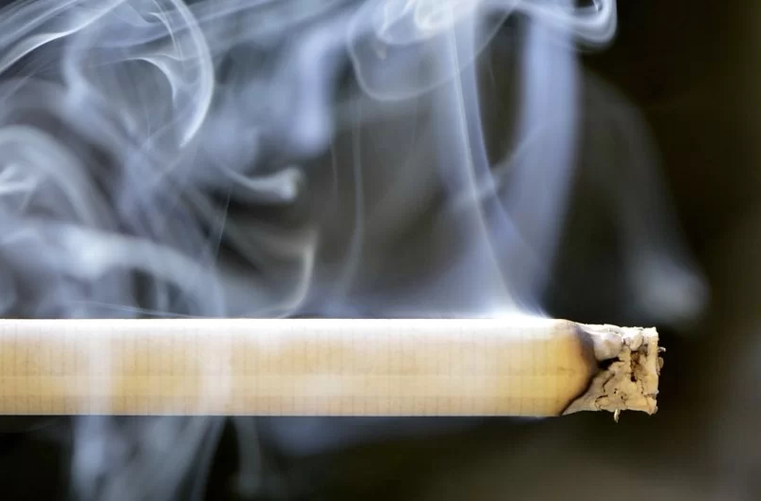
Chemicals in Tobacco
Example Common use
Acetone Nail polish remover
Ammonia Toilet cleaner
Arsenic Rat poison
Benzene Industrial solvent
Cadmium Batteries
Carbon monoxide Car exhaust
Formaldehyde Preservative for dead bodies
Hexamine Barbeque lighter
Hydrogen Cyanide Gas chamber poison
Magnesium Flares
Methane Swamp gas
Methanol Rocket and car fuel
Nicotine Insecticide
Polonium 210 Radioactive compound
Steric Acid Candle wax
Titanium Aeroplane and missiles
Over 4000 chemicals are found in tobacco smoke

Slide 10
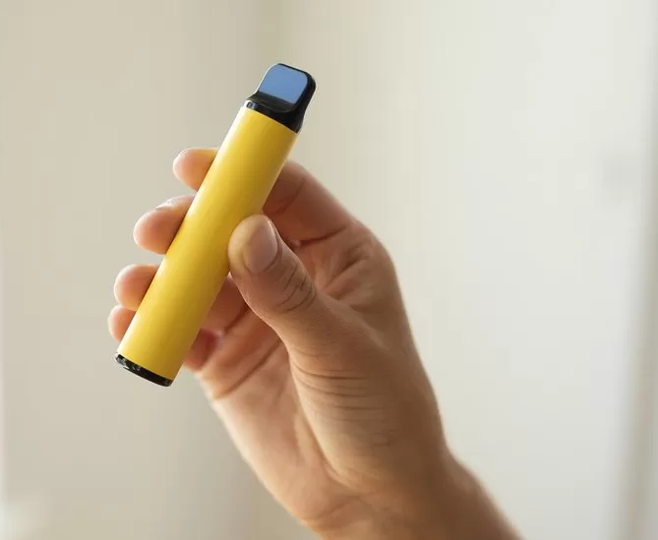
Chemicals in vapes
Main components in vapes and e-liquids:
  Flavours
  Sweeteners
  Solvents – such as vegetable glycerin and propylene glycol – produce the visible cloud
  Nicotine
These basic ingredients take on different properties when heated and contain toxins
Other chemicals including metals have been found in e-liquid/vapour. A recent BBC investigation found children could be inhaling more than twice the daily safe amount of lead and more than nine times the safe amount of nickel.
The Chief Medical Officer, Professor Sir Chris Whitty, has put the case very succinctly, “The key points about vaping can be easily summarised. “If you smoke, vaping is much safer; if you don’t smoke, don’t vape.”

Slide 11

Nicotine and Addiction
Nicotine is a highly addictive chemical found in the tobacco leaf
When tobacco smoke or vapour from a vape is inhaled, nicotine enters the blood stream and quickly reaches the brain where it results in the release of chemicals such as dopamine - a ‘feel good’ chemical associated with pleasure
The more you smoke, the more nicotine you need to feel good because there is a change in brain chemistry or ‘wiring of the brain’ and the receptor in the brain want more and more nicotine
Nicotine dependence occurs when you need nicotine and can't stop using it
Going without nicotine for a period of time often results in unpleasant mental and physical changes. These are symptoms of nicotine withdrawal
Smoking and vaping as habits are addictive as they soon become associated with different emotions, situations and activities

Slide 12
Vaping and Nicotine Strength
Many children and young people are unaware of the amount of nicotine they are consuming by vaping.
To put it into perspective, vaping one of the popular 2mg 600 puff disposable vapes a day is roughly the same amount of nicotine as smoking 40 cigarettes a day.
Vape strength | Equivalent to cigarettes
0.6% (6mg) | 1-5 cigarettes a day
1.0% (10mg) | 5-10 cigarettes a day
1.4% (14mg) | 15-20 cigarettes a day
1.8%(18mg) | 20 plus cigarettes a day

Slide 13
The harmful effects of vaping
Physical (anecdotal)
Vaping can cause:
dizziness
headache
racing heart
nausea/possible vomiting
stomach cramps
Weakness
Some of the common side effects of vaping are:
coughing
dry mouth and throat
shortness of breath
mouth and throat irritation, gum disease
headaches

Slide 14
The harmful effects of vaping
Environmental
A typical disposable vape pen, designed for single-use, contains plastic, copper, rubber and a lithium battery
Some parts, like the battery, can be widely recycled, whereas others, such as any rubber parts, may not be
Most disposable vapes are not designed to be taken apart easily.
Incorrect disposal of these items can potentially release, plastic, electronical and hazardous chemical waste into the environment
Financial
A typical disposable vape currently costs just over £5. If used every 3 days this is a yearly cost of over £600. If used daily, this results in a yearly cost of nearly £2000.
Refillable vapes can cost less overall but there is an initial outlay for the device and charger as well as the continued cost of vape juices.

Slide 15
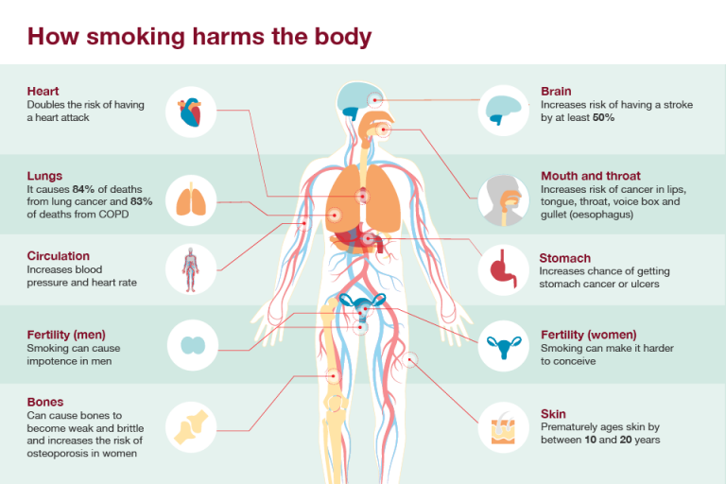
Title

Slide 16
The harmful effects of smoking
Short Term Physical
Coughs, colds, chest infections, increased phlegm production, reduced capacity for physical activity, bad breath and bad personal odour, stained teeth, gum disease, stained fingers, reduced circulation, pale skin, premature aging of skin and wrinkles (especially around the mouth), reduction of sense of smell and taste, reduced fertility, erectile dysfunction
Long Term Physical
Reduced lung function, asthma exacerbation, COPD (emphysema and chronic bronchitis), cardio vascular disease, peripheral vascular disease, stroke, dementia, type 2 diabetes, cancers (mouth, throat, lung, stomach, bladder, cervical…), reduced circulation, ulcers, impotence, risk to foetal development, increased risk of miscarriage, still birth and cot death

Slide 17
The harmful effects of smoking
Economy and cost
A habit of 20/day can cost a smoker as much as £4000 per year
Nationally, the cost to society is around £17 Billion. This is far more than generated in taxes on tobacco products (£10 billion)
Cost incurred by NHS alone are approx. £2.4 billion
Smoking costs society in Somerset £149.34m a year;
25,564 smoking households live in poverty
1,722 people are out of work due to smoking
13,579 people receive informal care from friends and family because of smoking
Environment
5.3 million hectares of fertile land is used to grow tobacco
An estimated 1.5 billion hectares of forests have been lost worldwide since the 1970s, contributing to up to 20% of annual greenhouse gas increases
Trees are destroyed for use in the tobacco curing process
90% of cigarettes contain non-biodegradable filters
Many cigarette butts are simply discarded but are an environmental pollutant

Slide 18
Benefits of stopping smoking
Better skin, reduced wrinkle risk Fresher breath
Oral hygiene Clothes don’t smell
- reduced risk of gum disease Breathe better
Improved fitness and capacity for exercise Save money
Feel healthier and increased quality of life Lower risk of cancer
Cardiovascular health improved and risk reduced Improved life expectancy
Respiratory health improved and risk reduced
Improved fertility
Pregnancy – reduced risk to child and their ongoing health
Reducing NHS and public health costs
Reduced risk of accidents (fires) related to smoking
Benefits to environment

Slide 19
Support and Advice
Our standard offer is a 12 week treatment programme with support provided by our team of qualified and experienced Stop Smoking Practitioners
Support for adults (18 and over): community face-to-face sessions take place at a variety of venues across the county and offer either daytime or evening support: https://www.healthysomerset.co.uk/smokefree/support-me/
Telephone support is available for those unable to access face-to-face sessions due to location, medical condition or personal circumstances
Support for 12-18 year olds: we have a specific pathway of support for young people offering a range of support options from basic advice about smoking and vaping, cutting down or a treatment programme to quit smoking or vaping completely
Support is provided weekly and this can be by telephone, text, email, face-time or WhatsApp
Smokefree Families is a specialist service supporting anyone around the birth of a baby, pre conception, pregnancy, significant others, adoption and surrogacy

Slide 20
Online resources
https://ash.org.uk/resources/view/ash-brief-for-local-authorities-on-youth-vaping

Slide 21
Treating Habits and Addiction
Smoking is a habit, a routine, a social activity, an addiction, an emotional crutch, a psychological response, an identity
The programme with SFS focuses on supporting behaviour change and developing new routines and coping strategies
Stop Smoking Practitioners advise on the use of licensed stop smoking medications to ease nicotine withdrawal
Nicotine Replacement Therapy (NRT) is licensed for 12 years and over
If use of NRT is recommended, Smokefree Somerset will supply the products
Correct and appropriate use of NRT doubles the chances of quitting successfully
Using NRT alongside experienced support from a qualified Stop Smoking Practitioner makes quitting much easier

Slide 22
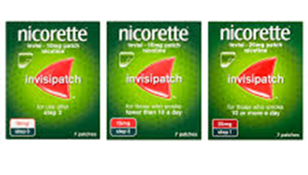
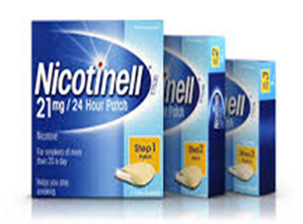
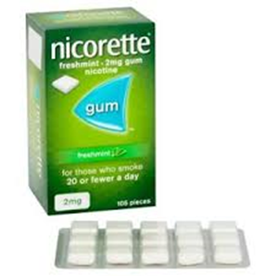
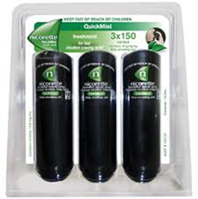
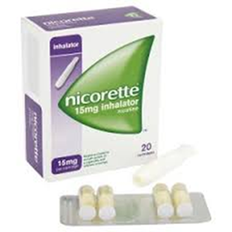
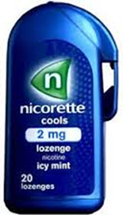
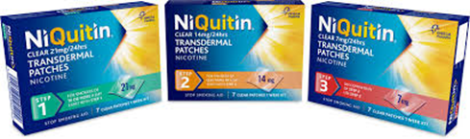
Nicotine Replacement Therapy

Slide 23
Vapes/e-cigarettes
In the UK, selling vaping products to anyone under 18 is prohibited and so is buying vaping products for anyone under 18 (gov.uk)
The maximum strength of e-liquid permitted in the UK is 20mg of nicotine per ml = 2%
Vaping products are a popular aid used by people trying to quit smoking
Public Health England (PHE) review in 2014 found that the hazard associated with electronic cigarette products currently on the market “is likely to be extremely low, and certainly much lower than smoking”
The harm from smoking is caused primarily through the toxins produced by the burning of tobacco
Electronic cigarettes represent a safer alternative to cigarettes for smokers who are unable or unwilling to stop using nicotine

Slide 24
Treating Habits and Addiction - Vapes
Adults (18 and over) who choose to use e-cigarettes or vapes to help them stop smoking can access behavioural support with SFS but we do not currently supply these products
Reducing Nicotine Dependence – we offer support to help people who are motivated to stop using vapes and other forms of nicotine
Education for young people about vaping
Vaping devices are not recommended for those aged under 18.
The Engagement and Participation Team worked with young people in Somerset to produce an animation on vaping prevention for young people.
https://cypsomersethealth.org/?page=vaping

Slide 25
Brief interventions in practice
ASK ADVISE ACT
Once smoking status is established, there is no need to state the obvious “you should stop”. Instead, advise that free advice and support is available and …
“The best way to stop smoking or vaping is with a combination of support and medication. With the right support and treatment, it can be much easier to quit”
“Smokefree Somerset has experienced and friendly Stop Smoking Practitioners who advise and support on the best way for you to stop smoking or vaping”
If ready to stop: offer referral to SFS, or self-referral by calling 01823 356222 or via the website
If not ready at this moment, that’s fine, it can be discussed in the future and support is always available when ready

Slide 26
Making a referral for support
Telephone: 01823 356222
Self referral via the website:
https://www.healthysomerset.co.uk/smokefree/
Website professional referral:
https://www.healthysomerset.co.uk/smokefree/resources-for-professionals/
Service cards, leaflets and posters have the service contact details and QR code

Slide 27


Contact details:
Smokefree Somerset
01823 356222
Email: smokefreelife@somerset.gov.uk
Website: https://www.healthysomerset.co.uk/smokefree/
QR code:
GoSmokefree Service
Caroline Brooks (Service Manager)
01823 357327
Email: caroline.brooks@somerset.gov.uk
Smokefree Families Service
Tracey Hellyar (Service Manager)
01823 357324
Email: tracey.hellyar@somerset.gov.uk
Insert SFS, GSF and SFF contact details, website QR Code etc.

Slide 28
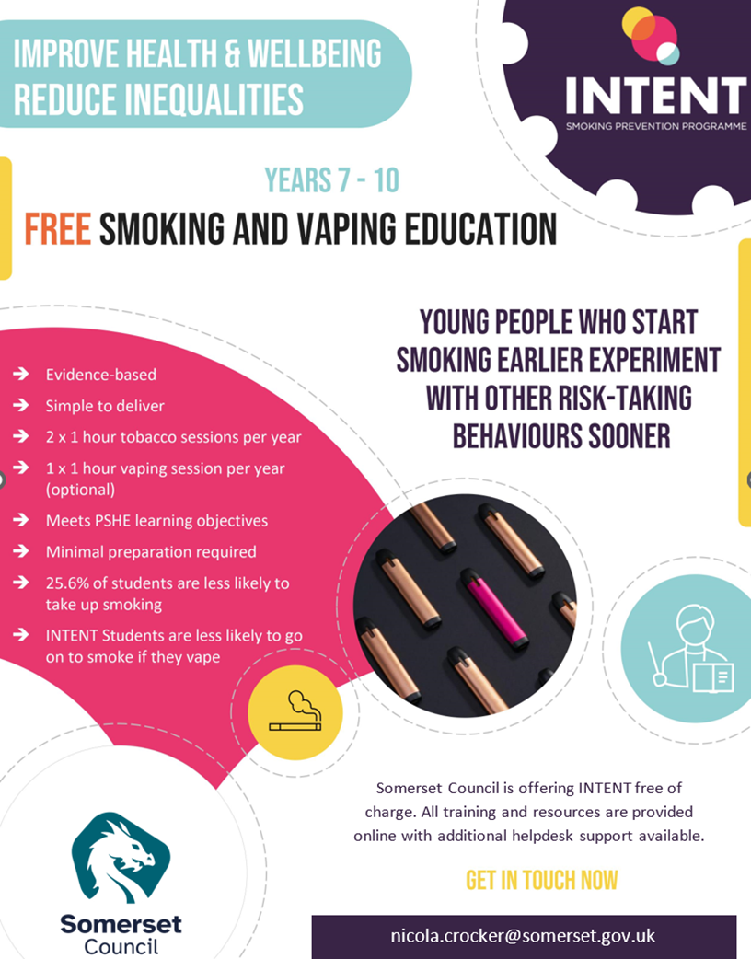
INTENT
A smoking prevention programme for schools
It is evidence-based and easy to deliver
Free for Somerset schools
Includes the option of self-led training for school staff
Resources for interactive whiteboard provided
New vaping education included for delivery alongside smoking prevention resources
Notes:
INTENT is a smoking prevention programme for years 7 – 10. It is evidence-based and provides teachers with two one-hour tobacco sessions to be delivered each year. Detailed session plans and a Curriculum Guide support delivery.
The programme covers various themes which build incrementally over the 4 years. The activities are engaging for students.
As part of each session students repeatedly form implementation intentions to refuse cigarettes. Practising how to respond to environmental cues to achieve a goal before the opportunity to act presents itself.
New resources have been added to the programme around vaping, which can be delivered in addition to the smoking prevention resources.

Slide 29
Benefits of INTENT for schools
Evidence based
Reduces the uptake of smoking by students
Provides teachers with 2 high quality RSHE/PSHE lessons per year
Has a large reach, covering years 7-10
Requires minimal training and preparation
The skills and method can be applied to other risk-taking behaviours e.g. drugs, alcohol and gambling
Notes:
INTENT is the result of 20 years of research. Findings published in 2019 – very current.
INTENT significantly reduces smoking initiation. Adolescents who received INTENT were 25.6% less likely to start.
INTENT significantly reduced the likelihood of young people moving from e-cigarettes to cigarettes.
The skills and approach can be used with other PSHE topics such as drugs and alcohol.

Slide 30
INTENT
For more information on the INTENT programme in Somerset please visit:
Somerset children & young people : Health & Wellbeing : Intent Smoking Prevention Programme (cypsomersethealth.org)
To deliver the programme within your school please contact
Nicola Crocker
01823 359425
email: nicola.crocker@somerset.gov.uk

Slide 31
Any Questions?
caroline.brooks@somerset.gov.uk

